Slide 1
New Mexico
Land of Enchanted Partnerships

Slide 2
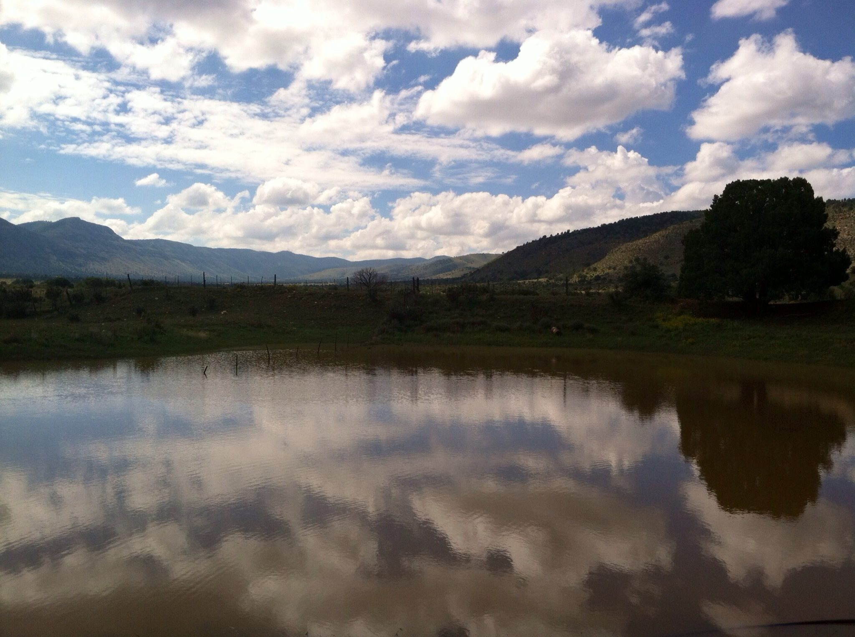
New Mexico’s Soil and Water Conservation Districts Leading the Nation!
Debbie Hughes, Executive Director
NM Association of Conservation Districts

Slide 3
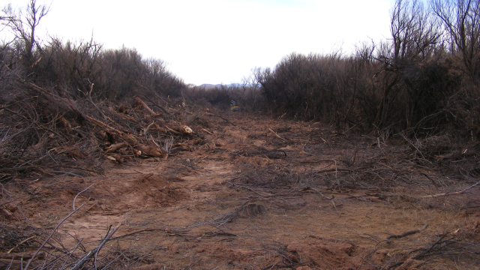
Sometimes
Problems
Seem
TOO-BIG!

Slide 4
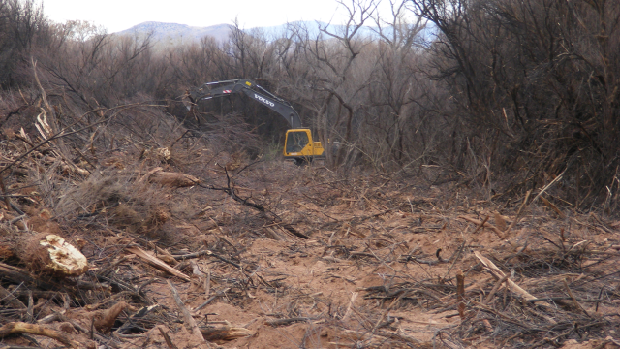
LOOK AT THE REAL SIZE OF THE MACHINE CAN BE DONE WITH PARTNERSHIPS
Pictures by Will & Nyleen-Socorro SWCD

Slide 5
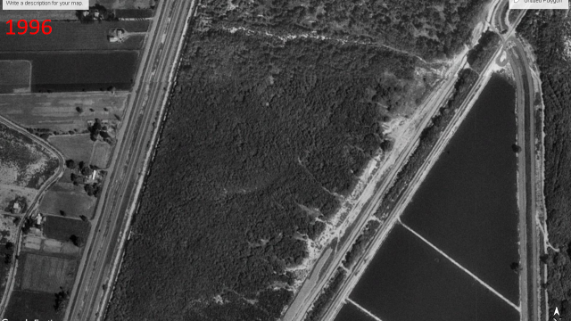
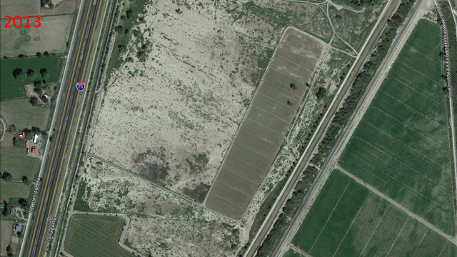
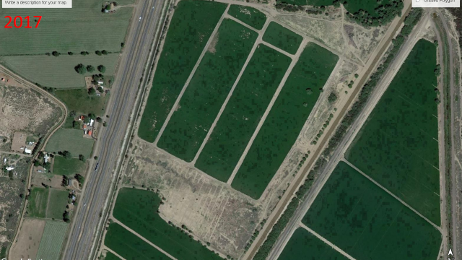
DEAD REMOVED
PRODUCTIVE AGRICULTURE
Massive
Tracts of Salt Cedar
Land must be expertly cared for if it is to be maintained in a productive state.

Slide 6
NEW PARTNERSHIP WITH BLM & SWCDS BEGAN IN 2003
IF WE DO NOT CARE WHO GETS THE CREDIT-
WE ALL GET THE CREDIT!
Notes:
Type Notes Here

Slide 7
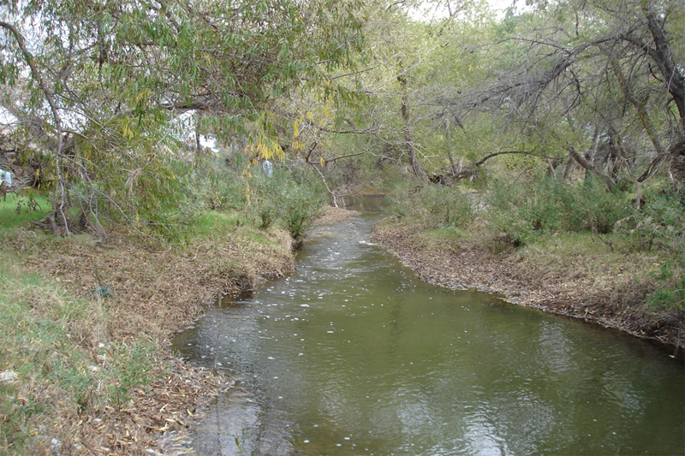
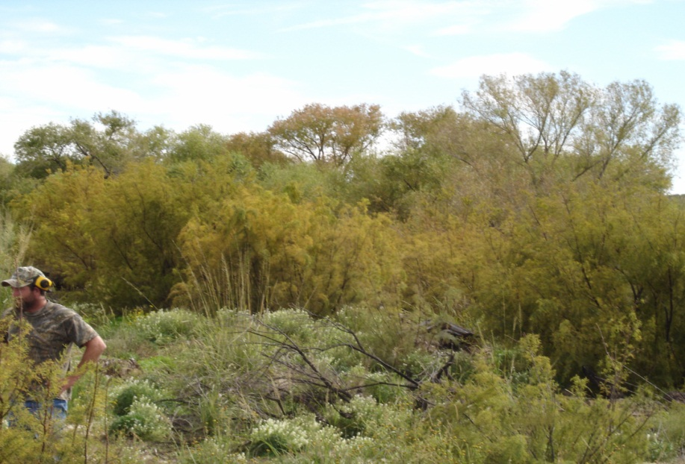
2003-2005 Salt Cedar Restoration By SWCDs on 3 River Systems 13.5 Million State Legislature Funding used on Entire River- Private, State, & BLM
Started Building Relationships
Notes:
Delaware River watershed in the Carlsbad Field Office. Work has been ongoing over the last 12 years. Removing the salt cedar, burning the piles, treating re-sprouting salt cedar, planting desirable species where needed.

Slide 8
NM SOIL AND WATER CONSERVATION DISTRICTS began “COLORBLIND” restoration efforts across state, private, and public lands.
Before Creosote Treatment
After Creosote Treatment

Slide 9
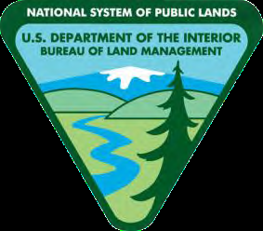
Started in 2005 Funding Earmark
1.5 Million EQIP to be spent on Federal Land
BLM Matches EQIP Dollars
NMACD Coordinates and Facilitates
SWCDs “DELIVER ON THE GROUND”
Restore New Mexico
Partnerships are the Key to Success

Slide 10
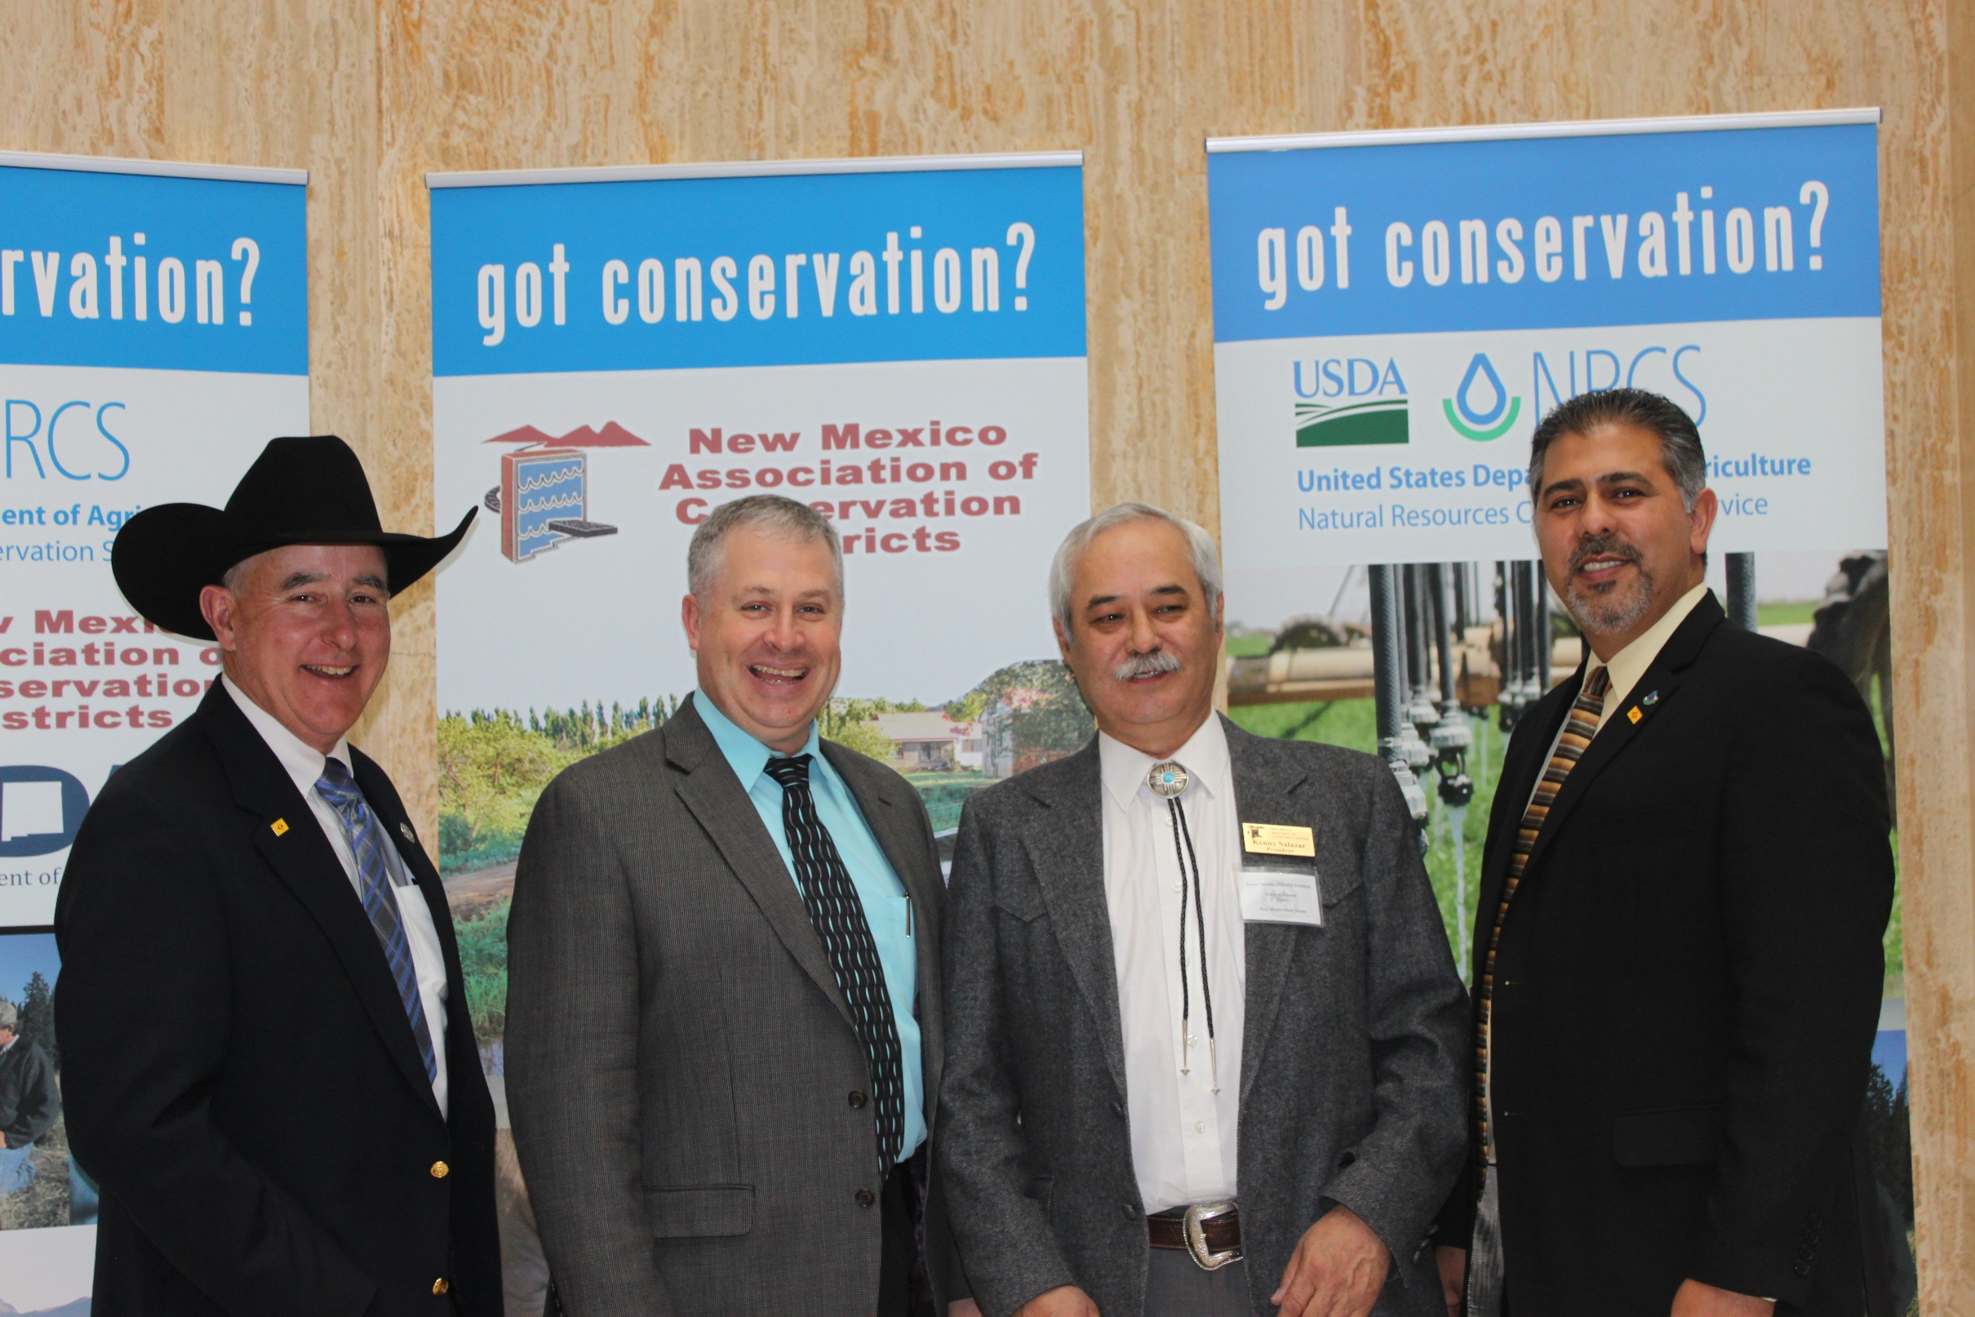
IT IS ALL ABOUT RELATIONSHIPS
Notes:
IT IS ALL ABOUT “RELATIONSHIPS” and “PARTNERS”

Slide 11
SWCD’s & PARTNERS Great Success- Year 1 & 2 (we put RAIN in NEPA)
Before Mesquite Treatment
After Mesquite Treatment

Slide 12
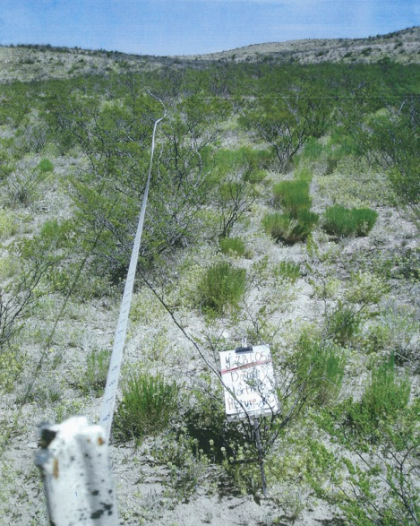
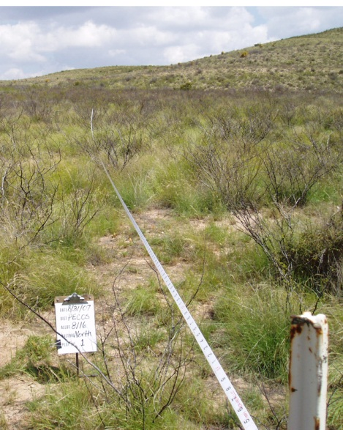
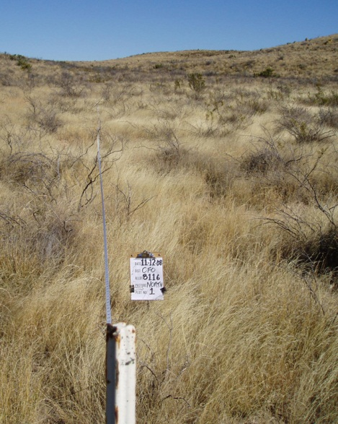
GRASSLAND RESTORATION RESPONSE AMAZING
Large-scale restoration efforts by SWCDS & Partners to restore our state’s grasslands, woodlands, and riparian areas to a healthy and productive condition.
NMACD gets a
10 MILLION DOLLAR GRANT
5 YEAR AGREEMENT FROM BLM

Slide 13
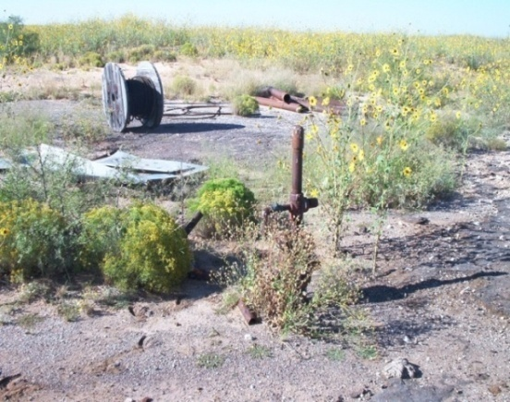
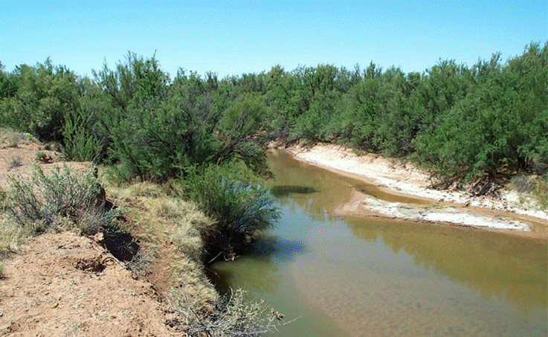
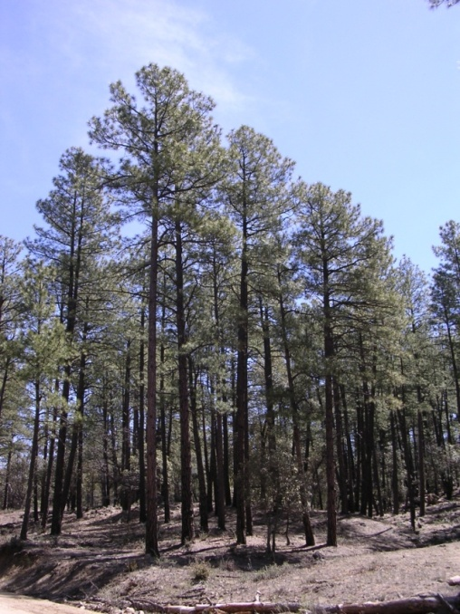
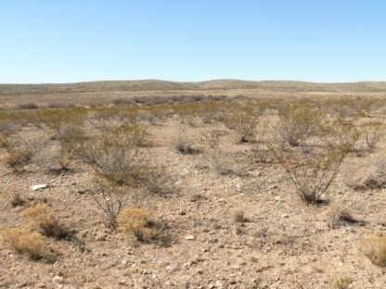
New Mexico’s Large Landscape Restoration Benefits everything
Removal of invasive riparian species
Juniper encroachment and fuels reduction
Brush Invaded grasslands
Abandoned O&G well reclamation
Notes:
Brush = Mesquite and Creosote

Slide 14
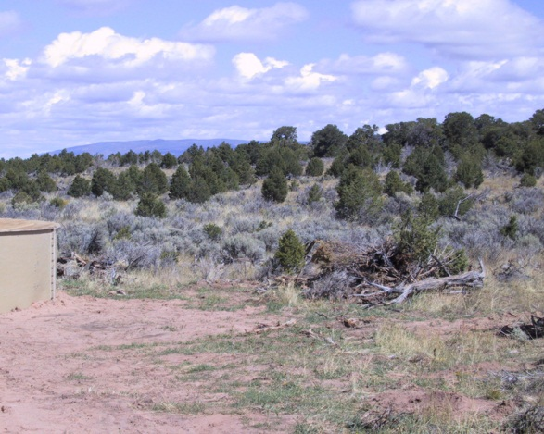
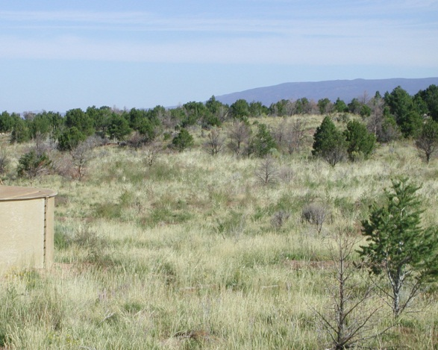
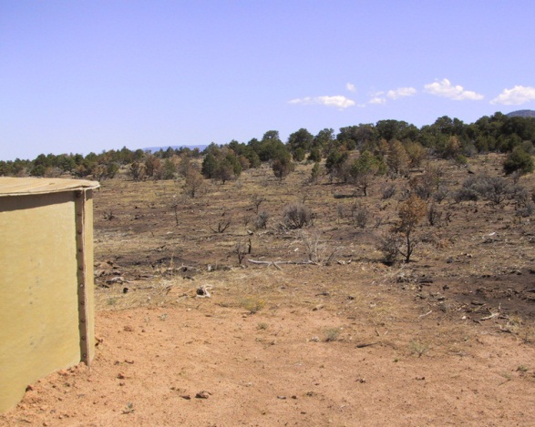
FARM BILL FUNDING ON FEDERAL LAND RANCHES
IS KEY TO LEVERAGE OTHER DOLLARS FROM PARTNERS!
Sagebrush and Juniper Treatment
Notes:
Chaining was the treatment back in the 70s. Now we conduct prescribed burns in sagebrush and juniper areas. Natural re-vegetation
of the grass understory, Elk Springs area south of Cuba, New Mexico in the Rio Puerco Field Office.

Slide 15
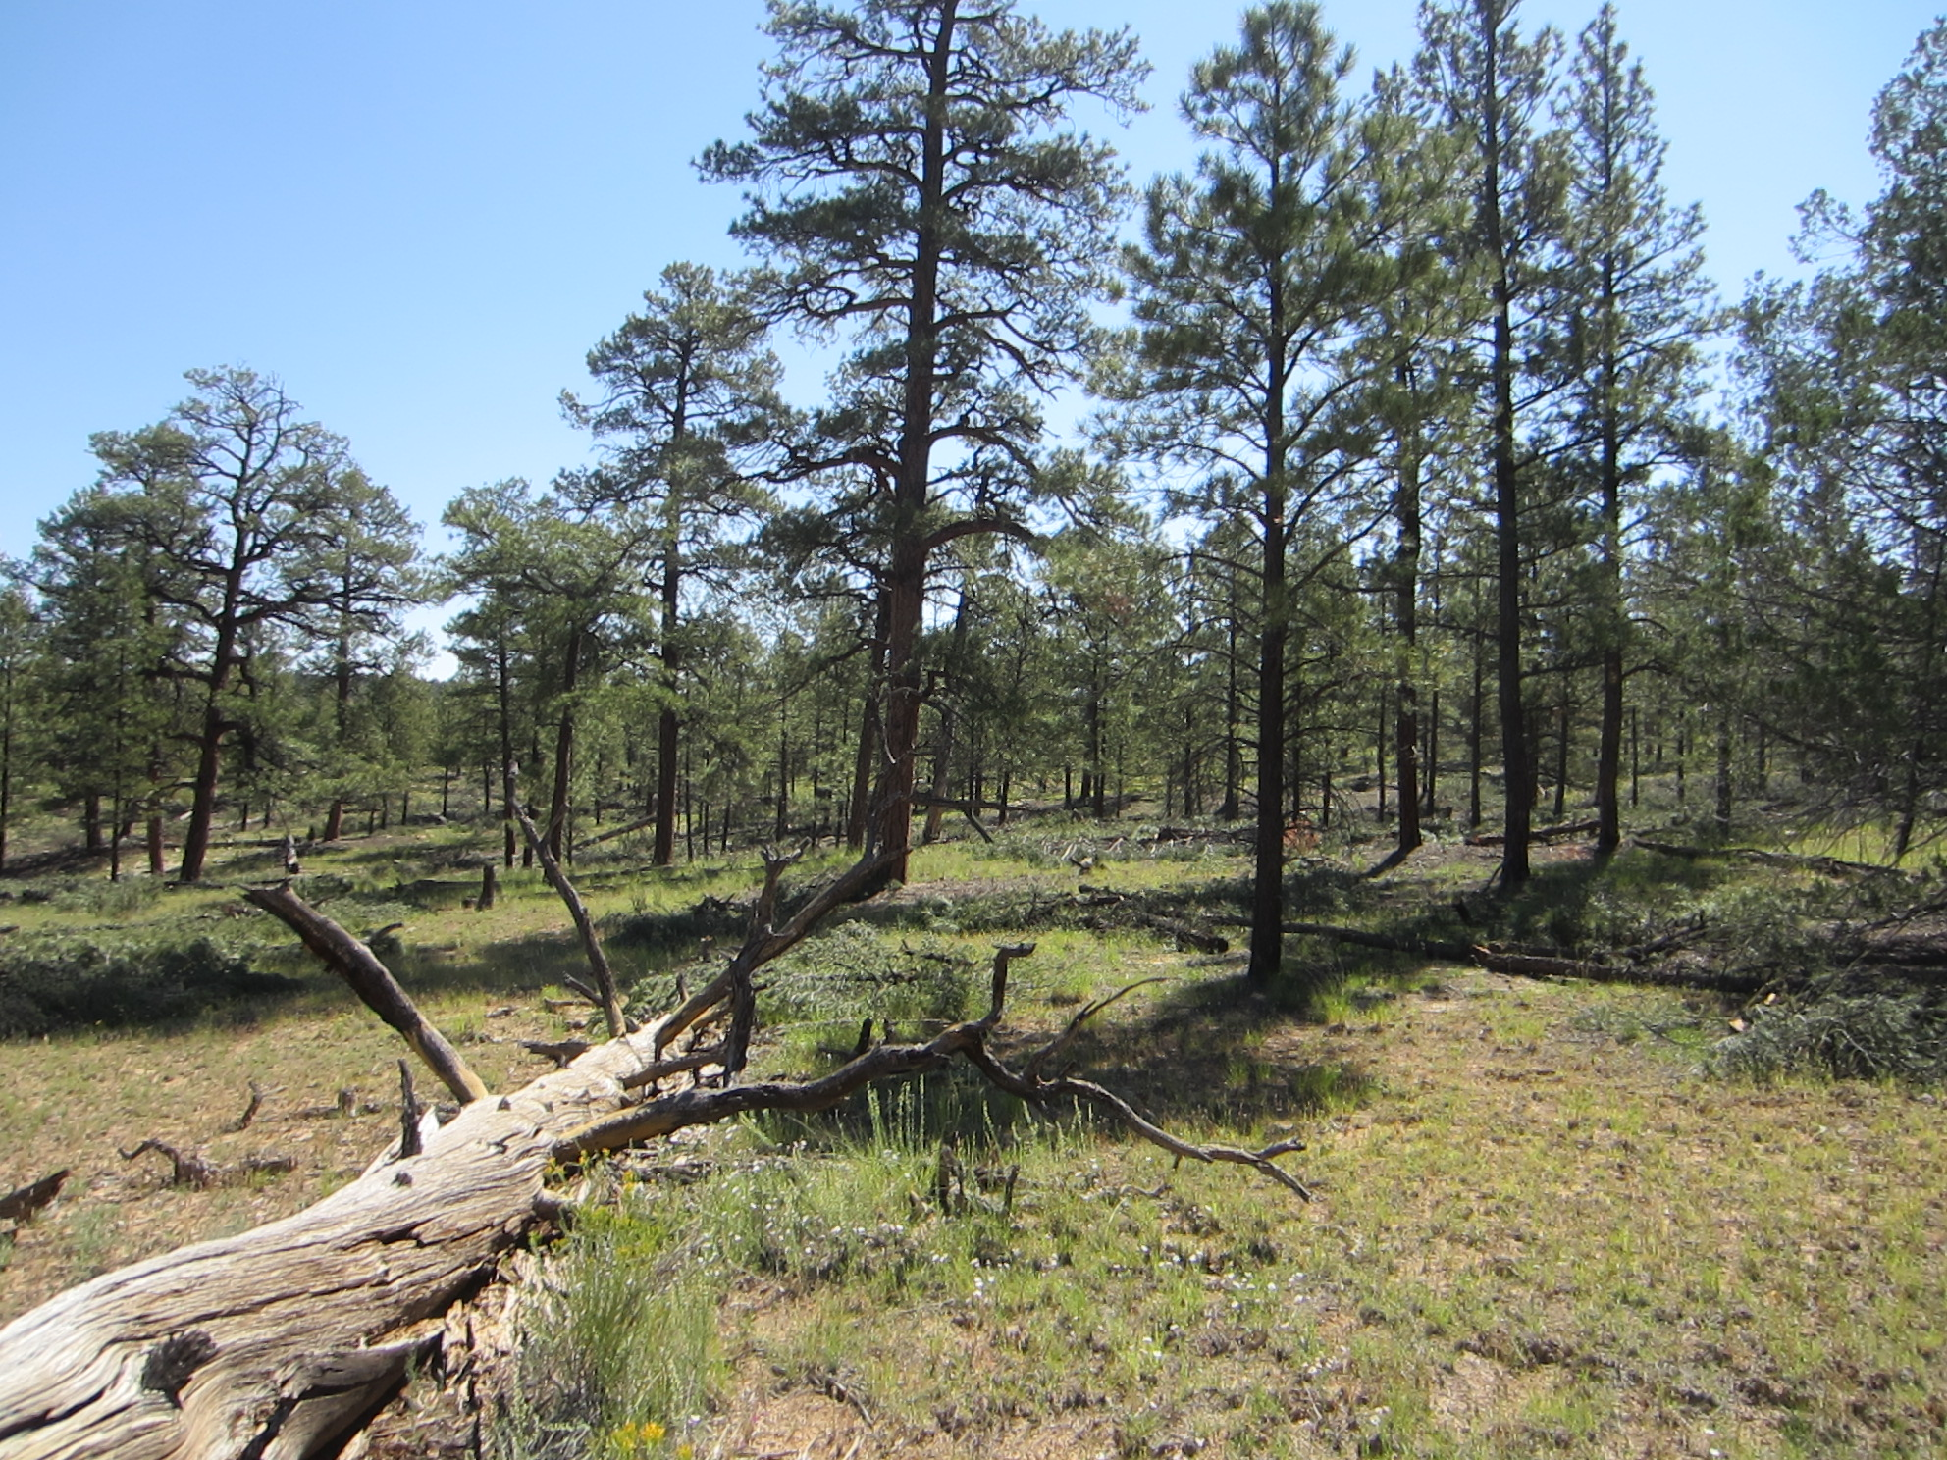
NM SWCD’S have learned how to “build better partnerships and more coordination across all levels of government.

Slide 16
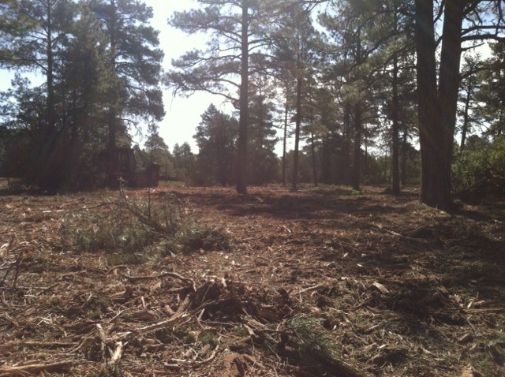
New Mexico SWCDs are Building Capacity at Local Level
Districts are Using the “Power and Authority” of Conservation Districts which are:
POLITICAL SUBDIVISIONS OF STATE GOVERNMENT!

Slide 17
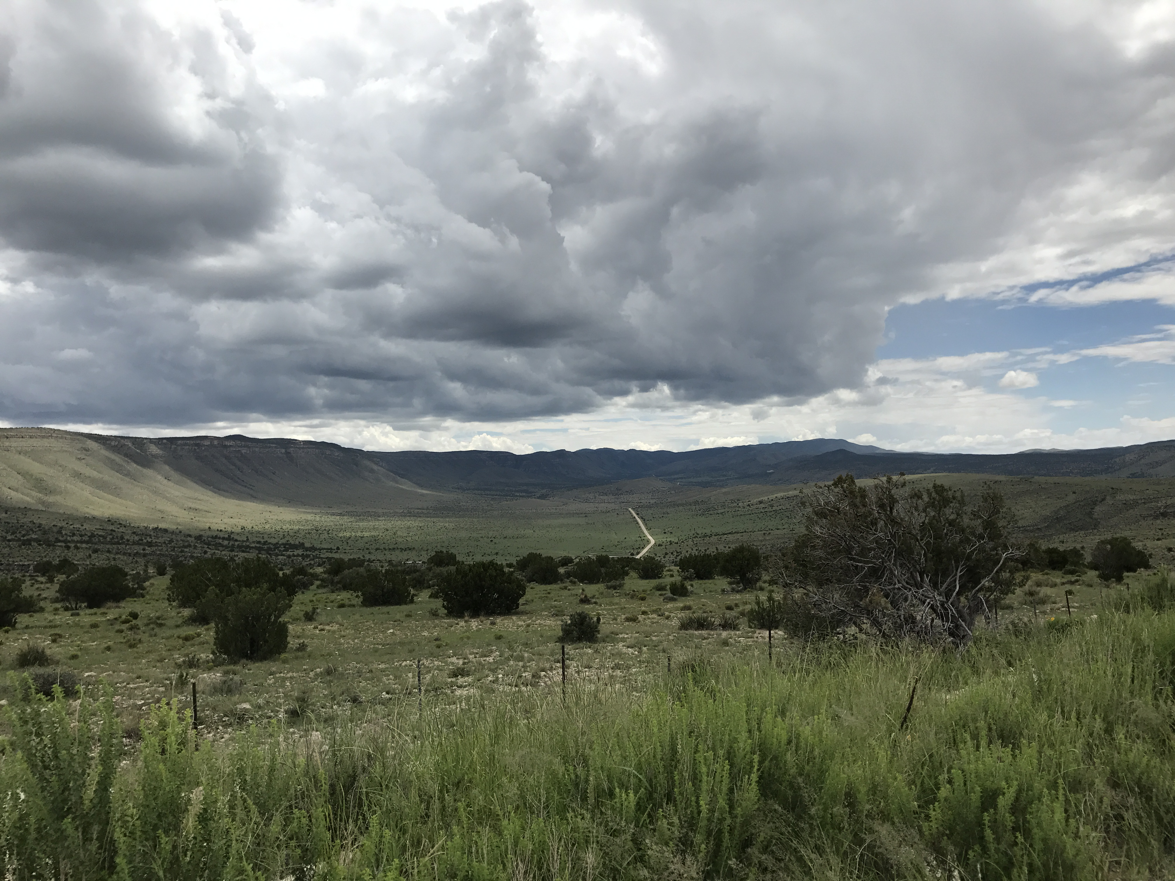
NMACD UTILIZES RETIRED NRCS & BLM CONTRACT0RS TO WORK WITH SWCDS & LANDOWNERS.
Another 5 Year
Grant from
BLM for
20 Million
Dollars
Notes:
Shaving sagebrush in the Taos Field Office. Push piles are burned and then the area is reseeded with a native seed mix.

Slide 18
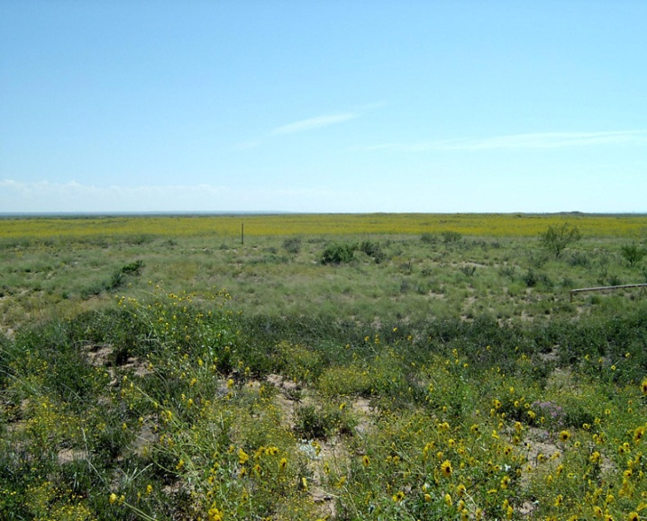
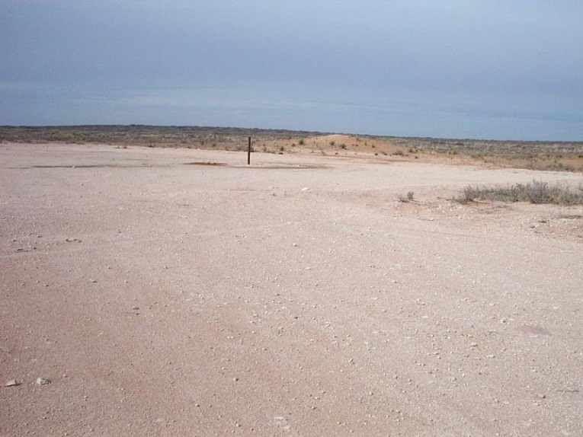
13 SWCDs provide the procurement service
for Restore NM funding for
Aerial and Ground brush treatments and reclamation of abandoned oil and gas pads.
Oil Field Reclamation
Notes:
Abandoned well pad sites reclamation. First we needed to remove the caliche, then disk the site and plant a native seed mix, and then pray for rain.

Slide 19
5 Soil & Water Conservation Districts Advertised a joint Request for Proposals (RFP) for aerial brush treatments
Creosote Restoration
Notes:
Treatment of creosote and catclaw mimosa. Re-vegetation is naturally occurring from species in place. We can now use fire for any maintenance projects in the future.

Slide 20
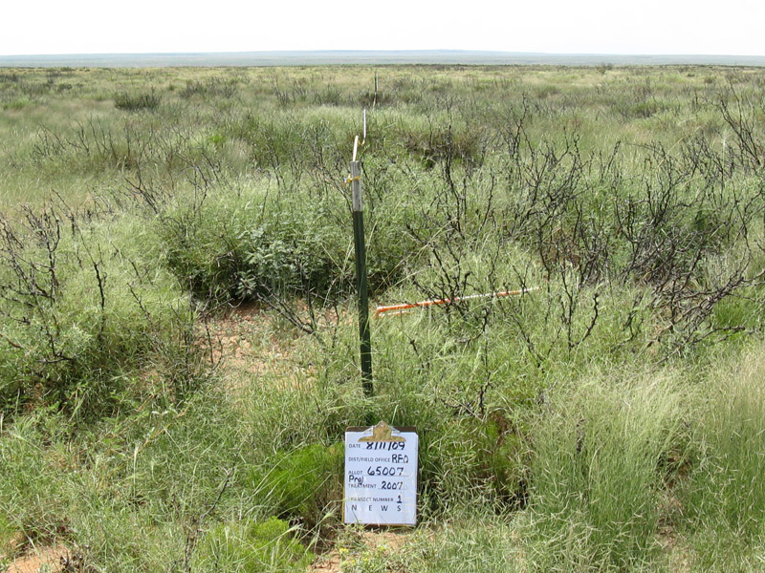
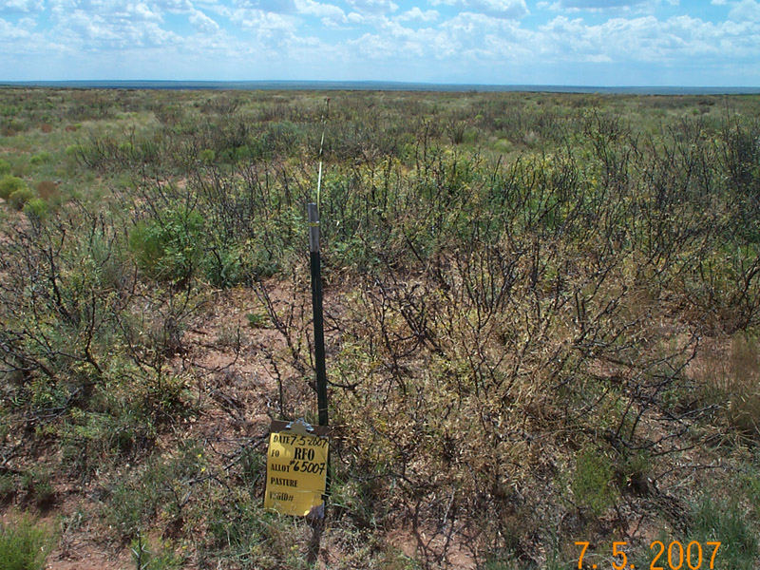
3 SWCDs let out a RFP for
3 year price agreement contracts for aerial brush treatments which helps to implement a project in a shorter timeframe.
Mesquite Treatment
Notes:
Mesquite treatment, re-vegetation is by existing native vegetation. We are still working on the possibility of using fire to maintain these site in the future.

Slide 21
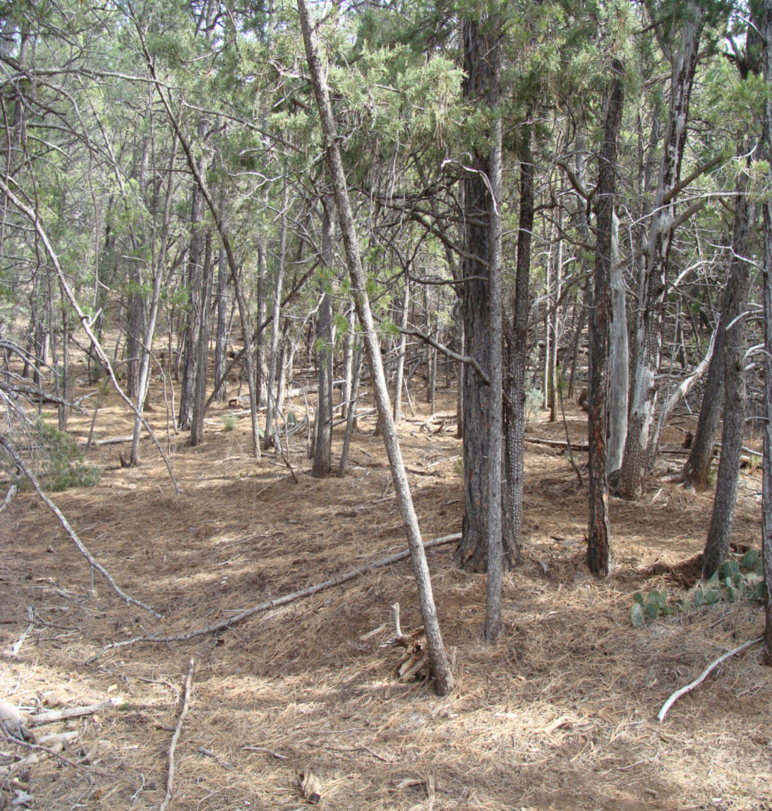
2 SWCDs – using G&F price agreement to contract for P/J thinning
Prior to Treatment
During Treatment

Slide 22
2 SWCDs - erosion control work on roads
BLM wilderness area
well in a national monument.

Slide 23
NMACD Participating Agreement -Forest Service
Facilitate Orientation Meetings with all 5 Forests in NM
Meet with SWCD’s, FS, BLM and NRCS to coordinate and develop CRMPs- 34 Ranches with FS permits to date.
Almost $900,000 in contracts on Forests from RCPP.

Slide 24
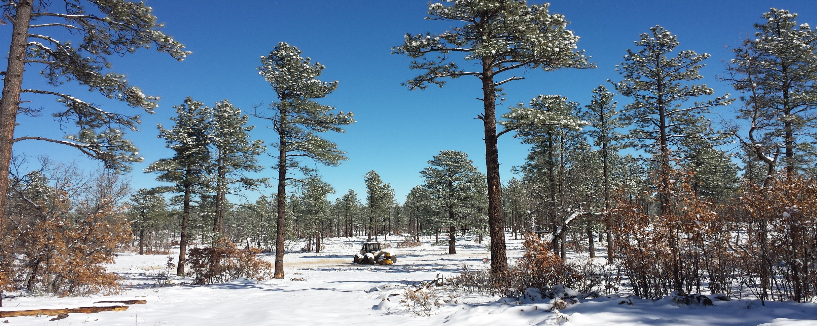
SWCDs Participating in Forest Planning- As Cooperating Agencies
SWCDs hosting Public Meetings for US Forest Service

Slide 25
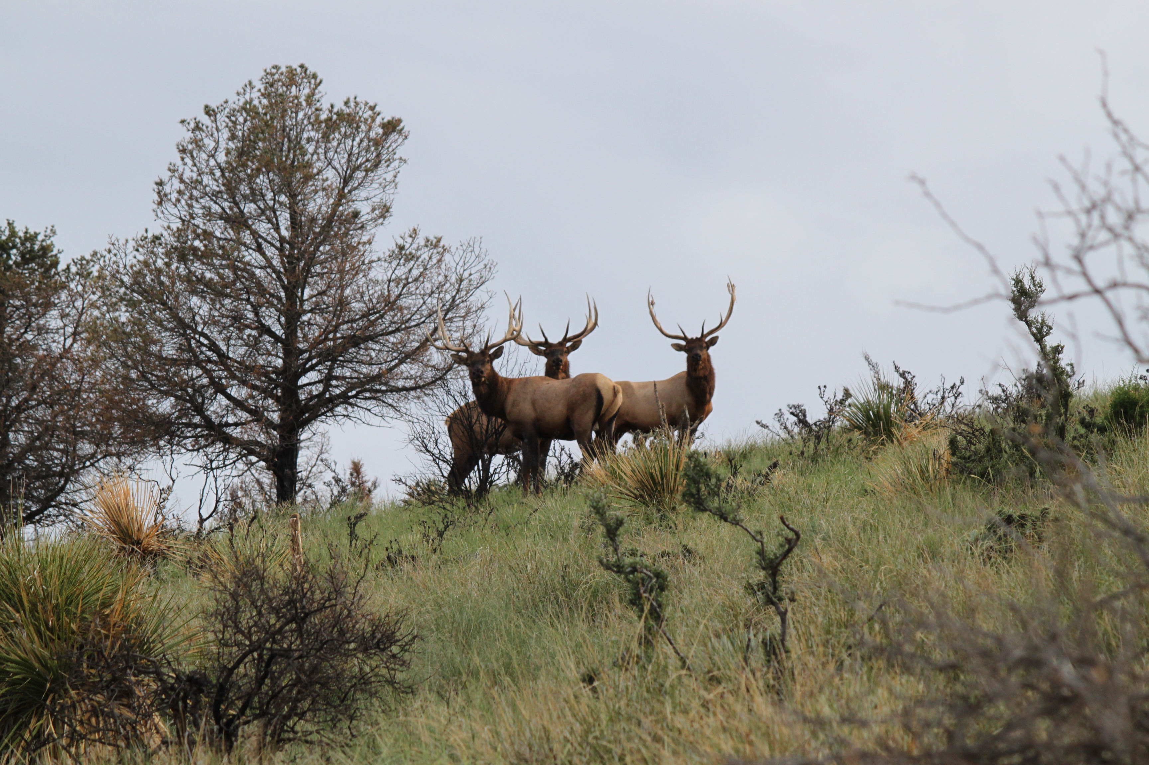
Professional
Services
Agreement
with NM
G & F
Coordinate
& Facilitate
With SWCDs
NRCS & FS

Slide 26
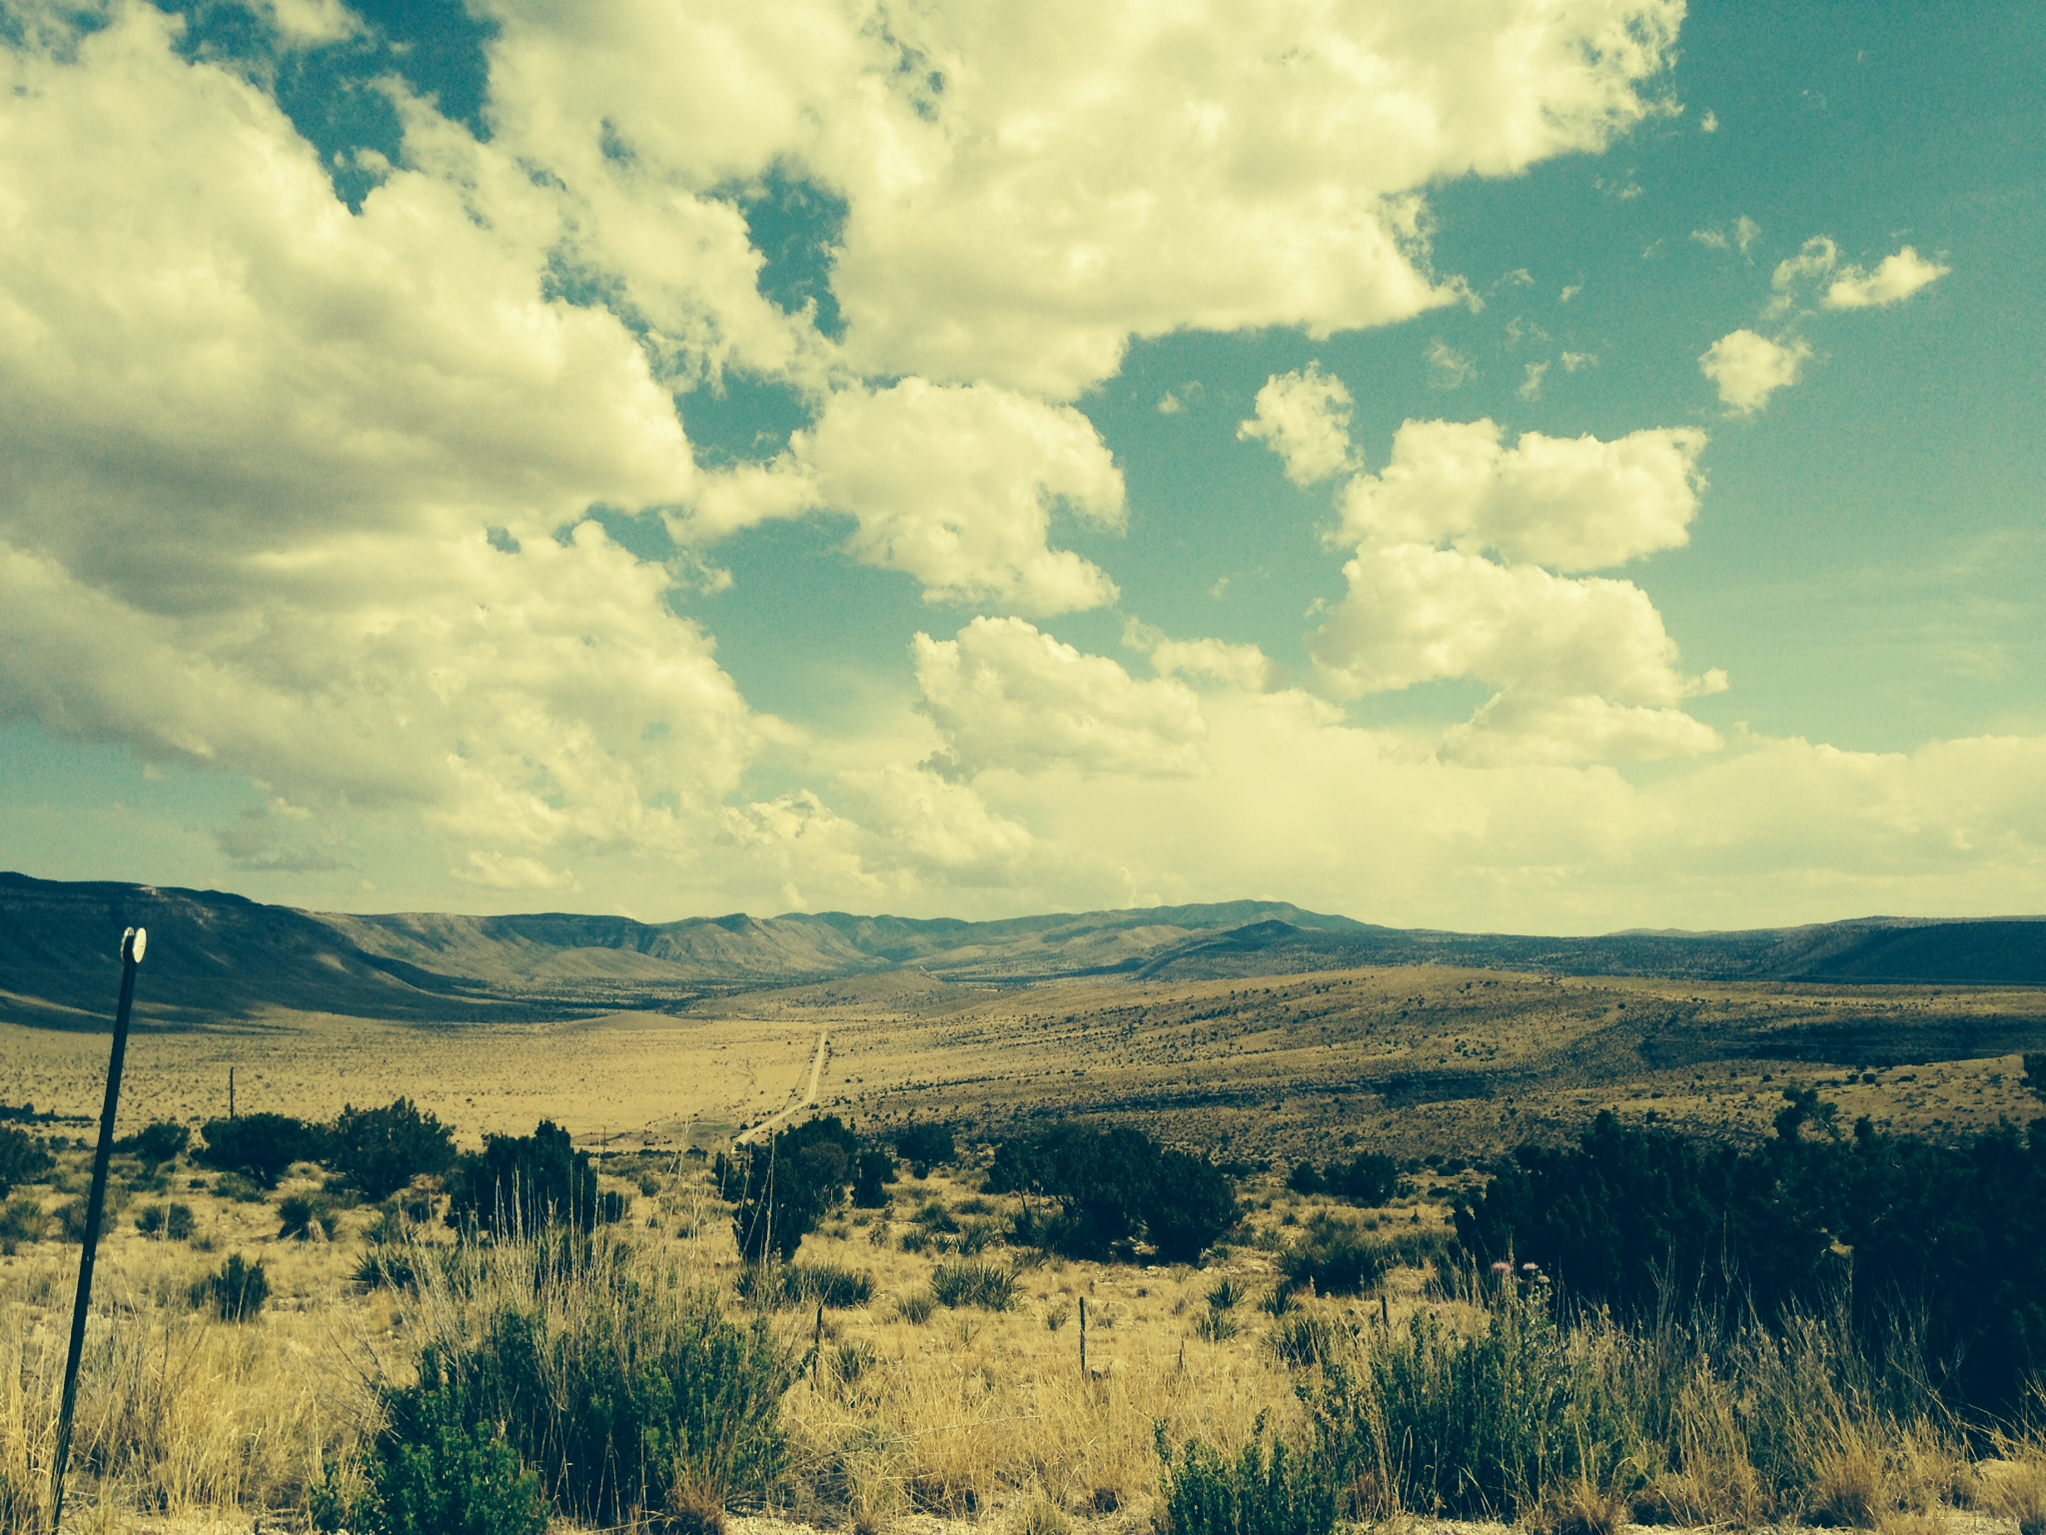
2015 -Successful in getting 4 million dollars to NM for Ranches with Federal lands Restoration RCPP
2017 New Mexico Range and Forest Soil Health Initiative- NMACD- 7million dollars.
2017 Building Resiliency in the San Juan-Rio Chama Region-3.25 million dollars. East Rio Arriba SWCD-alternative funding agreement
2017 North Central NM Watershed Restoration Project— Claunch-Pinto SWCD - $969,220
OVERVIEW
OF NM REGIONAL CONSERVATI0N PARTNERSHIP PROGRAM (RCPP) being Utilized for Restore NM

Slide 27
2015 & 2016 RCPP The New Mexico Acequia Revitalization (NMAR) The
1.2 Million-2015
3 Million-2016
$2,907,670 -2017
utilizing the "alternative funding arrangement"

Slide 28
Soil and Water Conservation Districts Made this POSSIBLE, SUCCESSFUL AND LEADING THE NATION

Slide 29
Canadian River Riparian Restoration Project Aerial Application to Control Salt Cedar
WTB $600,00 per yr
NM G & F matched with 2 million
2015 RCPP- 2 million
2017 CRWRP
Canadian River SWCD $3.6m (CCA – Prairie Grasslands)

Slide 30
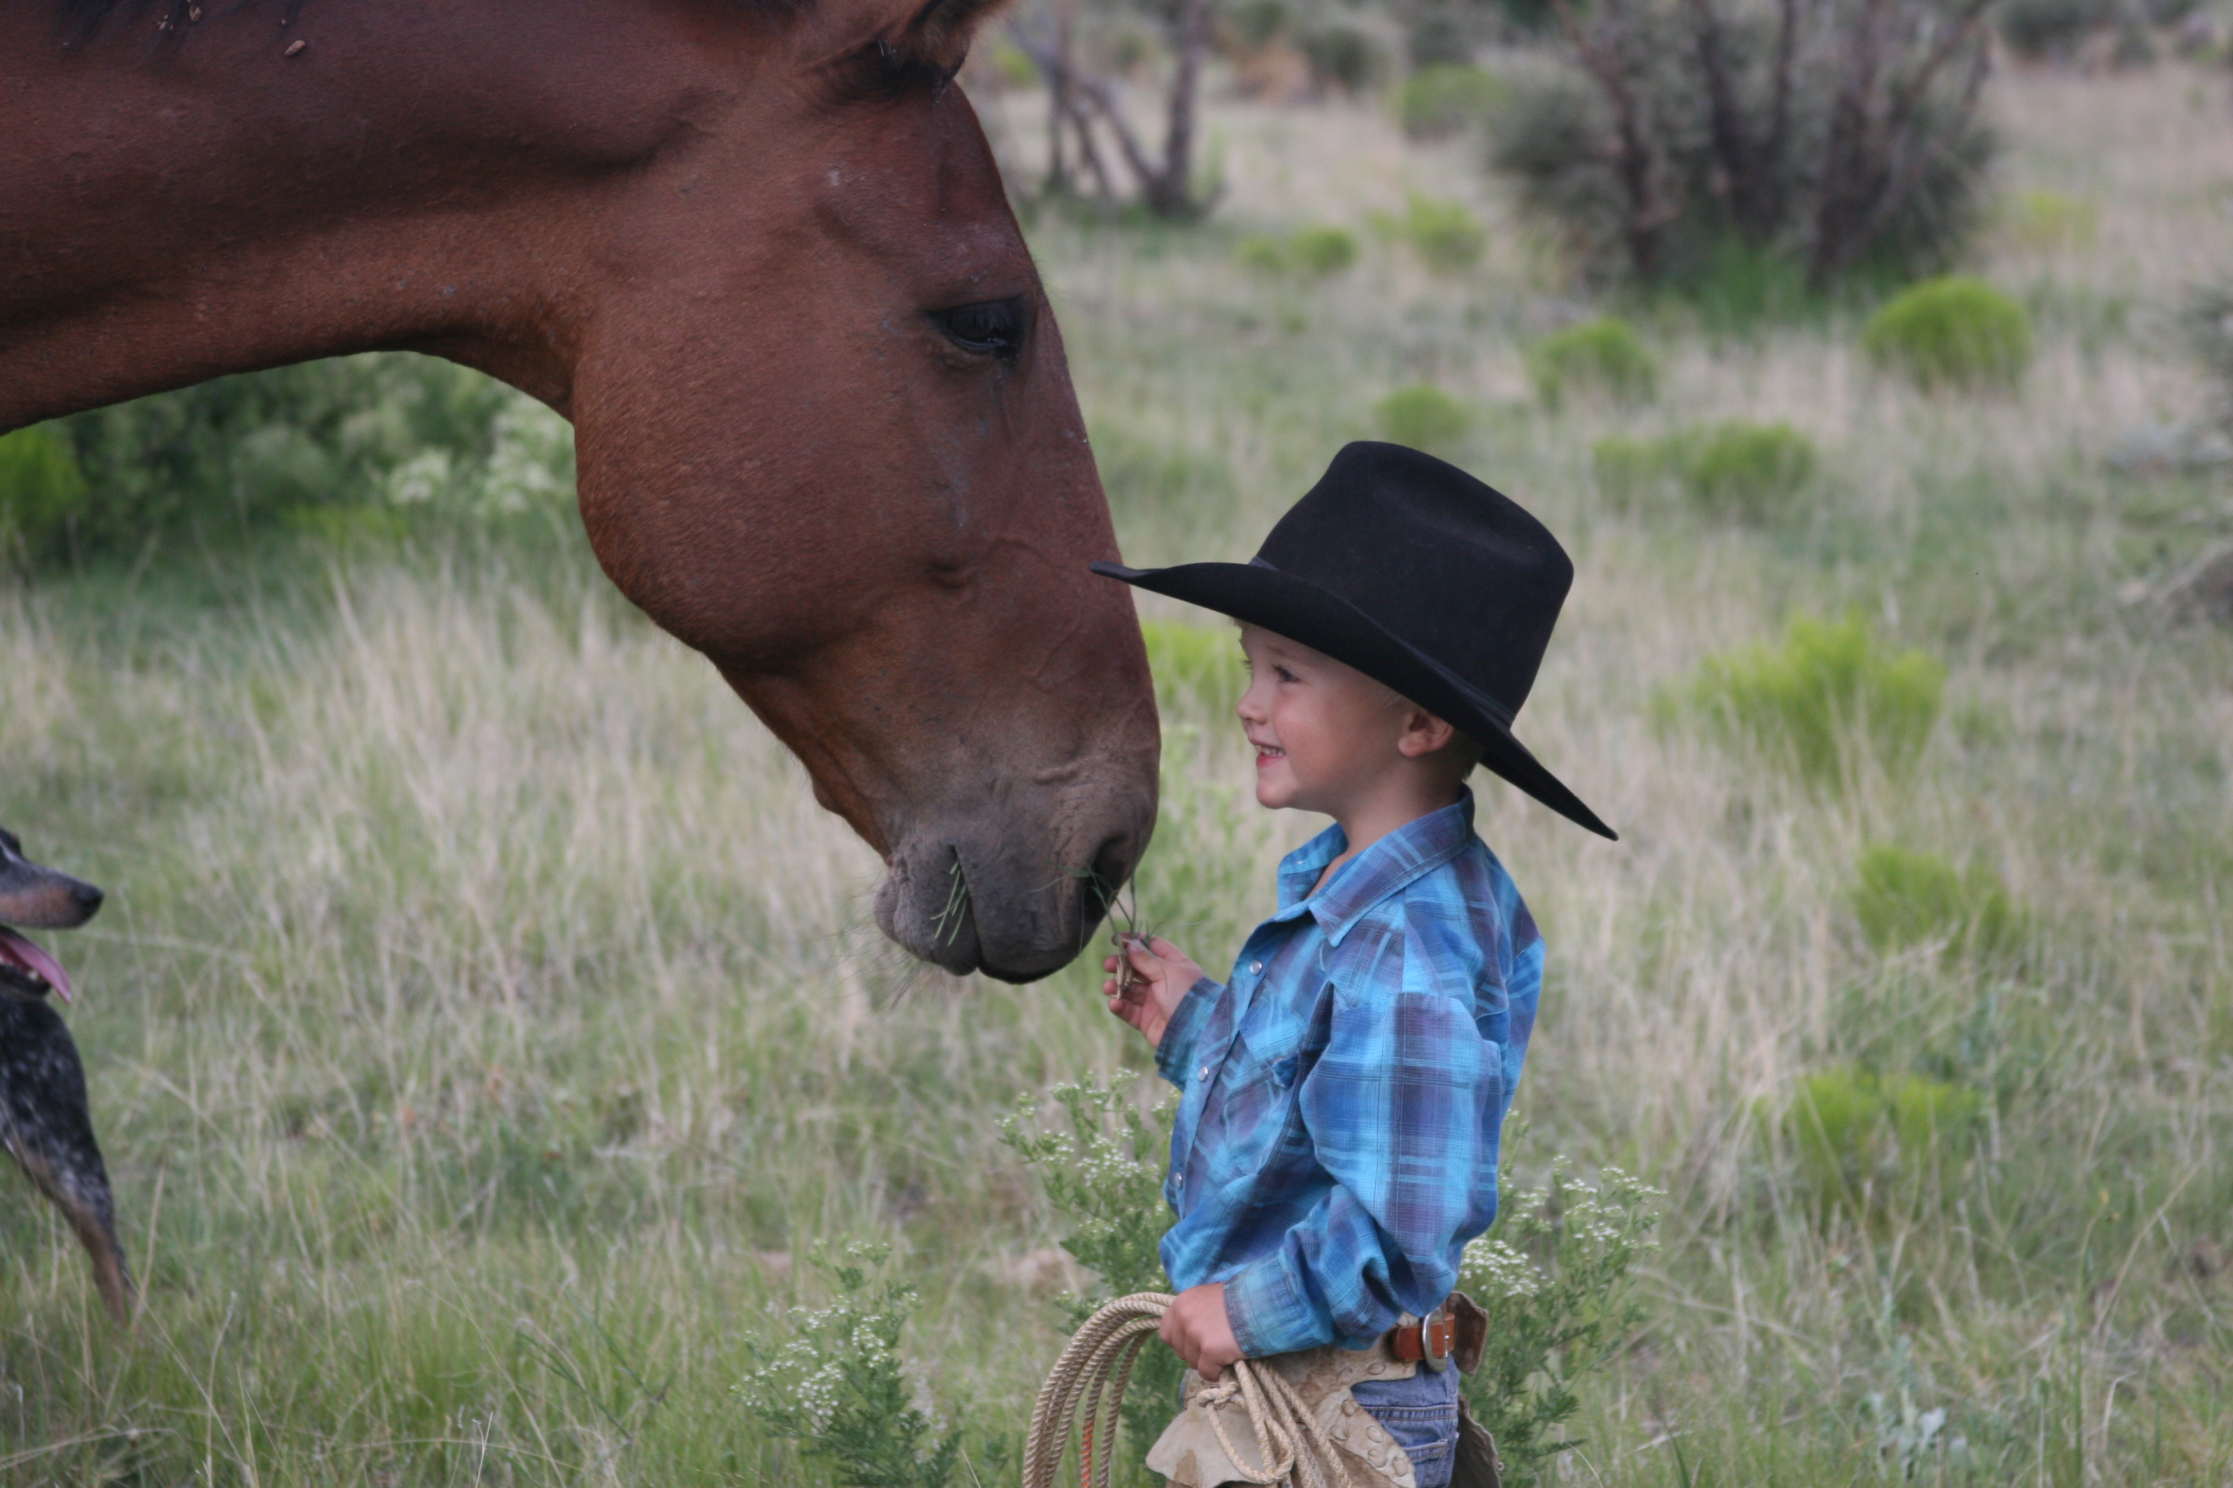
REACHING LANDOWNERS THAT HAVE BEEN UNDERSERVED!
NMACD Develops Plans WITH SWCDS
247 Coordinated Resource Management Plans developed to date for 2015 RCPP for Ranches with Federal Land.
34 of the 97 CRMPs for Ranches with Forest Service Permit
2017 RCPP for NM Range and Forest Soil Health Initiative funded 7 Million dollars.

Slide 31
NMACD started 2014 Road Show to help SWCD’s build partnerships and relationships
NMDA
NRCS
FSA
BLM
FS
NM G & F
NMACD

Slide 32
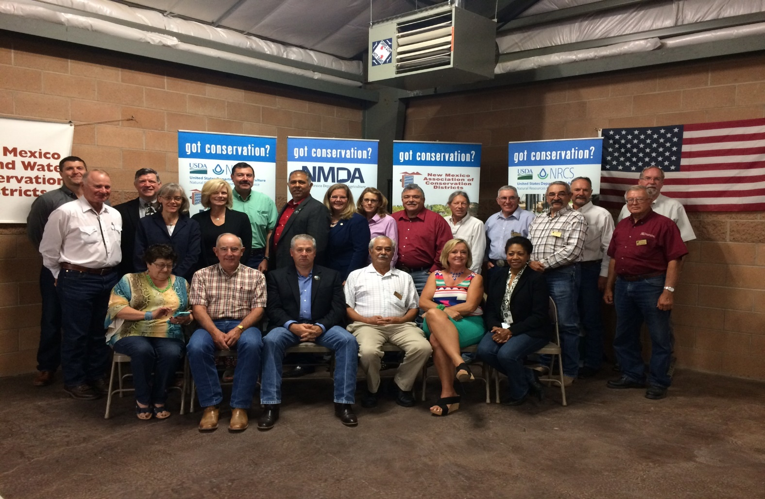
2015 “ PARTNERSHIP Road Show”
NRCS
FSA
NMDA
NMED
BLM
US Forest Service
NM State Engineer
NM State Forester
NM Interstate Streams Commission
US F &W Partners Program
NM Acequia Association
NM Soil & Water Commission
“The More Partners – the Better”
Keep Building Relationships with Partners for SWCDs and Landowners!

Slide 33
HABITAT RESTORATION INCREASING SPECIES and Prohibit Listing (such as Dune Sand Lizard)
WHAT DO SWCDS PARTNERSHIPS ACCOMPLISH?

Slide 34
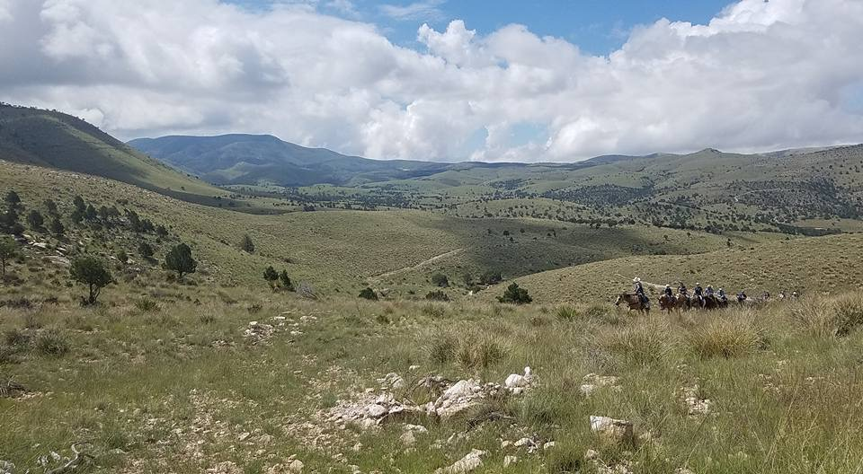
SWCD & PARTNERS RESTORATION TREATMENTS AS OF 2016
Restore NM acres treated since Inception:
3,335,572 acres of public, private & state lands
BLM 2,653,832 acres
State 328,105 acres
Private 313,560 acres
USFS 56,075 acres
Treatments included Chemical,
Mechanical and Prescribed Fire

Slide 35
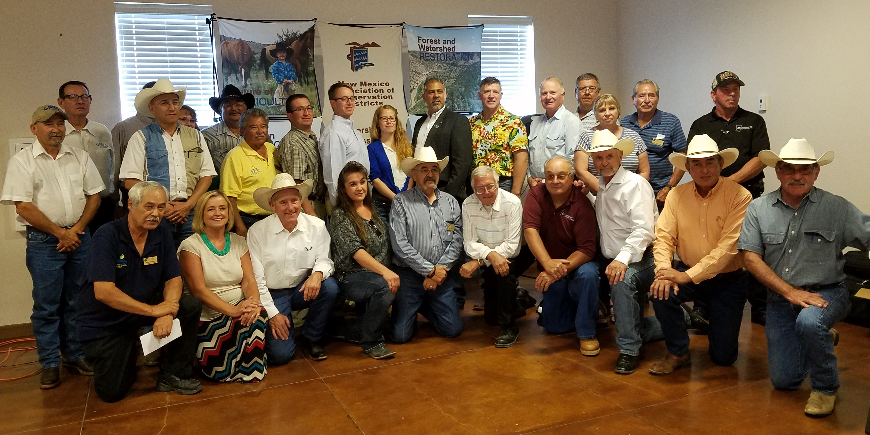
2016 NMACD ROAD SHOW MORE PARTNERS & MORE SWCD’S LEADING THE NATION!

Slide 36
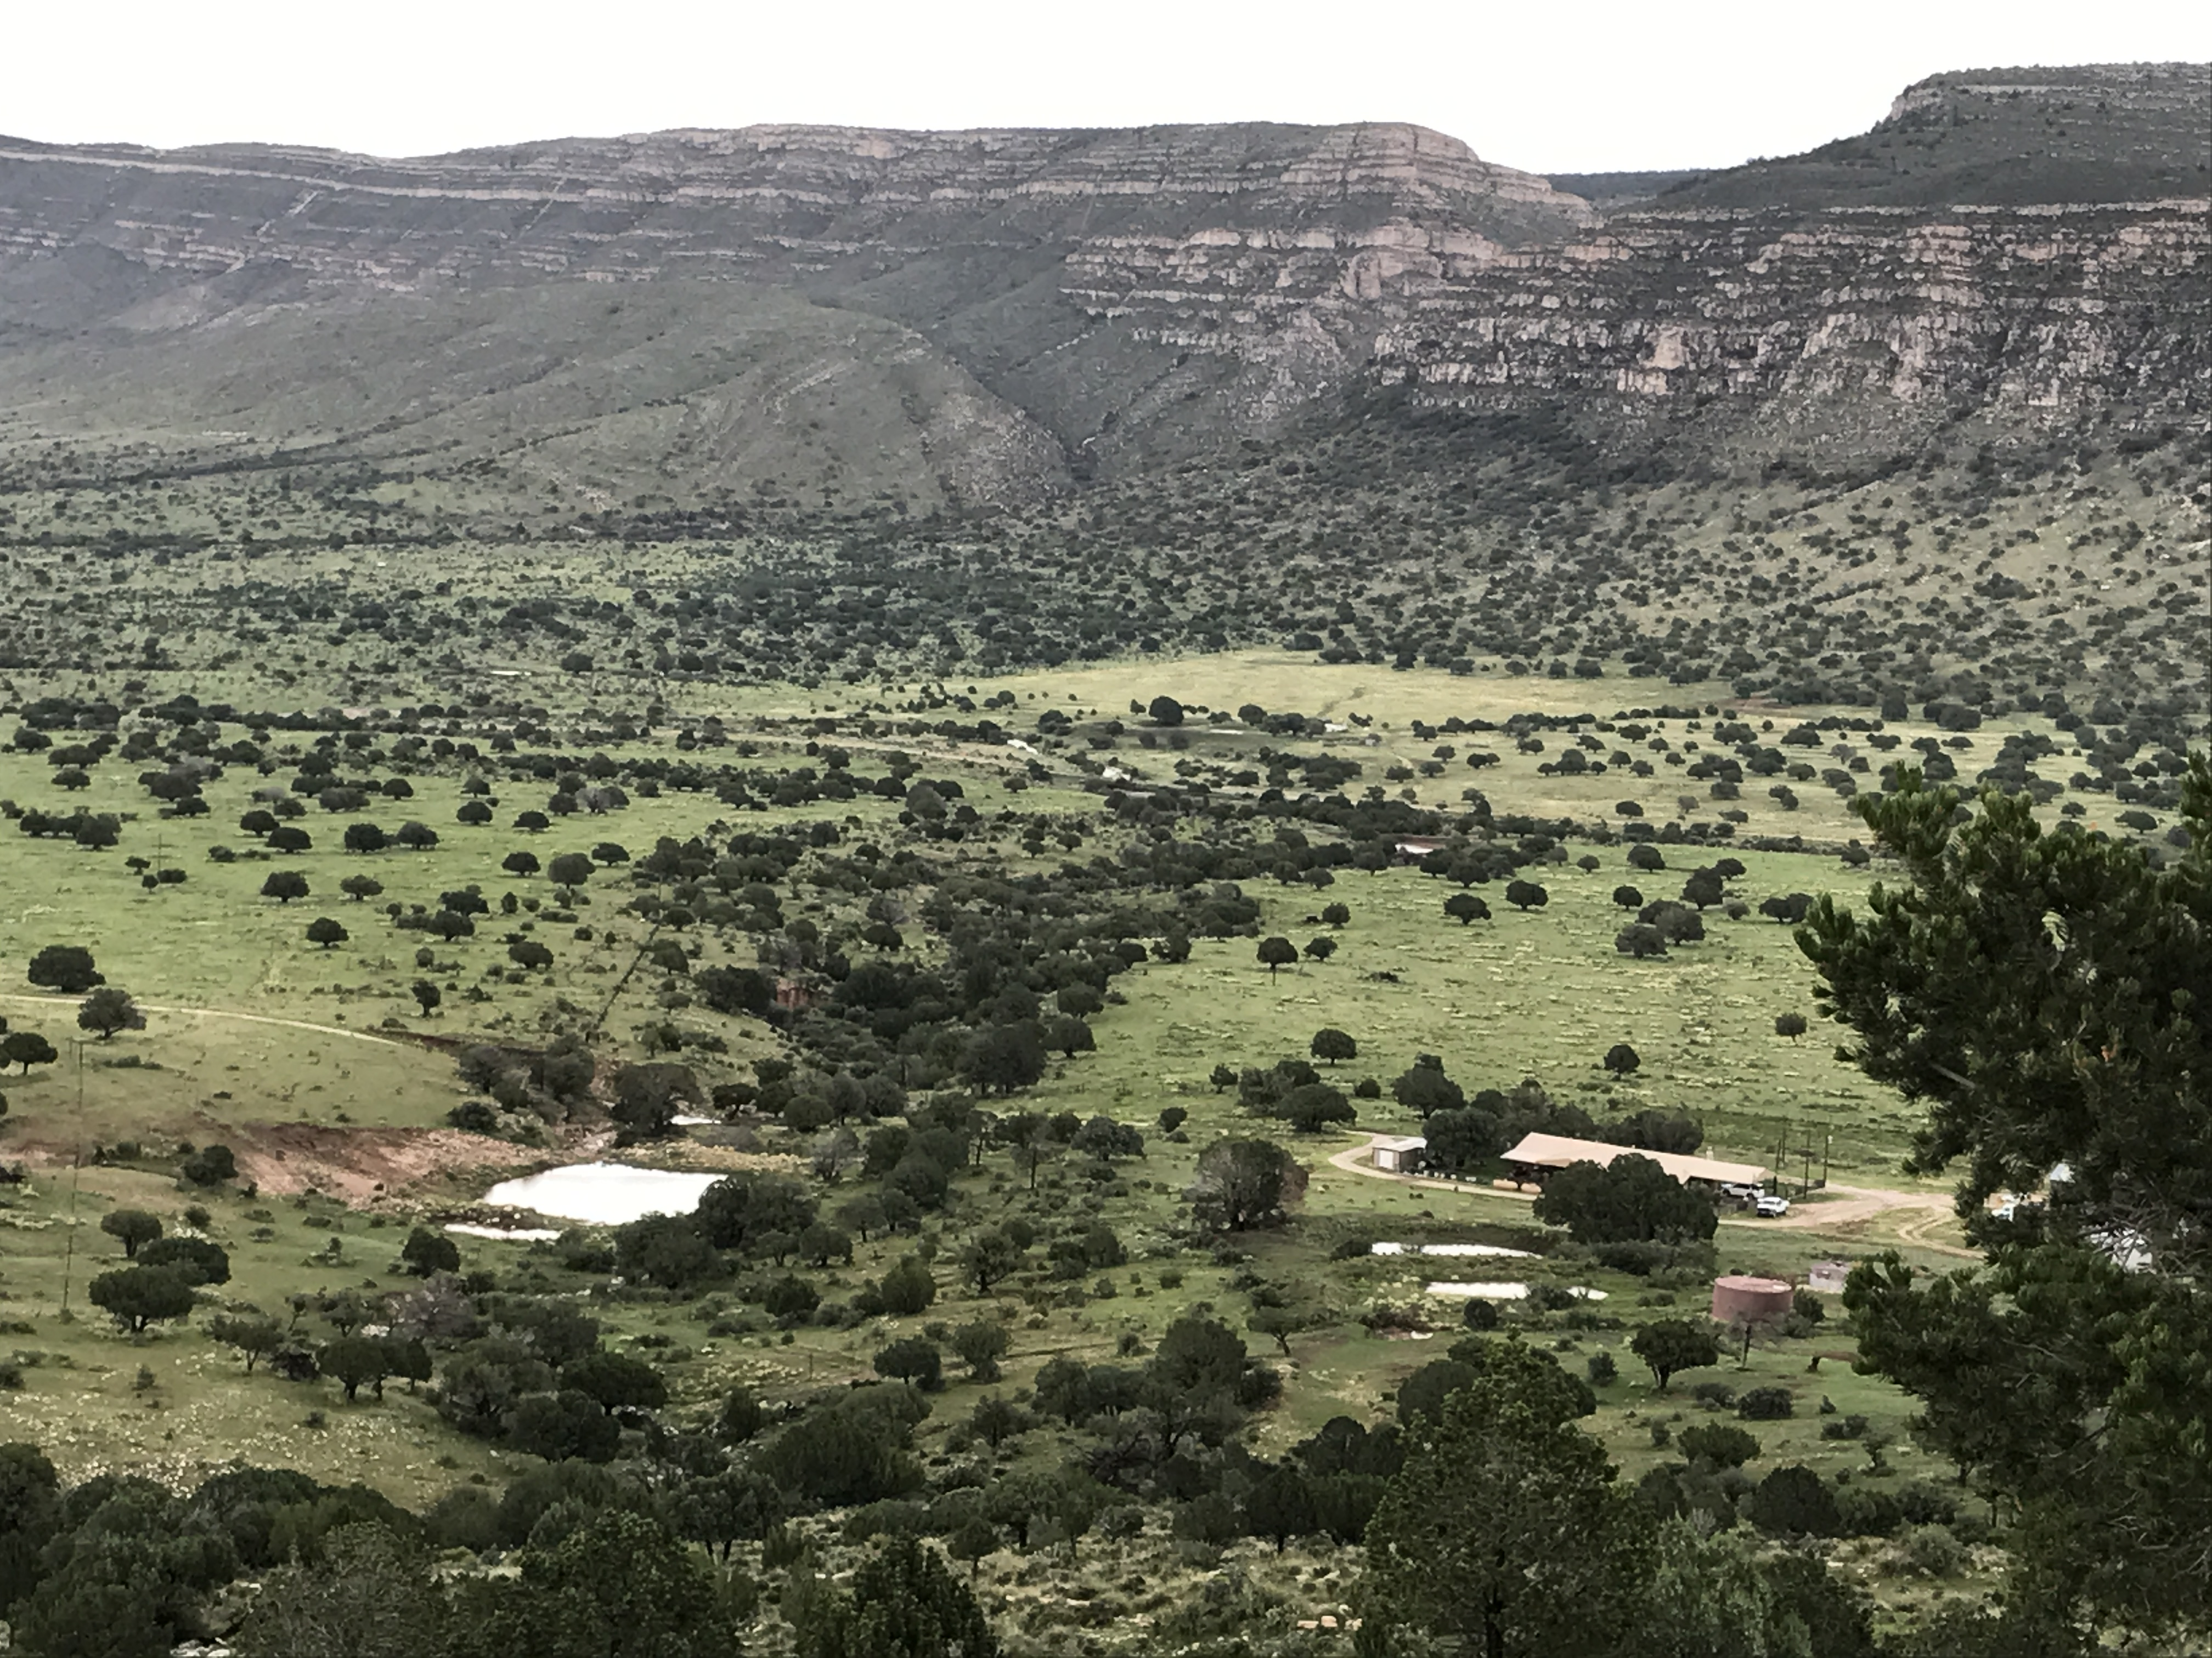
Funds Spent on Restore New Mexico by SWCD’s & PARTNERS as of 2017
Funds from BLM: $30,298,536 million
Funds from NRCS: $11 million
Funds from RCPP: 18,614,519 million
Funds from other partners: $9,782.000
Funds from Fire (non-WUI): $10.8
Total funds over the last 13 years
Over $69,705,855 Million

Slide 37
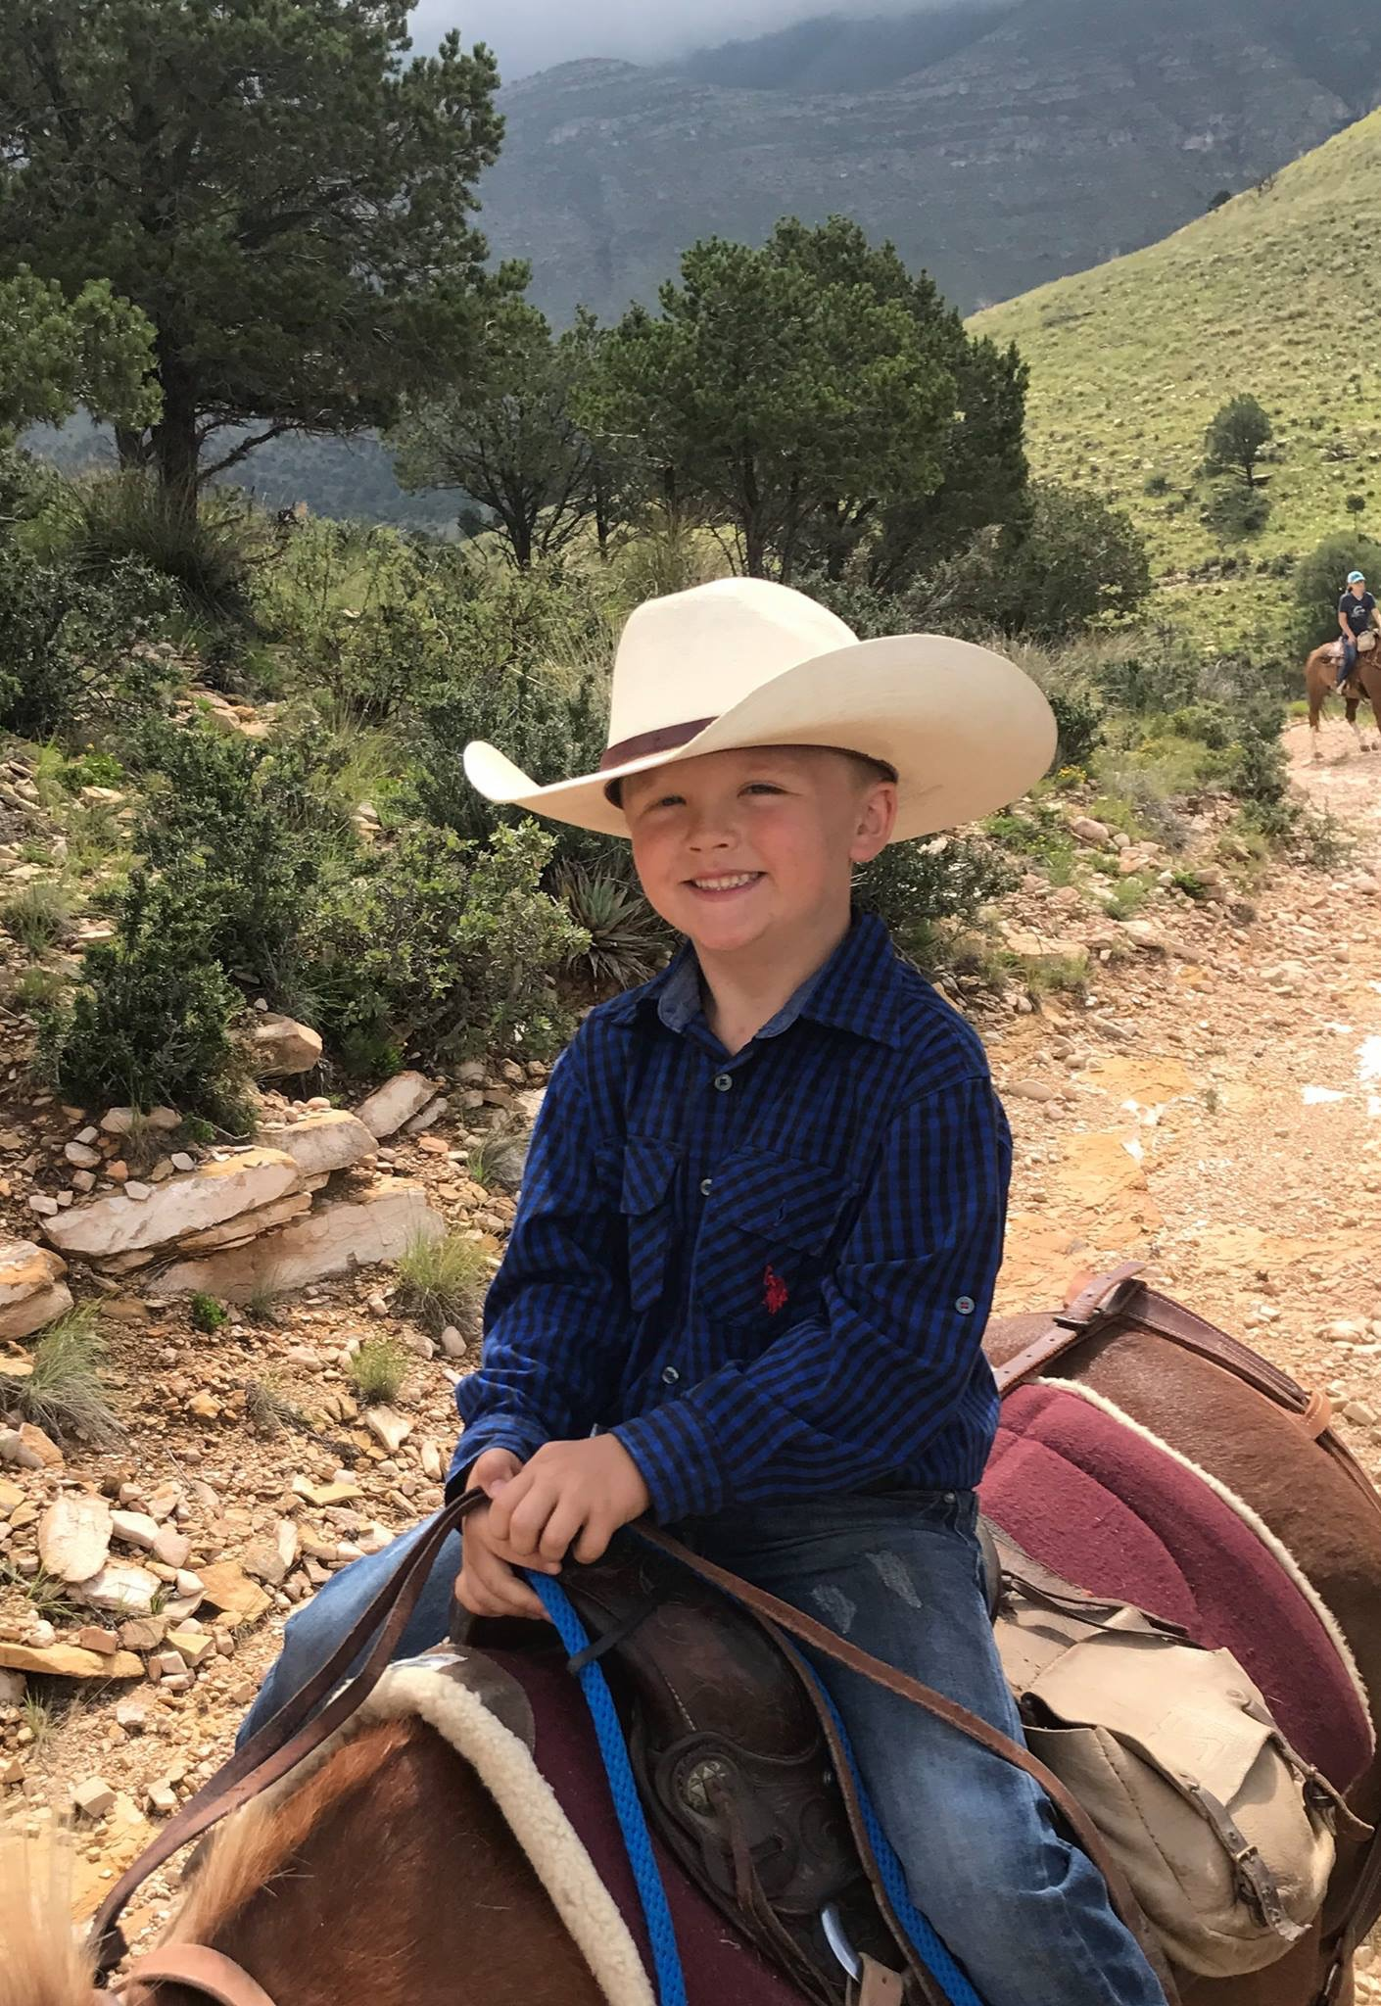
NMACD, SWCDS & PARTNERS
3 Year RCPP Total
$31,426,890

Slide 38
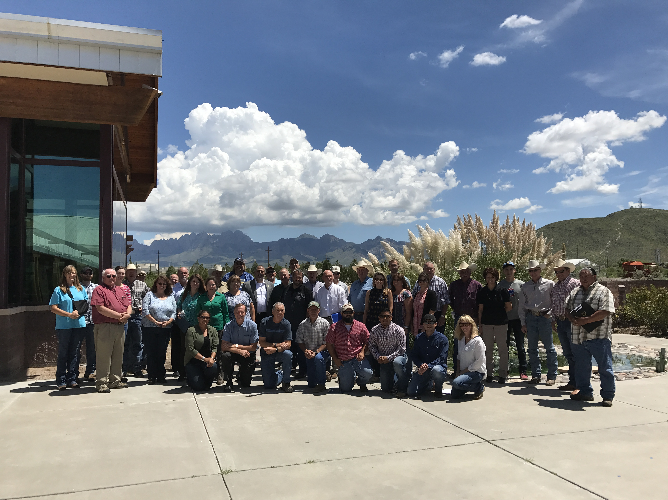
Las Cruces BLM/NRCS
Partnership

Slide 39
NM SWCDS ARE LEADING THE NATION with their work and PROUD to have Brent Van Dyke leading the Nation as the NACD President!
!

Slide 40
