Slide 1

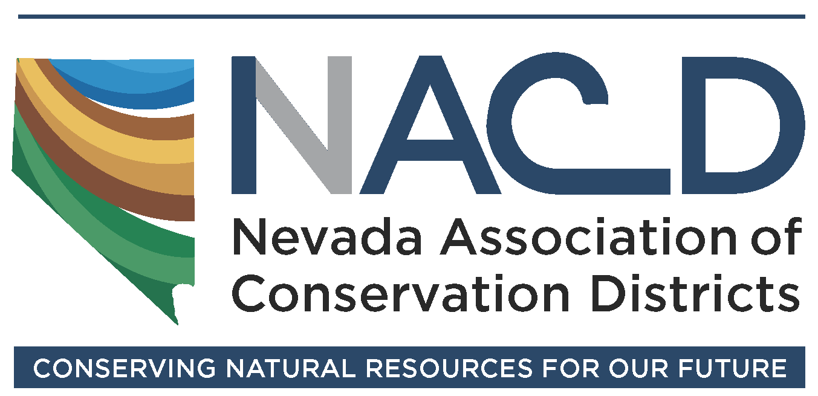


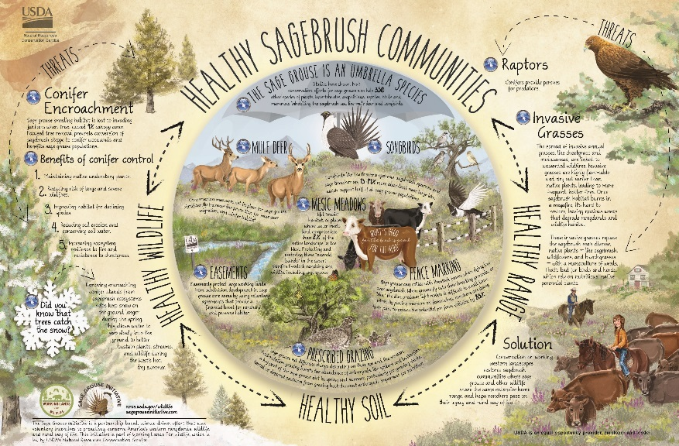


Resource Needs Assessments are fundamental to
Locally Led Conservation
in support of
“Ecological sustainability,
economic resilience, and
social and
cultural preservation”

Slide 2
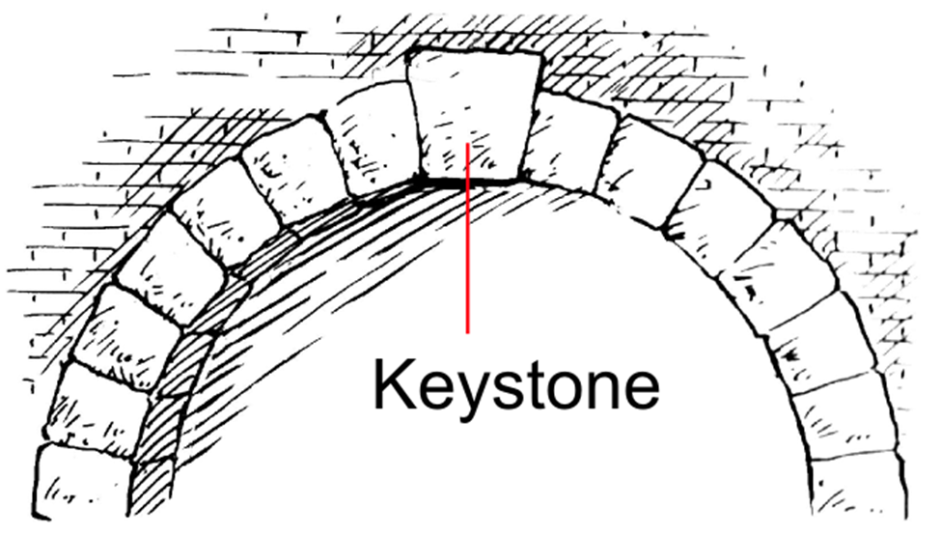
Resource Concerns Inventory
Resource Needs Assessment
Conservation Action Plan
CD’s
Keystone
Locally Led
Conservation
Like an architectural keystone, RCI, RNA and CAP forms the keystone that will allow CD’s to “bear weight” and be “self-supporting,” becoming the Keystone Entities for
Locally Led Conservation in Nevada
Notes:
Merriam-Webster Online Dictionary:
Keystone:
The wedge-shaped piece at the crown of an arch that locks the other pieces in place
something on which associated things depend for support
Wikipedia:
“It is the final piece placed during construction and locks all the stones into position, allowing the arch or vault to bear weight. A masonry arch or vault cannot be self-supporting until the keystone is placed….”

Slide 3
Locally Led Conservation
Locally led conservation is a process based on the principle that community stakeholders are best suited to identify and resolve local natural resource problems.
These objectives will help define a desired future condition for these resources in terms of what the local people want.

Slide 4
Conservation District
LWG
Resource Concerns
Conservation Needs &
Priorities
Program Funding Recommendations
Resource Needs Assessment Committee
Community leaders & stakeholders
Business/Industry/Tribes
Conservation Groups
SG LAWG
City/County, State and Federal Agencies in District
RNA Technical Team
CD, NvACD
NRCS
UNCE
BLM, USFS
DCNR, SETT, NDA, NDOW, etc.
Others?
District Conservationist
Resource Concerns Checklist & CPPE Identification
SWAPA = Resource Based Concerns & Action alternatives
STAC
Locally Led
Private, City, County
State & Federal (NCCN)
Working Landscapes
CD Resource Needs Assessment &
Conservation Action Plan
By Local Need and Priority
SWAPA + E + H = Resource & Program Based Actions
NRCS
USDA Conservation Program Delivery in State and District
By
Need and Priority
Collaborative Conservation
Notes:
Graphic model of Locally Led Conservation using Resource Needs Assessment process
Produces:
Local Resource Needs Assessment based on Resource Concerns
Conservation Needs, Priorities, and Program Funding Recommendations for the STAC process
Prioritized Conservation Action Plan to direct local projects and cooperate with State and Federal Resource Management in the District

Slide 5
NRCS National Planning Procedures Handbook
The planning process used by NRCS is a three-phase, nine-step process. The process is very dynamic
Phase I – Collection and Analysis (Understanding the Problems and Opportunities)
Identify problems and opportunities
Determine objectives
Inventory resources
Analyze resource data
Identify problems and opportunities
Phase II – Decision Support (Understanding the Solutions)
Determine objectives
Formulate alternatives
Evaluate alternatives
Make decisions = Develop Conservation Action Plan
Phase III – Application and Evaluation (Understanding the Results)
Implement the plan
Evaluate the plan
SWAPA
Resource Conditions
SWAPA + E + H
Applying Conservation Practices to meet private and public needs
Notes:
We are slightly altering the process to begin with identifying and inventorying resources and current resource conditions.
The reason behind this is to decrease political and value based bias (causal factors) when identifying resource conditions. Begin with SWAPA to complete the Resource Concerns Inventory. Then add in the Energy and Human (socio-economic) values in the Resource Needs Assessment and Conservation Action Plan so that local community needs and broader social desires are met as closely as possible

Slide 6
Resource Inventory
What: A comprehensive evaluation of the condition of the district's natural resource base and local priorities, needs and objectives
Resource needs assessment provides a comprehensive evaluation of the conditions of the area’s natural resources and becomes the platform for making decisions about local conservation needs, priorities, policies and projects
    Private Lands
    State Lands
    Federal Lands
    County and City Lands
All Natural Resources on all Lands across all Jurisdictions within the District
Conservation Action Plan, Annual Plan, and STAC recommendations guide conservation implementation and funding

Slide 7
Resource Inventory
Why: Understand District wide
        Current Resource Conditions
        Local Needs, Concerns and Priorities, i.e. resource and socio-economic management objectives
To support the Board in:
        Establishing scientifically sound Locally Led or “Community Based” Conservation Plans and Actions based on Local input and a list of ranked science based conservation practices
        Assist coordination and cooperation with federal, state and local planning and implementation of all conservation programs in your area
        Improve natural resource management, minimize conflict, and address identified resource concerns and opportunities
The locally led process establishes a foundation upon which all of your district’s conservation efforts are based. It provides the informational and scientific rigor for planning and project implementation that is on par with other federal agency planning processes.

Slide 8
Resource Needs Assessments & Conservation Action Plans
Why:
  Set measurable conservation objectives and goals;
  Identify science based conservation systems and practices needed to achieve these objectives and goals;
  Provide recommendations to the STAC for local Farm Bill Funding priorities
  Become the Keystone Conservation Entity
  Identify federal, state, local and non-government programs and services that are available to address specific conservation needs. Influence the implementation of these programs and services to fit the resources and socio-economic needs of the community.
Conservation decisions should be made at the local level
A process, which is resource driven rather than program driven, should be used to guide and coordinate all federal, state and local conservation efforts.
Notes:
The planning process used by NRCS is based on the premise that clients will make and implement
sound decisions if they understand their resources, natural resource concerns and opportunities, and
the effects of their decisions

Slide 9
Resource Needs Assessments & Conservation Action Plans
When: Start 2018 – 2 CD’s in each of the 3 Areas (NW, NE and South) for a total of 6 CD’s by December 2019
How: Complete
Resource Inventory
Resource Needs Assessment
Conservation Action Plan
Participate in the LWG and STAC process
The planner strives to balance natural resource issues with economic and social needs through the development of the conservation plan.

Slide 10
Resource Needs Assessment – Process
Beginning with Resource Concerns Inventory
HOW/ Stepwise Process:
          Assemble a Resource Needs Assessment Committee (RNAC) – Should be representative of all local use and interest groups, tribes, industry, and citizens at large – Local Stakeholders invested enough to show up and participate
          Community Leaders and Stakeholders Business, Industry, & Tribes
          Conservation/environmental groups
          Sage Grouse Local Area Work Groups/ SANE & Others
          City/County, State and Federal Agencies situated in the District
Notes:
Steps 1-5 are strictly resource based
RNAC is a subcommittee of the Board directed to perform this specific task.
Get as broad a representation of the community as possible

Slide 11
Resource Concerns Inventory
HOW/ Stepwise Process:
          Assemble a Resource Needs Assessment Technical Team (RNATT)
          Technical assistance and technicians could include representatives from:
          Local citizens
          NvACD members
          NRCS
          UNCE, CABNR
          BLM, USFS, USFWS
          DCNR, SETT, NDA, NDOW, etc.
          Other expertise as needed and available
Notes:
RNATT is also a subcommittee of the Board appointed to provide information and technical assistance to the Board and the RNAC in completion of the Resource Concerns Inventory, CPPE, and Resource Needs Assessment. Some members may be required through Conservation Action Plan completion.
Assistance from state and federal agencies is available through mutual goals, MOU’s, and duties assigned.

Slide 12
Resource Concerns Inventory
HOW/ Stepwise Process:
          RNAC and RNATT - Assemble Area Resource Information
  Use this information to:
  Identify existing or potential resource concerns or opportunities.
  Further define known existing and potential resource concerns and opportunities.
  Clarify resource concerns.
  Formulate and evaluate alternatives.
  Inform Stakeholders (When asking for local resource knowledge and when conveying results of the inventory)
Notes:
Resource data can range from stakeholder information conveyed in a local town hall meeting, or otherwise, to GIS layers, NRCS area data, Watershed or project analyses and plans (BLM or FS EA’s and EIS’s), Ologist observations, Research studies, etc.
To supplement data from other agencies or groups, the district and NRCS rely on local knowledge,
specific discipline input, and existing public information that relates to the local area. The locally led
process utilizes the RNAC to meet with stakeholders interested in resource issues. This
public information can help identify other resource issues or human considerations that have not
previously been a focus of interest in the area.

Slide 13
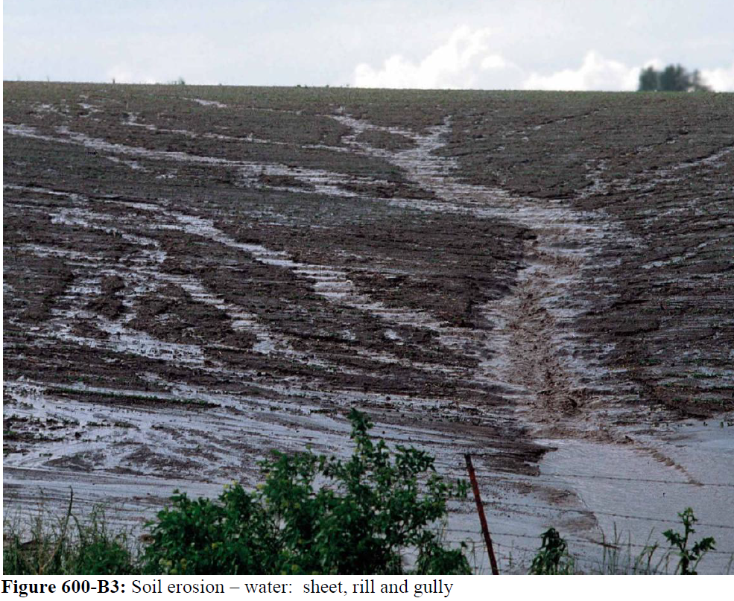
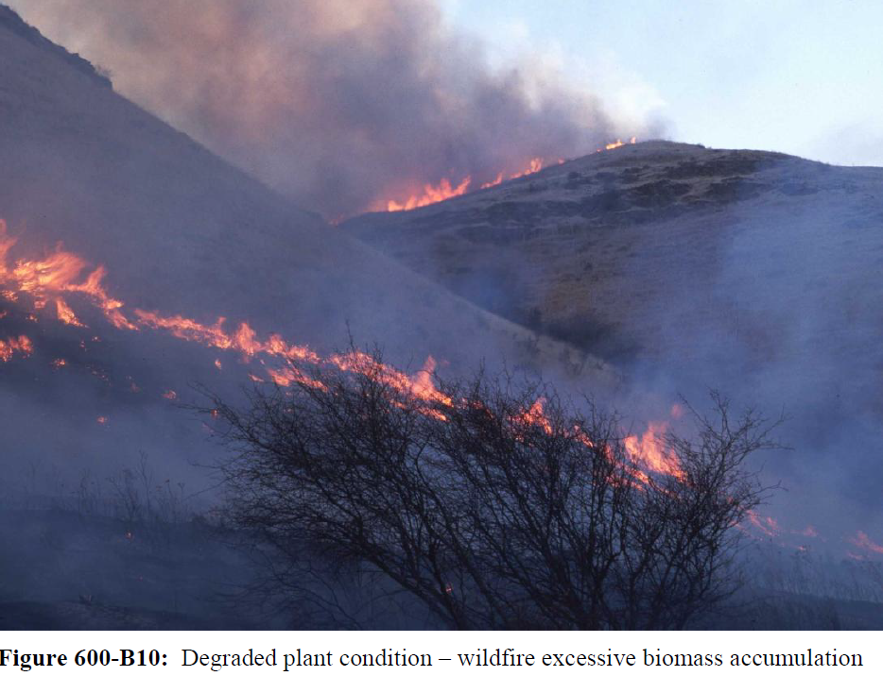
Resource Concerns Inventory
HOW/ Stepwise Process:
          Organize, Analyze and Document information/data and complete the Resource Concerns Checklist and Inventory
Soil Erosion – water:
Sheet, rill and gully
Degraded Plant Condition
Wildfire excessive biomass accumulation
The Inventory is the anchor point of the Resource Needs Assessment
Notes:
This information must be documented, organized, analyzed, contextualized, and otherwise put in useful form in completing the Resource concerns checklist and available for inclusion in RNA and CAP write ups. Mutual effort between the RNA Committee, Technical Team, and Board

Slide 14
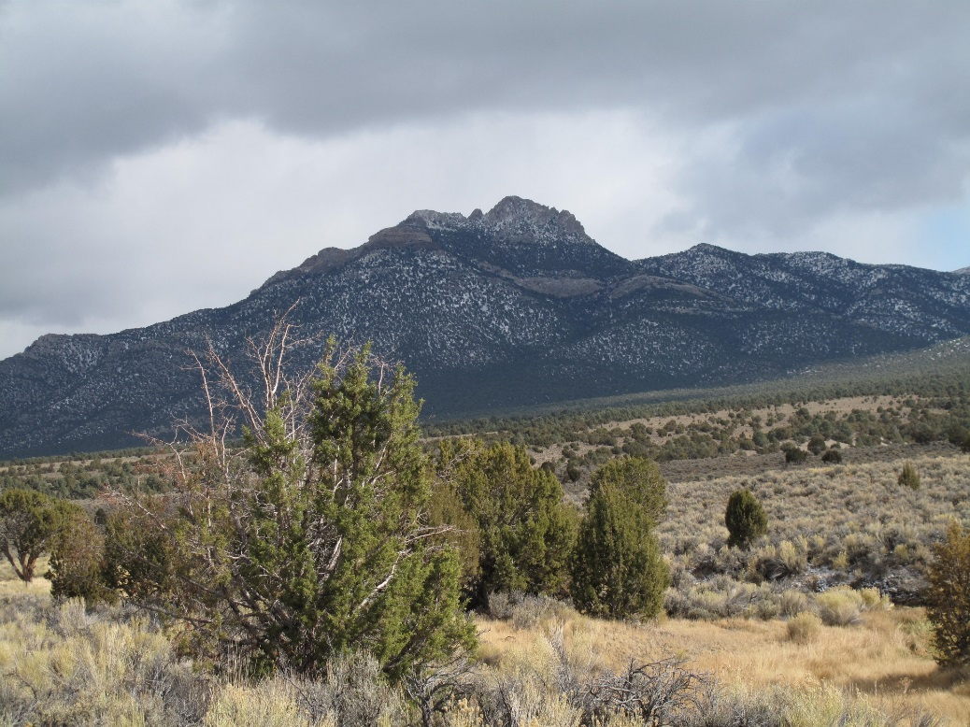
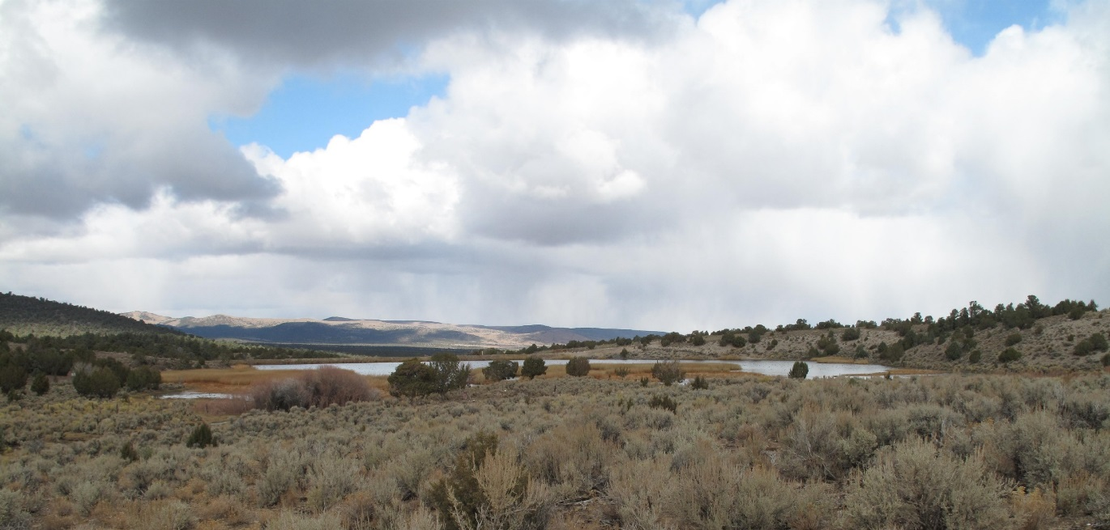
Resource Concerns Inventory
Addresses the entire resource base:
soil
water
air
plants
Animals (ALL Animals)
SWAPA – Strictly Resource Based
Notes:
When developing the Resource Needs Assessment and Conservation Action plan, the effects of energy and humans are integrated into the process

Slide 15
Resource Concerns Inventory
Document and/or publish results:
Notes:
These findings may be published as the inventory or included in the RNA
This document summarizes the findings of the Resource Concerns Inventory.
The Inventory is the anchor point of the Conservation Needs Assessment and all planning, programming, and recommendations to the STAC process with NRCS

Slide 16


HOW/ Stepwise Process:
          Determine as a group, with broad stakeholder input, what the concerns and local objectives are and prioritize by place and importance
          Stake holder meetings
          Online Community Survey (UNR/UNCE Assistance)
          Facilitated discussions if necessary
Notes:
Local objectives are integrated with the FOTG and may form the basis for developing additional
technical guidance material. This is accomplished by ensuring that—
(1) New or existing planning criteria support identified objectives.
(2) Guidance documents reflect local resource issues.
(3) Management systems in the FOTG, Section III, serve as examples that work toward
accomplishing the identified human considerations for that area.

Slide 17
Resource Needs Assessment - Process
HOW/ Stepwise Process:
          Utilize CPPE Matrix to develop conservation practice alternatives
          Then evaluate alternatives for effect and funding potential
Provides the Conservation Action Plan and proposed District actions considerable weight and basis when dealing with other agencies and parties that may, or may not agree with the Districts proposal
Notes:
This will require NRCS assistance but will provide a list of ranked conservation practices as action alternatives for consideration and use in the Conservation action plan.
Looks at every SWAPA concern, adds in E and H considerations that modifies the concern and considers it against every conservation practice developed by NRCS to give a suite of practices, that if implemented, will have a positive effect on the resource concern. This information has been developed by accumulating years of research and application into effective practices.
Provides defensible scientific basis for conservation actions. This provides the Conservation Action Plan and proposed District actions considerable weight and basis when dealing with other agencies and parties that may not agree with the Districts proposal.

Slide 18
Resource Needs Assessment - Process
Document and Publish RNA:
          Finalize, formally adopt, and Publish the Resource Needs Assessment
Notes:
This document summarizes the findings of the Resource Concerns Inventory and CPPE alternatives

Slide 19
Resource Needs Assessment - Process
HOW/ Stepwise Process:
          Develop Conservation Action Plan - to manage resources for sustained use and productivity considering economic and social needs of the local community
          Using all resource information gathered in process
          Utilize Stakeholder Online Survey for choosing objectives and priorities
          Utilize CPPE developed alternatives for conservation actions
          Utilize Conservation Action Plan for Locally Led Conservation

Slide 20
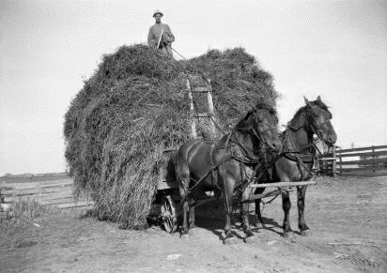
Conservation Action Plan
Documents decisions and time schedules, identifies priorities, sets goals, and identifies Government and nongovernment programs to meet those needs.
Notes:
The locally led process establishes a foundation upon which all of your district’s conservation efforts are based. It provides the informational and scientific rigor for planning and project implementation that is on par with other federal agency planning processes.

Slide 21
Become the Keystone Conservation Entity
          Use Resource Concerns Inventory, Needs Assessment, and Conservation Action plan to inform:
          STAC process to prioritize NRCS funding and projects in the District
          Ensure that conservation programs address the most important local resource needs acceptable to community objectives
          Provides foundation for conservation
          actions and management of resources

Slide 22
          STAC process prioritizes NRCS funding and projects in the District to ensure that conservation programs address the most important local resource needs appropriate to community requirements
USDA seeks input from State Technical Committees and local working groups on State and local conservation program delivery.
The State Conservationist considers the recommendations from the State Technical Committee, along with technical expertise and national program policies, to develop the NRCS conservation program available in the State.
Notes:
Recommendations for local program delivery should be submitted to the local designated conservationist. The local designated conservationist considers the recommendations from the local working group, along with technical expertise and national and State program policies, to develop the local NRCS conservation program available in the assigned geographic area.

Slide 23
          STAC and LWG may provide
Information, analysis, and recommendations for the following activities
and programs.
FB Programs – AMA,EQIP,WHIP, (etc.)
Easement Programs – GRP,WRP, FRPP
SGI, CRP, CIG, AWEP, TSP, GLCI (etc.)
According to 16 U.S.C. Section 3862(d), State Technical Committees and
local working group are exempt from the provisions of the Federal Advisory
Committee Act (5 U.S.C. App. 2).
Notes:
Recommendations for local program delivery should be submitted to the local designated conservationist. The local designated conservationist considers the recommendations from the local working group, along with technical expertise and national and State program policies, to develop the local NRCS conservation program available in the assigned geographic area.

Slide 24
          Local Workgroup Responsibilities
Ensure that a conservation needs assessment is developed using community stakeholder input.
Utilize the conservation needs assessment to help identify program funding needs and conservation practices.
Identify priority resource concerns and identify, as appropriate, high-priority areas needing assistance
Recommend USDA conservation program application and funding criteria, eligible practices (including limits on practice payments or units), and payment rates.
Participate in multicounty coordination where program funding and priority area proposals cross county boundaries.
Notes:
Recommendations for local program delivery should be submitted to the local designated conservationist. The local designated conservationist considers the recommendations from the local working group, along with technical expertise and national and State program policies, to develop the local NRCS conservation program available in the assigned geographic area.

Slide 25
          Local Workgroup Responsibilities
Assist NRCS and the conservation district with public outreach and information efforts and identify educational and producers' training needs.
Recommend State and national program policy to the State Technical Committee based on resource data.
Utilize the conservation needs assessment to identify priority resource concerns that can be addressed by USDA.
Forward recommendations to the NRCS designated conservationist or Farm Service Agency (FSA) County Executive Director, as appropriate.
Adhere to standard operating procedures identified in Title 440, Conservation Programs Manual (CPM), Part 501, Subpart B, Section 501.14.
Notes:
Recommendations for local program delivery should be submitted to the local designated conservationist. The local designated conservationist considers the recommendations from the local working group, along with technical expertise and national and State program policies, to develop the local NRCS conservation program available in the assigned geographic area.

Slide 26
          Examples of Recommendations to the STAC
State or regional identified natural resource concerns, priorities, and opportunities.
State or regional conservation program Priorities.
Levels of financial and technical support from available programs needed to address identified resource concerns.
Need for special initiatives focusing on priority resource concerns or areas
Notes:
Recommendations for local program delivery should be submitted to the local designated conservationist. The local designated conservationist considers the recommendations from the local working group, along with technical expertise and national and State program policies, to develop the local NRCS conservation program available in the assigned geographic area.

Slide 27
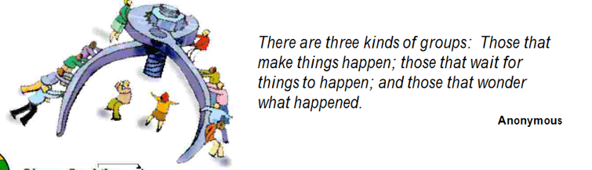
QUESTIONS
HOW/ Stepwise Process:
          Periodically review to determine progress and determine if modifications to the resource concerns, plan, or practices are required to achieve goals and determine if goals are still relevant – Adaptive Management

Slide 28
Conservation District
LWG
Resource Concerns
Conservation Needs &
Priorities
Program Funding Recommendations
Resource Needs Assessment Committee
Community leaders & stakeholders
Business/Industry/Tribes
Conservation Groups
SG LAWG
City/County, State and Federal Agencies in District
RNA Technical Team
CD, NvACD
NRCS
UNCE
BLM, USFS
DCNR, SETT, NDA, NDOW, etc.
Others?
District Conservationist
Resource Concerns Checklist & CPPE Identification
SWAPA = Resource Based Concerns & Action alternatives
STAC
Locally Led
Private, City, County
State & Federal (NCCN)
Working Landscapes
CD Resource Needs Assessment
Conservation Action Plan & Management
By Local Need and Priority
SWAPA + E + H = Resource & Program Based Actions
NRCS
USDA Conservation Program Delivery in State and District
By
Need and Priority
Collaborative Conservation

