Slide 1


Transferring Local Knowledge into Science, Management, and Sage-grouse Conservation Policy
“If it’s not good for the community its not good for wildlife “

Slide 2
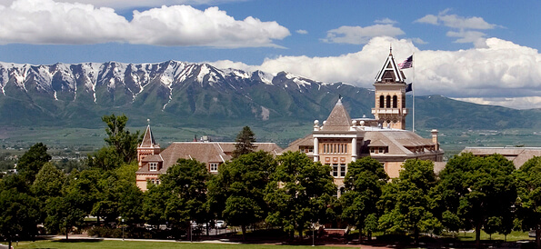

Slide 3

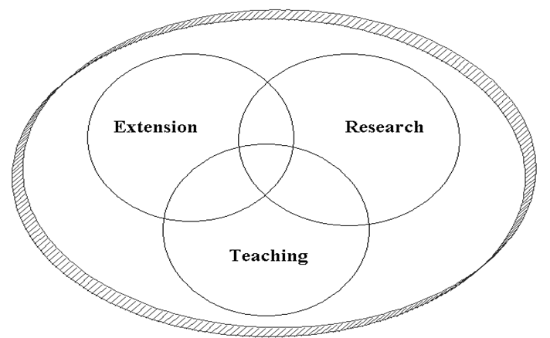

Land Grant University System

Slide 5


Slide 6
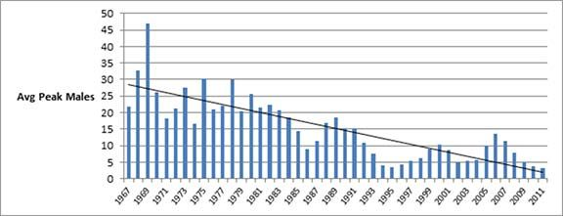
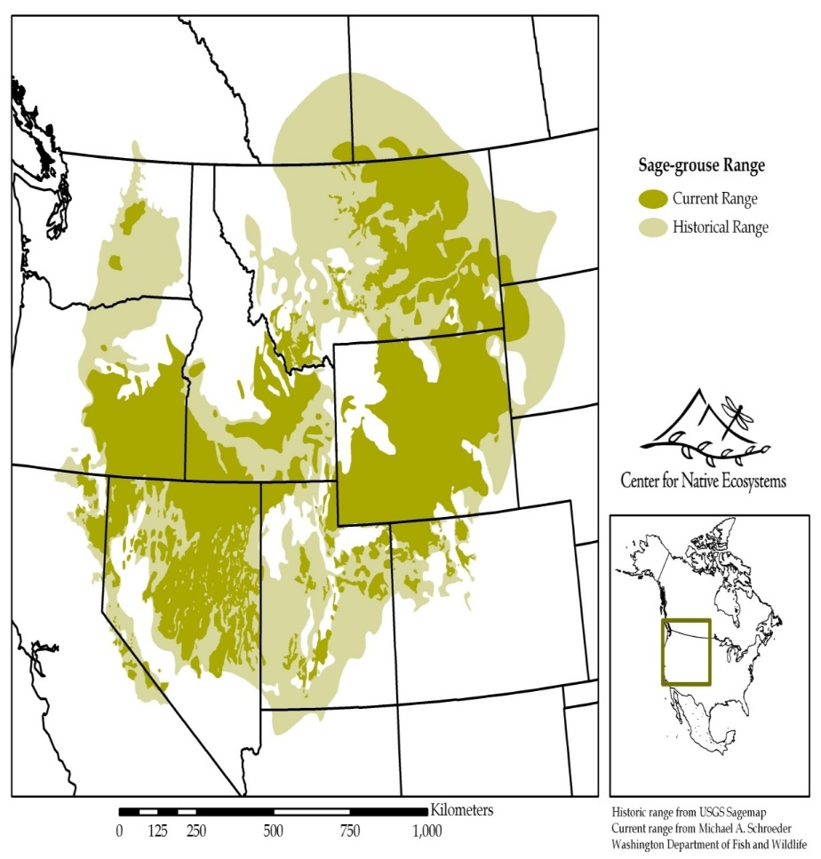
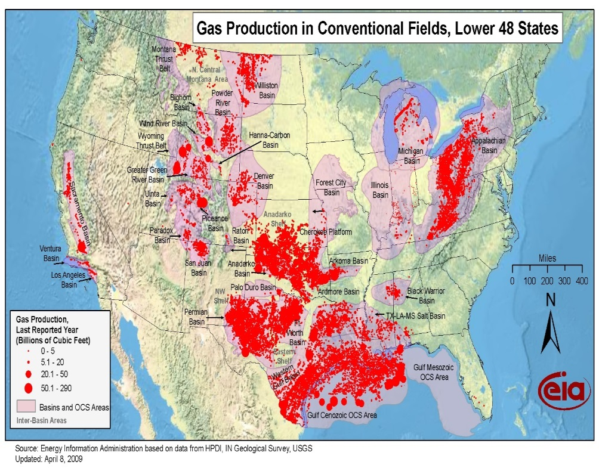
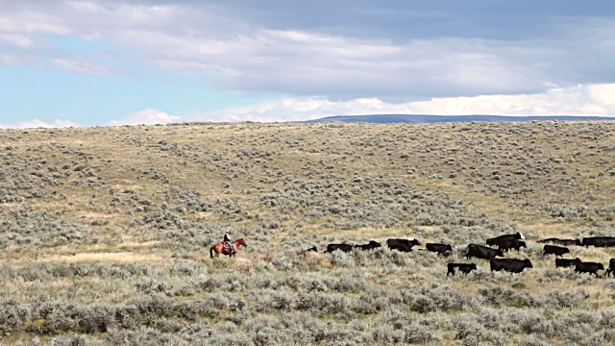
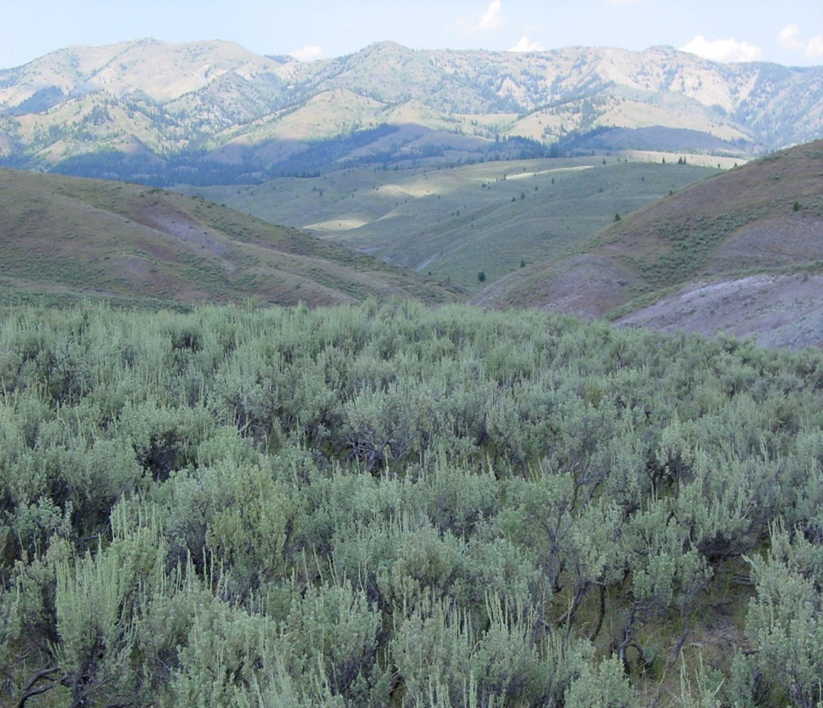
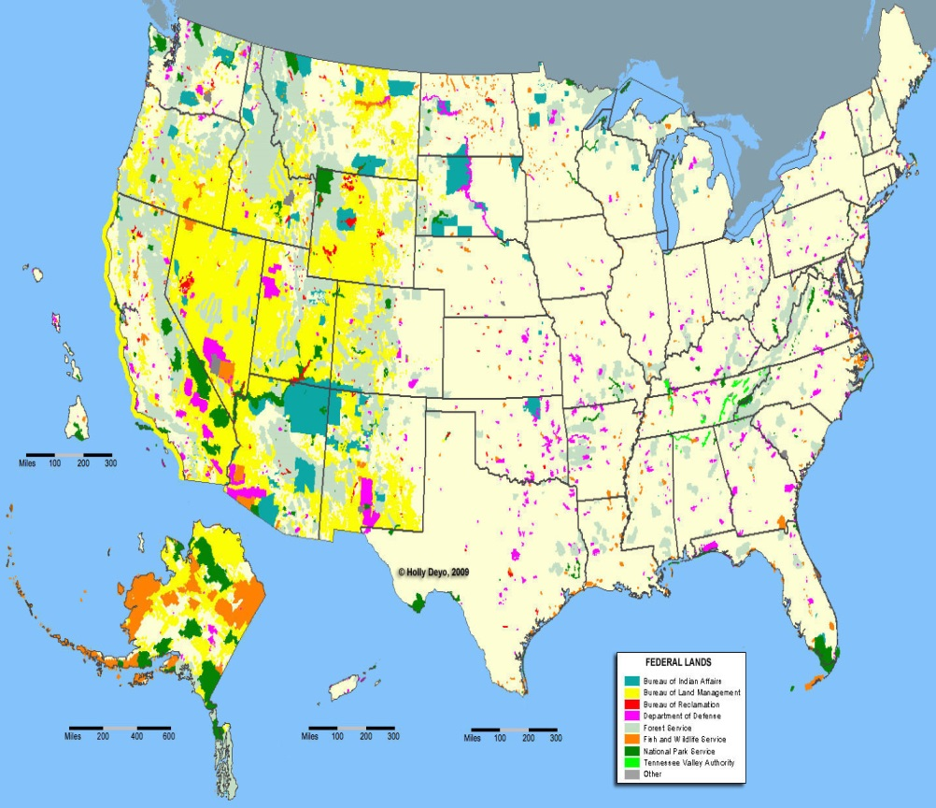
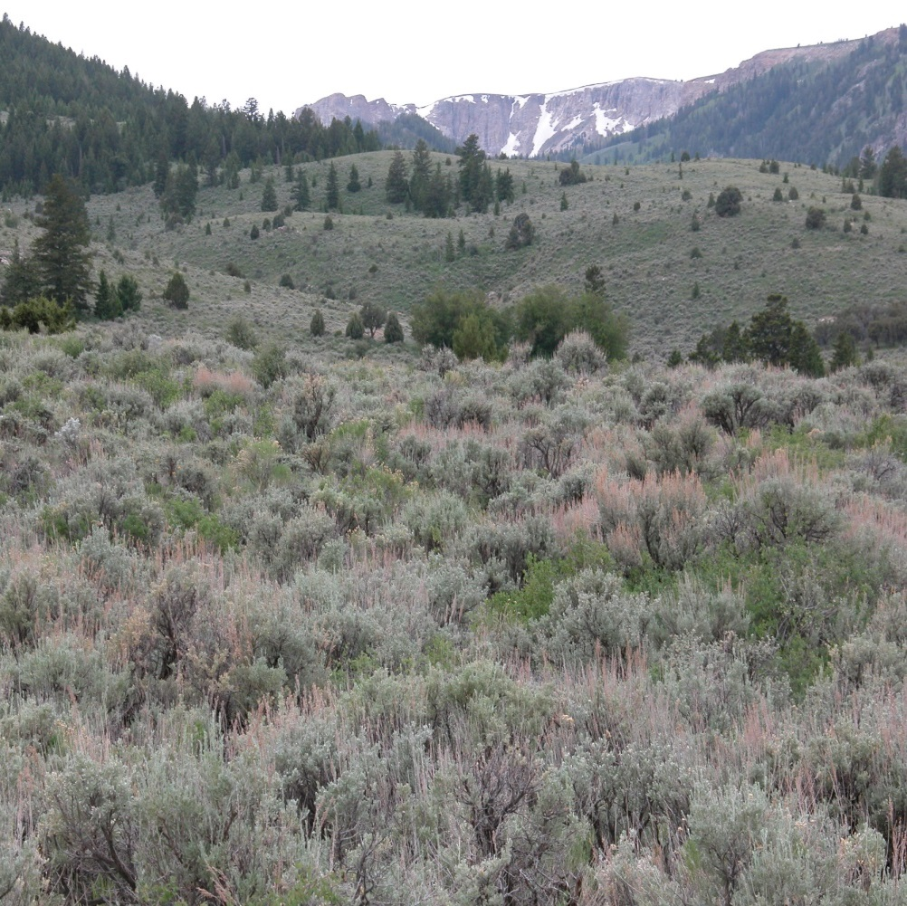
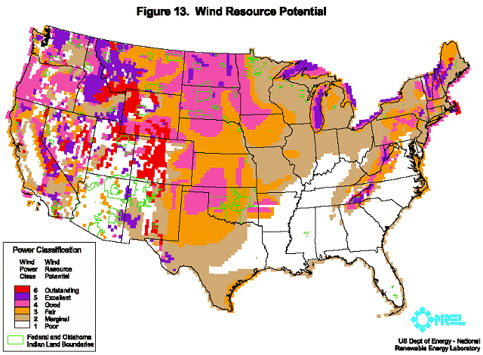
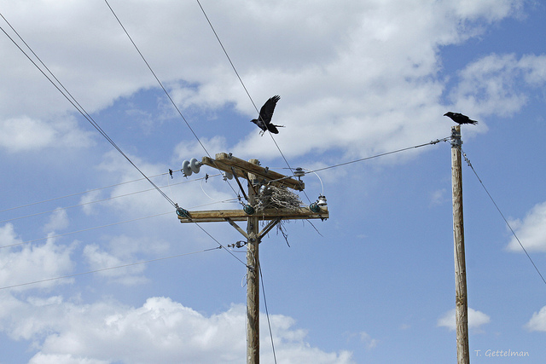
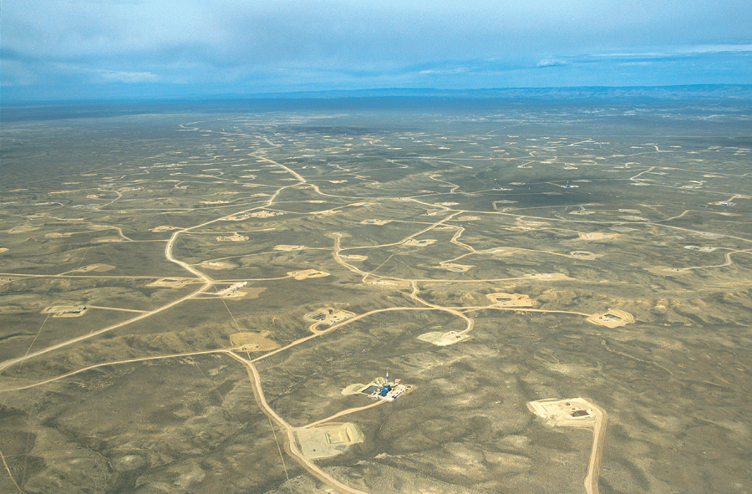
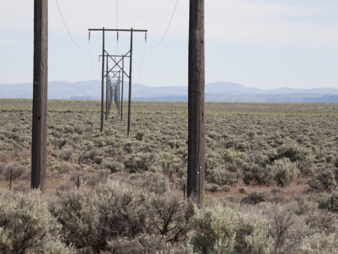
What’s the Big Deal?

Slide 7

Sage grouse “war” tests limits of partnership in West

Slide 8


Slide 9


Slide 10


Slide 11
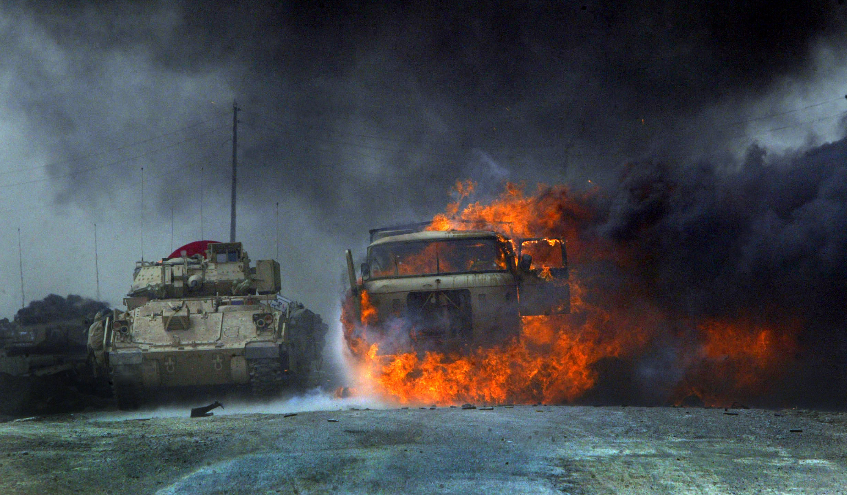

Slide 12


Slide 13

“No bastard ever won a war by dying for his country……”
“He won it by making some other poor dumb bastard die for theirs…..”

Slide 14


Slide 15
WAR ?
  “a sustained effort to deal with or end a particular unpleasant or undesirable situation or condition.”

Slide 16


Slide 17



Slide 18


Slide 19


Slide 20


Slide 21
“… each year, we discover a few more of those unknown unknowns.”
Donald Rumsfeld
Former Sec of Defense

Slide 22


Slide 23


Slide 24


Slide 25

What do – scientists - have to offer?
Best Available Science

Slide 26


Slide 27


Slide 28


Slide 29
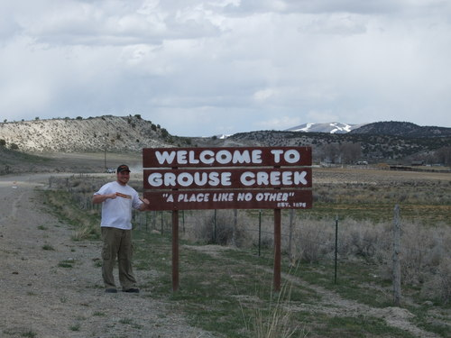

Slide 30
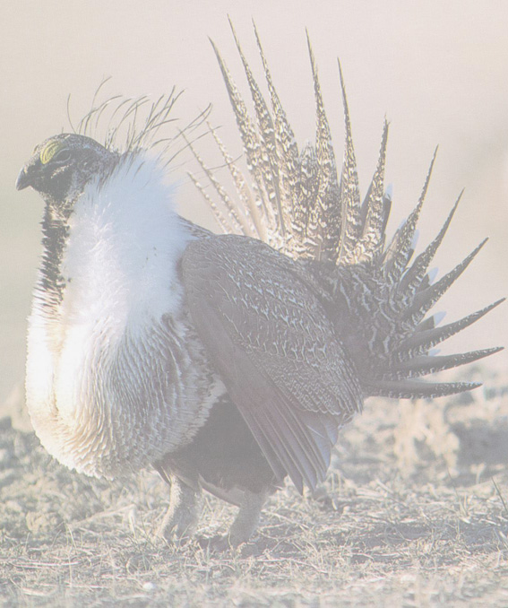
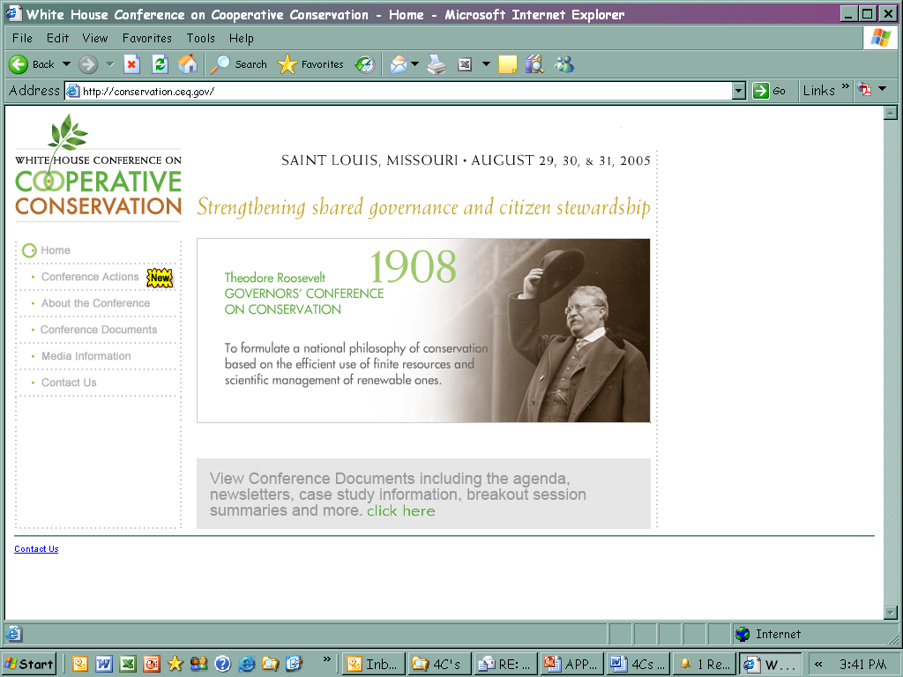
White House Conference on Cooperative Conservation

Slide 31


Slide 32


Slide 33
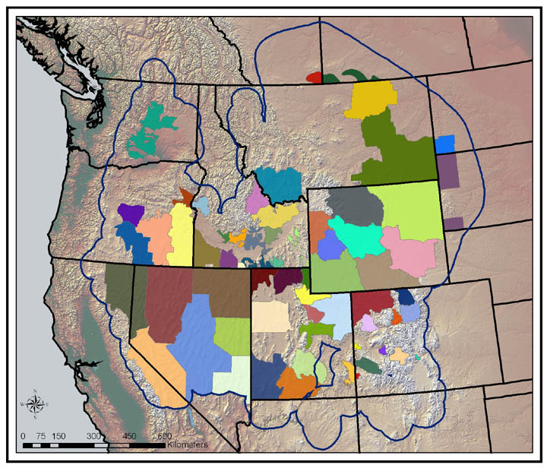

Slide 34
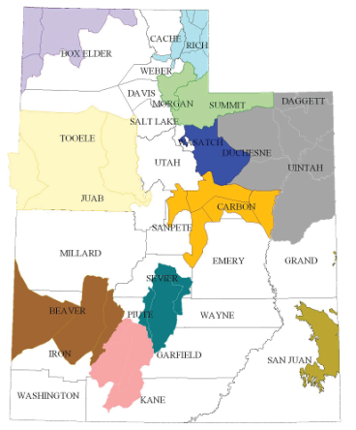
Local Working Groups: Utah CBCP

Slide 35
Objective #1 - Population
Sustain an average male lek count of 4100 males in the Sage-grouse Management Areas, and increase the population of males to an average of 5000.
Notes:
Weather/climate = influences range of variability,
Management = great impact on the overall trend

Slide 36


Slide 37
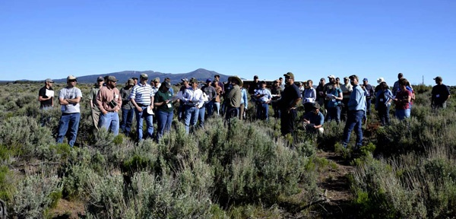
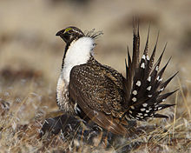

Slide 38


Slide 39


Slide 40
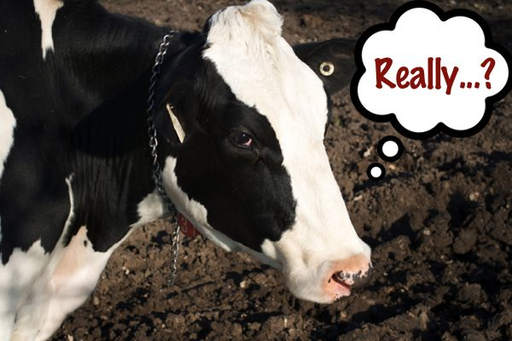

Slide 41
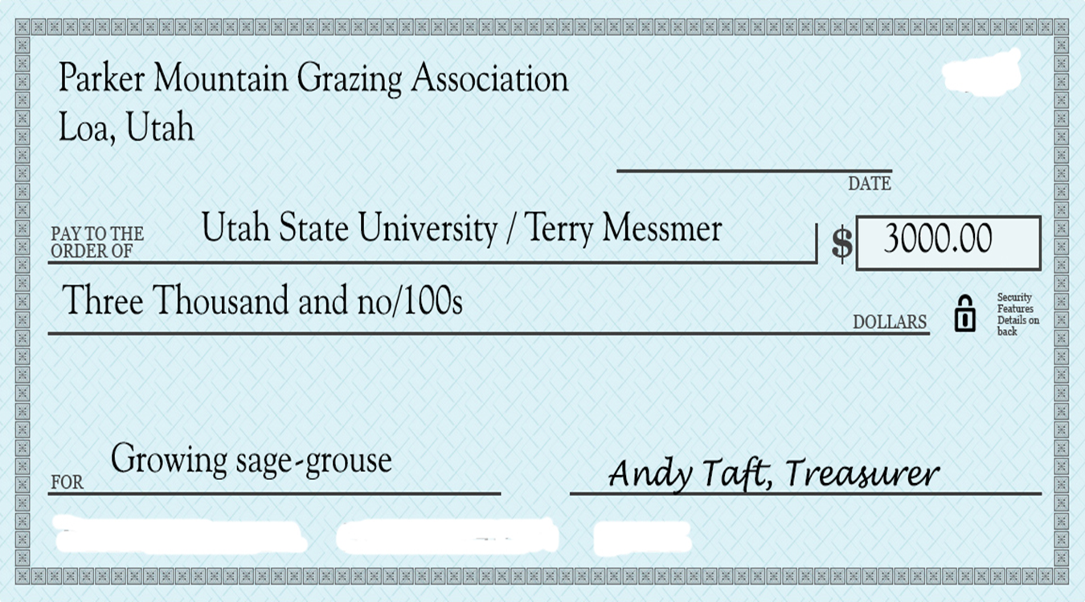
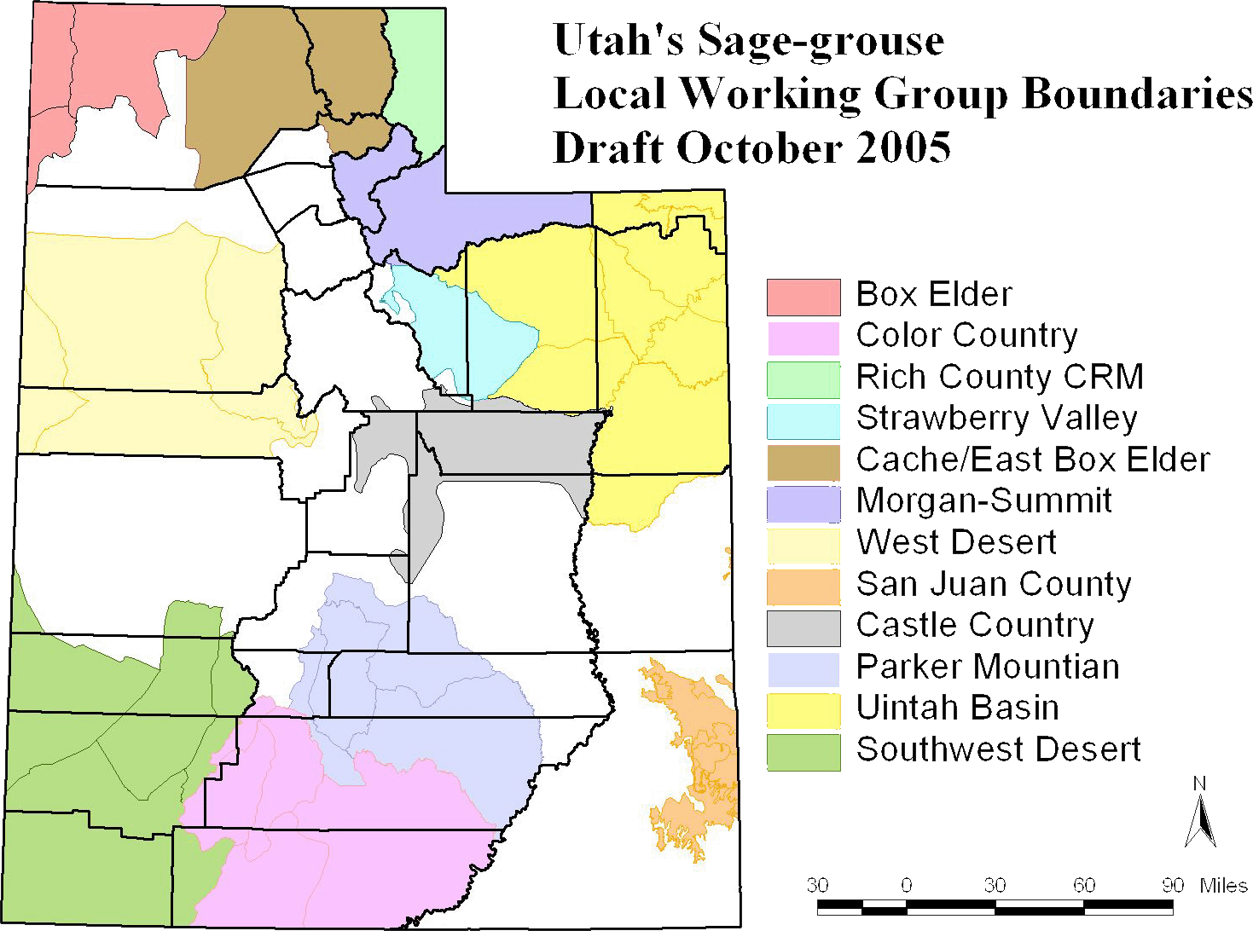
Learning together while managing landscapes

Slide 42
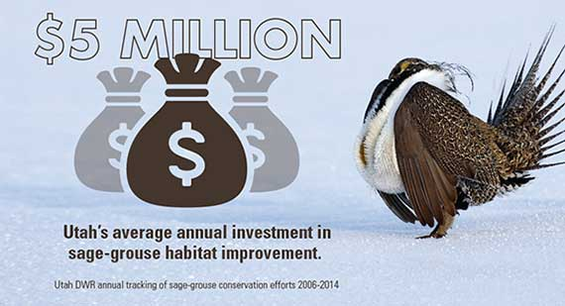
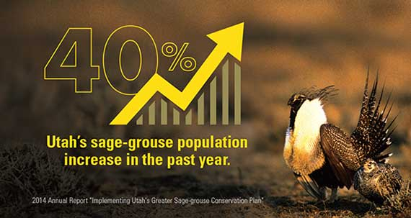
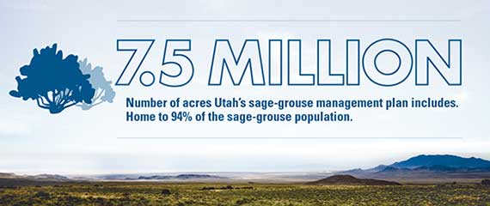
State conservation planS
Utah Sage-grouse Conservation Strategy

Slide 43


Slide 46

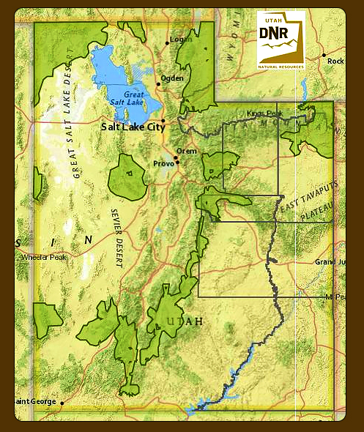
Utah’s Conservation Approach
Conservation Plan for Greater Sage-Grouse in Utah, Feb 2013
Not Lek Centric – But Seasonal Habitat Based
Population Metrics: Lek Counts monitor success
Habitat Metrics – Increase Usable Space
Disturbance Caps
Mitigation Measures
Best Available Science
Governor’s Executive Order

Slide 47
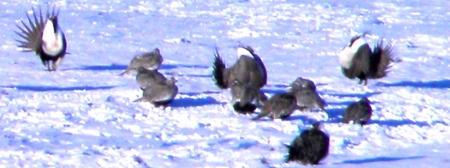
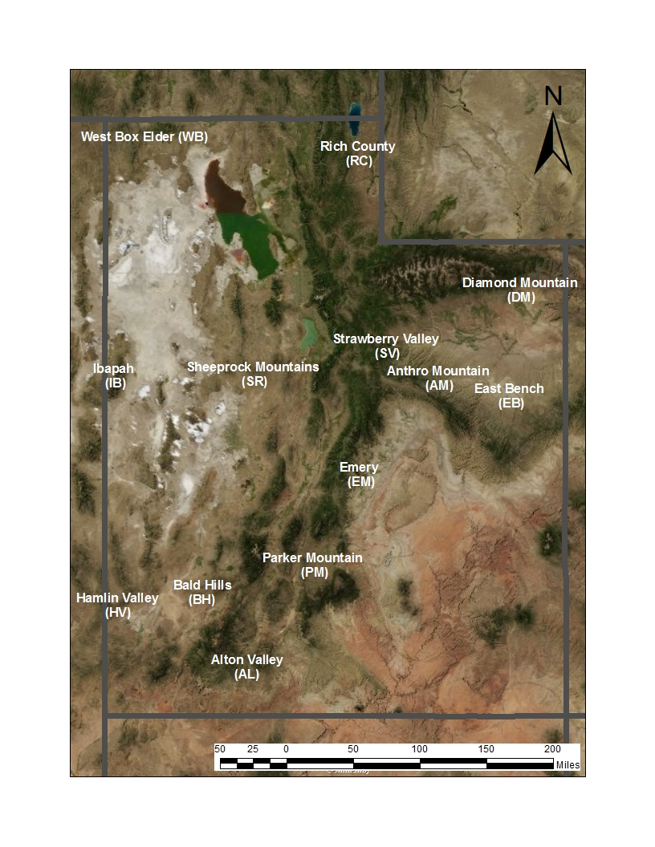
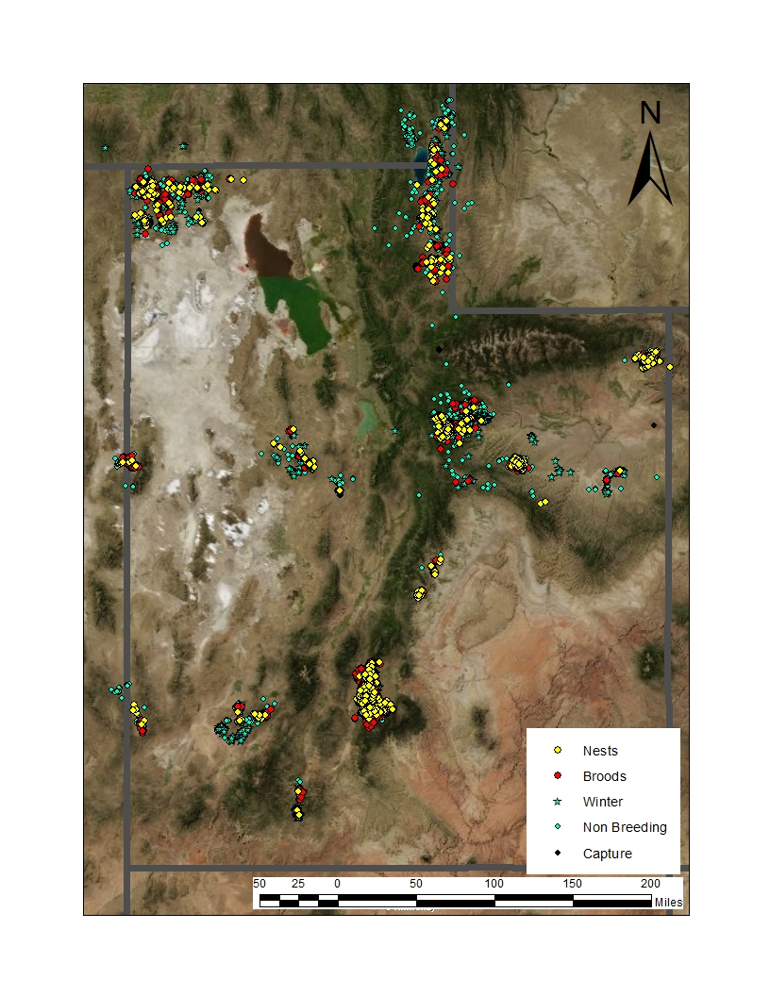
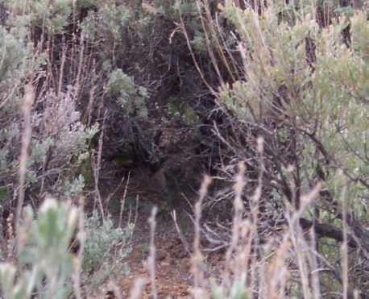
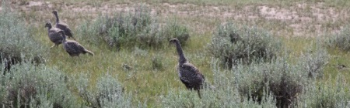
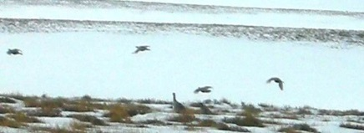
Sage-Grouse Research in Utah

Slide 48

Seasonal Movements
-Lek to Nest = 5 Km or 3 miles
-Lek to Brood = 8 km or 5 miles
-Lek to Winter = Variable
-SGMAs = >95% of weighted Locations
Lek to Nest Nest to Summer Summer to Winter
Lek to Brood Nest to Winter
Lek to Winter
1) Broods move farther from Nests in Large Populations
2) Winter Movements Farther from Lek for Small Isolated/Fragmented Populations
**Usable Space – PJ Treatments**

Slide 49
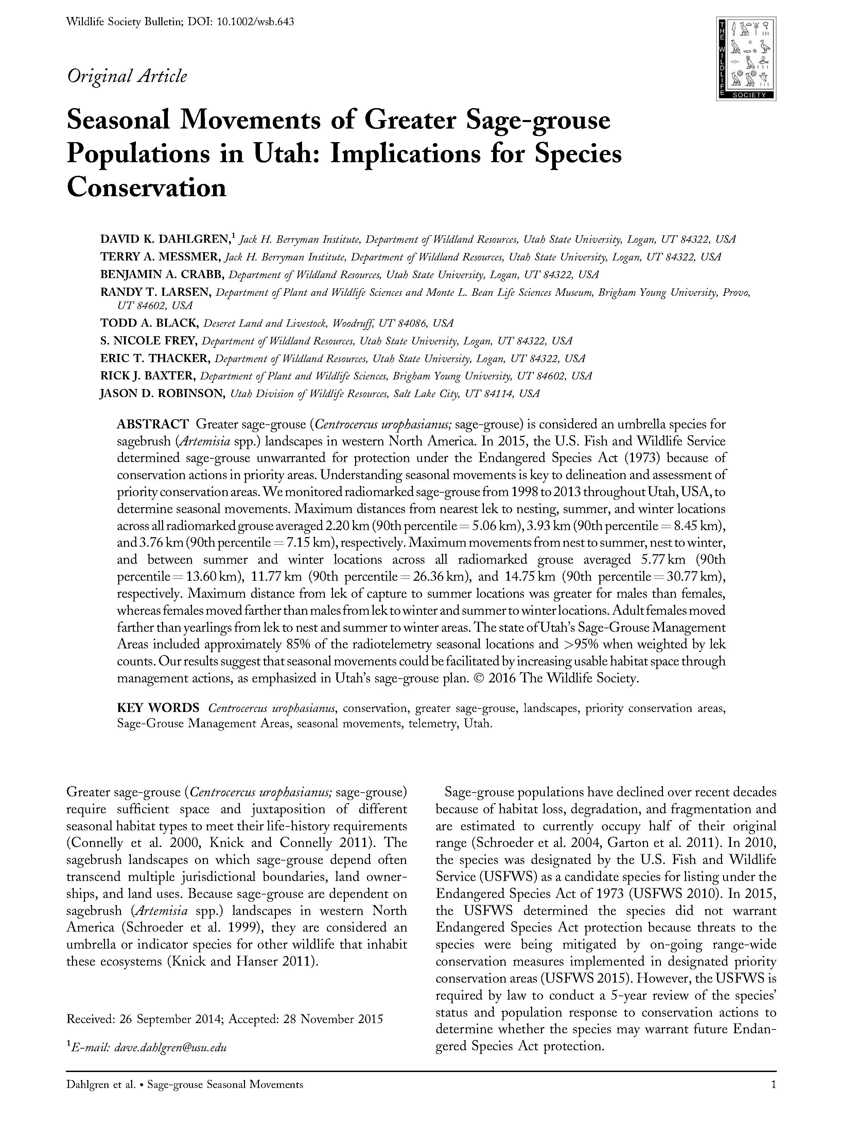
Our results offer a framework to provide more certainty to sage-grouse management decision-making in Utah and other areas with isolated or fragmented habitats.
Our reported seasonal movements indicate augmented usable habitat space could be readily occupied by sage-grouse with potential benefits to population growth.
Concomitantly, the Utah Plan has placed an emphasis on increasing the useable habitat space for Utah’s sage-grouse populations.

Slide 50
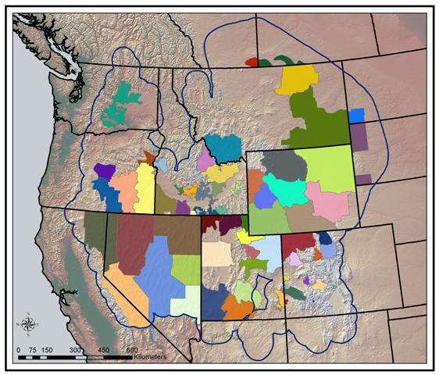
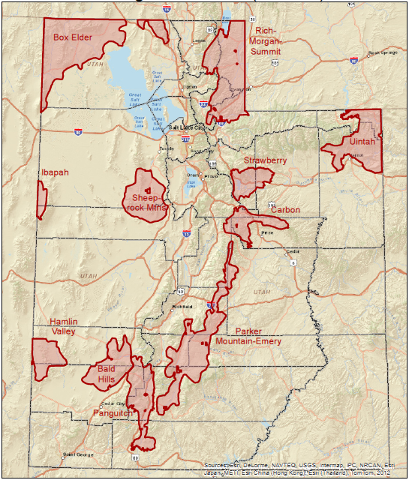
Local Working Groups: Utah CBCP

Slide 51
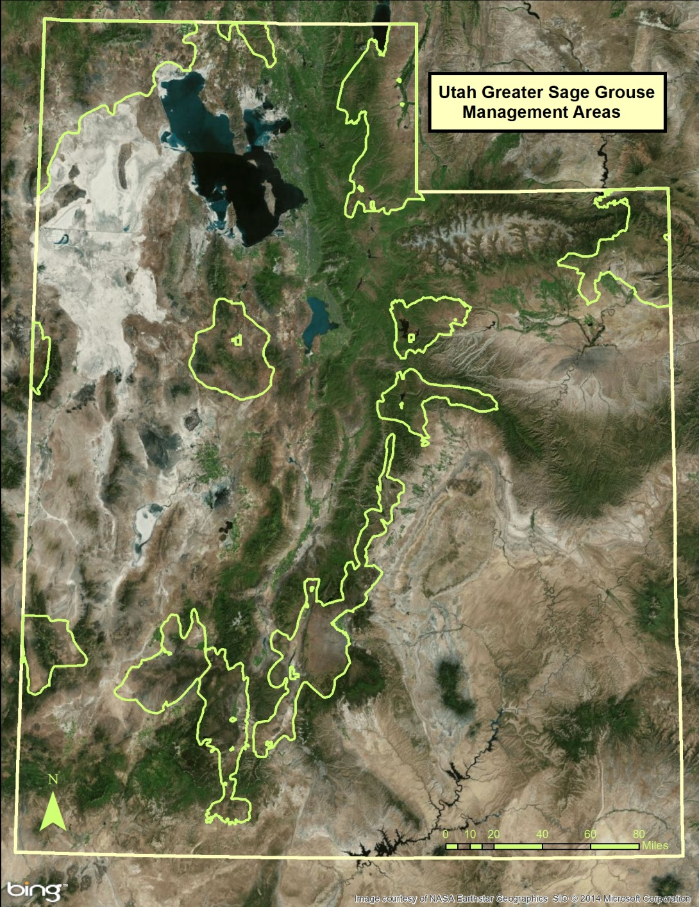
Utah Sage-Grouse Management Areas
7,439,331 Total Acres

Slide 52
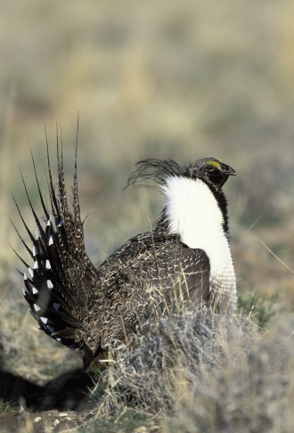
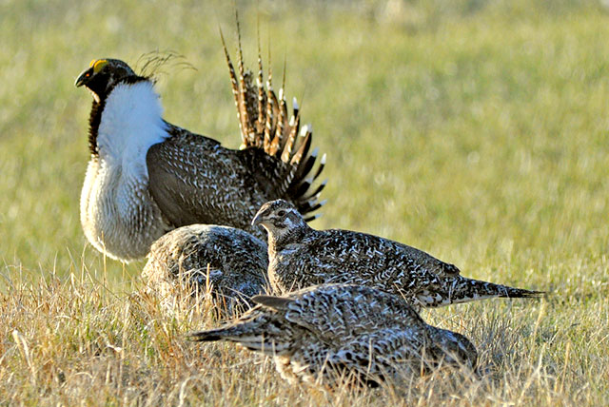
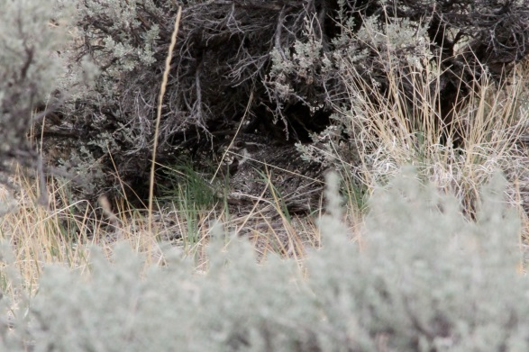
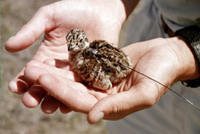
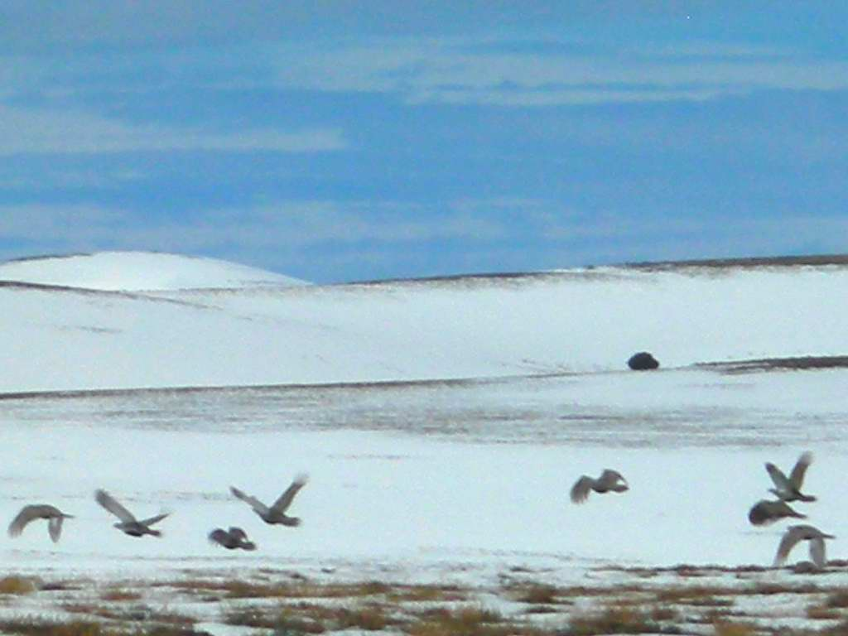

General Sage-Grouse Biology and Habitat

Slide 53
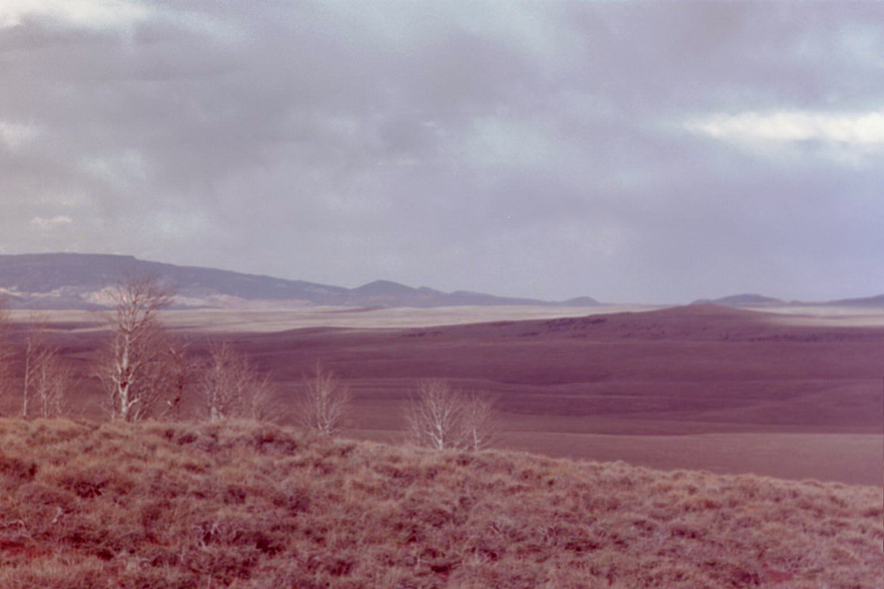
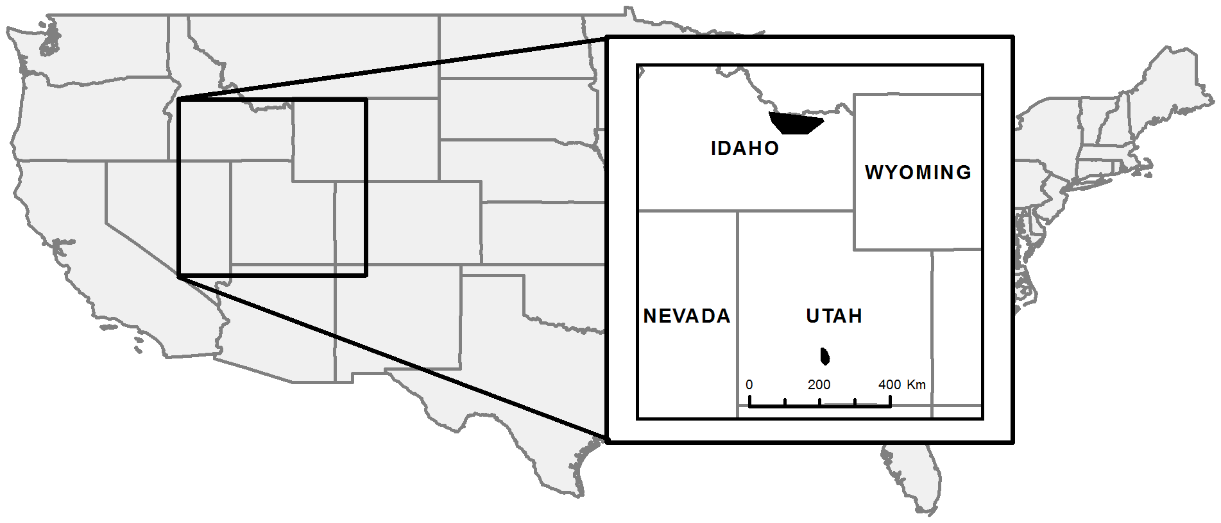
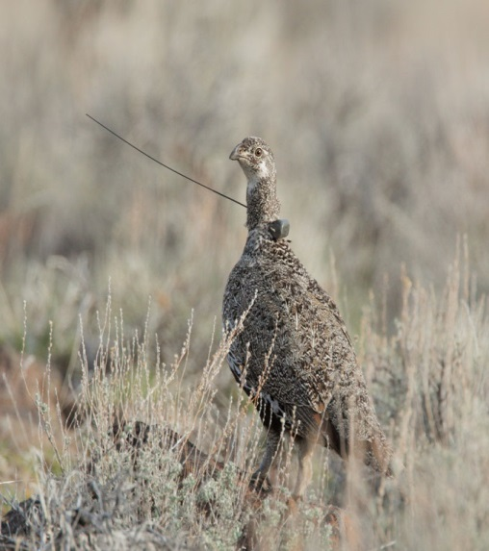
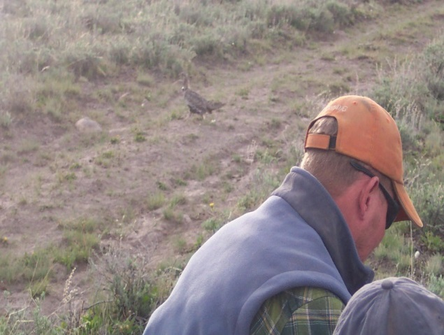
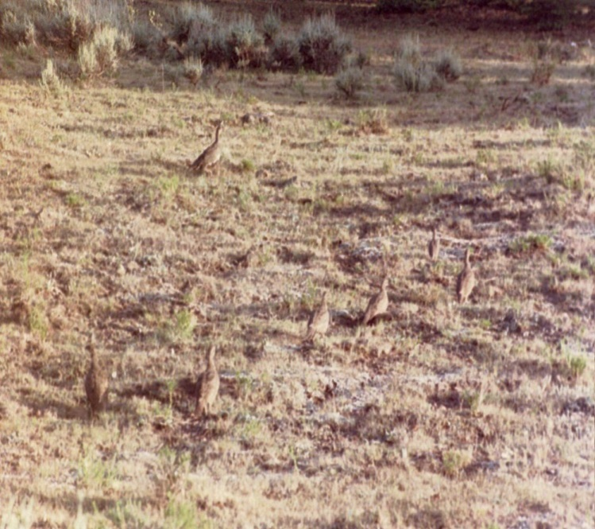
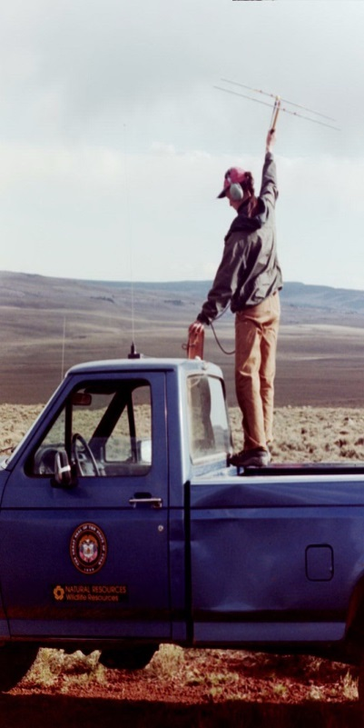
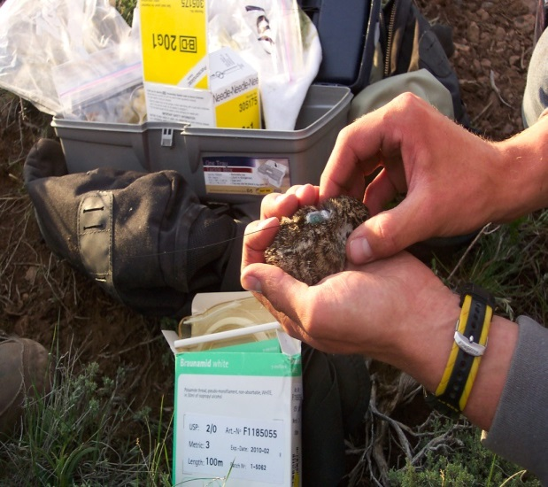

Parker Mtn.: Chick Survival
Grazing!!!!!

Slide 54


Parker Mtn.: Sagebrush Management

Slide 55







Parker Mtn. Population Model
SY
ASY
λ = 0.97 (SE = 0.025)
Take Home – !!!!!!STABLE!!!!!
Post-Fledgling Survival
(Juvenile- Hatch year Sept-March)
(Yearling-Second Year)
(Adult-After Second Year)

Slide 56

Overall, our results provide evidence that:
1) telemetry-based studies can provide unbiased demographic information for analysis and monitoring, and
2) male-based lek counts of sage-grouse can be an effective index to overall population change.
Lek counts can be used to document the effect of management actions on population growth. This publication further validates using lek count objectives to measure population response to management.

Slide 57
Objective #1 - Population
Sustain an average male lek count of 4100 males in the Sage-grouse Management Areas, and increase the population of males to an average of 5000.
Notes:
Weather/climate = influences range of variability,
Management = great impact on the overall trend

Slide 58

Utah Conifer Removal Strategies

Slide 59


59,950

Slide 60




Results - Brooding
LOWER
DISTANCE
GREATER
DISTANCE
Introduction Nesting Brooding Conclusions
Notes:
Ok, I know we’re all looking first at the graphs, and then the pictures and the little cartoons below. Let me explain them in context of the graphs really quick.
The first graph is the estimate of probability of brood success as a function of selection of distance to treatment. What we see is when sage-grouse AVOID distance (as in they want to be closer to removal), their probability of brood success is high. And as they select greater distance, their probability of brood success falls.
The second graph is somewhat more intuitive – avoidance of conifer cover means seeking areas with lower conifer cover, and selection means selecting areas with higher conifer cover
What these graphs show is that as sage-grouse broods select sites with higher conifer cover, probability of success declines.
And/or as grouse select areas farther from conifer removal treatments, probability of success declines.
Both of these declines were significant at 0.05 P level. The appearance of a non-significant result for distance to treatments is a function of the response being displayed as an odds ratio, and should not be taken to mean insignificant results.
Because brood success is a function of the log-odds, it is difficult to evaluate this in terms of a measurable distance, however the more important message is that selection of sites where conifer had been removed wouldn’t be possible without removing conifers, and thus this source of increased reproductive fitness would not be available.

Slide 61


Results - Nesting
Introduction Nesting Brooding Conclusions
Notes:
This model suggested that for every 1 km a nest was located farther from conifer removal, probability of nest success declined by 9.1% (P < 0.05)
Seeing that conifer removal had such a strong effect on nest success, we performed a post hoc analysis using the other univariate model with only conifer cover class as the predictor variable for nest success. Although non-significant – it did indicate that probability of nest success declined as sage-grouse selected nest sites in areas of greater conifer canopy cover.

Slide 62

Federal Land Management (BLM & USFS) Conservation Approach
Connelly et al. 2000 Sage-Grouse Habitat Guidelines

Slide 63





Utah Sage-Grouse Habitat Characteristics
Eco-Regional Habitat Guidelines for Sage-Grouse in Utah
Eco-Region | Vegetation Type | Breeding (Nest) |  | Brood-Rearing |  | Winter
 |  | Height (cm) | Canopy (%) | Height (cm) | Canopy (%) | Height (cm) | Canopy (%)
Sagebrush Steppe | shrub/sagebrush | 30-80 | 15-30 | 30-80 | 10-25 | 25-80 | 10-30
 | grass | >18 | >15 | >18 | >10 | NA | NA
 | forb | >10 | >10 | >10 | >5 | NA | NA
Wyoming Basin | shrub/sagebrush | 25-80 | 15-35 | 25-80 | 10-25 | 25-80 | 10-30
 | grass | >10 | >10 | >10 | >10 | NA | NA
 | forb | >5 | >10 | >5 | >5 | NA | NA
High Elevation Colorado Plateau | shrub/sagebrush | 25-80 | 15-35 | 25-60 | 10-30 | 25-80 | 10-30
 | grass | >12 | >10 | >12 | >10 | NA | NA
 | forb | >8 | >5 | >8 | >5 | NA | NA
High Elevation Semi-Desert | shrub/sagebrush | 20-60 | 15-30 | 20-60 | 10-25 | 25-80 | 10-30
 | grass | >8 | >5 | >8 | >10 | NA | NA
 | forb | >5 | >3 | >5 | >5 | NA | NA
Southwest Semi-Desert | shrub/sagebrush | 30-80 | 15-30 | 30-80 | 10-25 | 25-80 | 10-30
 | grass | >18 | >10 | >18 | >8 | NA | NA
 | forb | >10 | >5 | >10 | >10 | NA | NA
Great Basin Semi-Desert* | shrub/sagebrush | 30-80 | 15-35 | 30-80 | 10-25 | 25-80 | 10-30
 | grass | >15 | >10 | >15 | >10 | NA | NA
 | forb | >8 | >5 | >8 | >5 | NA | NA
Low Elevation Uintah Basin | shrub/sagebrush | 20-60 | 15-30 | 20-60 | 10-25 | 25-80 | 10-30
 | grass | >8 | >5 | >8 | >10 | NA | NA
 | forb | >5 | >3 | >5 | >5 | NA | NA

Slide 64

Background
  BLM grazing allotments
Service Layer Credits: DoI, Bureau of Land Management

Slide 65

Background
  BLM grazing allotments and SG extent
Service Layer Credits: DoI, Bureau of Land Management

Slide 66










Grazing Management Systems
Season-long
March
April May June July
Prescribed Rotational
August

Slide 67


Grazing Management Systems
Season-long
March
April May June July
Prescribed Rotational
August

Slide 68


Study Design

Slide 69
Study Design
Three Creeks
10 BLM/USFS allotments
146,000 acres
season-long grazing
Three Creeks
Deseret Land & Livestock
private
200,000 acres
rotational grazing
Deseret L&L

Slide 70
Study Design
Three Creeks
10 BLM/USFS allotments
146,000 acres
season-long grazing
Three Creeks
Deseret Land & Livestock
private
200,000 acres
rotational grazing
Deseret L&L

Slide 73


Slide 74
Lek Counts w/ 3-Year Moving Ave.
Notes:
Rates typically ~90% or better.
DLL nest initiation slightly lower overall.

Slide 75




2012-2015
Paired study
  habitat quality, nesting success, brood survival
?
Treatment
Control

Slide 76
Mean Precipitation at Nests
Jan-Jun

Slide 77
Mean Drought Index (SPEI) at Nest Sites

Slide 78
Nest Survival

Slide 79
Vegetation Results
 |  | Deseret L&L |  |  | Three Creeks
 |  | Actual | Random |  | Actual | Random
% Cover | Sagebrush | 21.2 (±3.3) | 18.6 (±3.4) |  | 19.3 (±1.8) | 19.5 (±2.6)
 | All Shrubs | 33.9 (±5) | 28.2 (±3.5) |  | 28.8 (±2.5) | 27.3 (±3)
 | Bunchgrass | 18.7 (±4.5) | 17.6 (±3.9) |  | 20.1 (±2.6) | 22.2 . (±3.2)
 | Forb | 15.7 (±2.9) | 17.0 * (±5.7) |  | 13.1 (±2.9) | 11.5 (±2.1)
 | Litter | 74.1 (±5.4) | 70.5 (±4) |  | 70.3 (±4.2) | 69.4 (±4)
 | Bare Ground | 21.4 (±4.2) | 23.7 (±4.4) |  | 17.4 (±2.9) | 17.9 (±3.3)
Height (cm) | Sagebrush | 43.9 . (±4.2) | 38.8 (±4.4) |  | 38.6 (±2.9) | 35.5 (±3.3)
 | Bunchgrass | 16.5 * (±1.9) | 14.0 * (±1.4) |  | 12.9 (±1.1) | 12.5 (±1)
 | Forb | 7.4 . (±1.4) | 5.7 (±0.6) |  | 6.2 (±0.6) | 5.2 (±0.5)
Signif. Codes ‘*’ .05 ‘.’ 0.1

Slide 80
Vegetation Results
 |  | Deseret L&L |  |  | Three Creeks
 |  | Actual | Random |  | Actual | Random
% Cover | Sagebrush | 21.2 (±3.3) | 18.6 (±3.4) |  | 19.3 (±1.8) | 19.5 (±2.6)
 | All Shrubs | 33.9 (±5) | 28.2 (±3.5) |  | 28.8 (±2.5) | 27.3 (±3)
 | Bunchgrass | 18.7 (±4.5) | 17.6 (±3.9) |  | 20.1 (±2.6) | 22.2 . (±3.2)
 | Forb | 15.7 (±2.9) | 17.0 * (±5.7) |  | 13.1 (±2.9) | 11.5 (±2.1)
 | Litter | 74.1 (±5.4) | 70.5 (±4) |  | 70.3 (±4.2) | 69.4 (±4)
 | Bare Ground | 21.4 (±4.2) | 23.7 (±4.4) |  | 17.4 (±2.9) | 17.9 (±3.3)
Height (cm) | Sagebrush | 43.9 . (±4.2) | 38.8 (±4.4) |  | 38.6 (±2.9) | 35.5 (±3.3)
 | Bunchgrass | 16.5 * (±1.9) | 14.0 * (±1.4) |  | 12.9 (±1.1) | 12.5 (±1)
 | Forb | 7.4 . (±1.4) | 5.7 (±0.6) |  | 6.2 (±0.6) | 5.2 (±0.5)
Signif. Codes ‘*’ .05 ‘.’ 0.1

Slide 81

Best Model

Slide 82
Federal Land Management (BLM & USFS) Conservation Approach
Regulatory Certainty!!!!
Connelly et al. 2000 Sage-Grouse Habitat Guidelines

Slide 83




GPS PTT vs. VHF Radios

Slide 84

Refining the HAF
Address 3rd and 4th Order Statewide
Reducing Assumptions: Seasonal Use Patterns, Home Ranges, Migratory and Dispersal Movements, Fitness
Grouping Leks and movements (Variable – Park Valley vs. Dry Basin)
Including Infrastructure in above
Barriers that compromise sage-grouse movements between habitat patches can be identified and addressed
  Conifer Band (the big squeeze!)
Analysis of Usable Space (Critical to the 3rd Order)
  We are showing unsuitable habitat being changed to suitable!!!

Slide 85
HAF 3rd and 4th Order
Seasonal Habitats (3rd Order)
Habitat Structure (4th Order)

Slide 86

HAF 3rd and 4th Order
Seasonal Habitats (3rd Order)
Habitat Structure (4th Order)

Slide 87

Box Elder
SGMA

Slide 88

Brood RSF Model Box Elder SGMA

Slide 89


Slide 90



Slide 91


SUMMARY
What are the effects of management?

Slide 92















Thank You!
Rich County Commission

