Slide 1
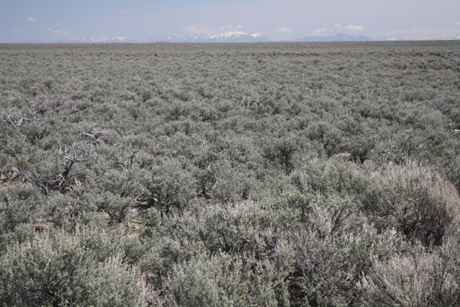





Slide 2
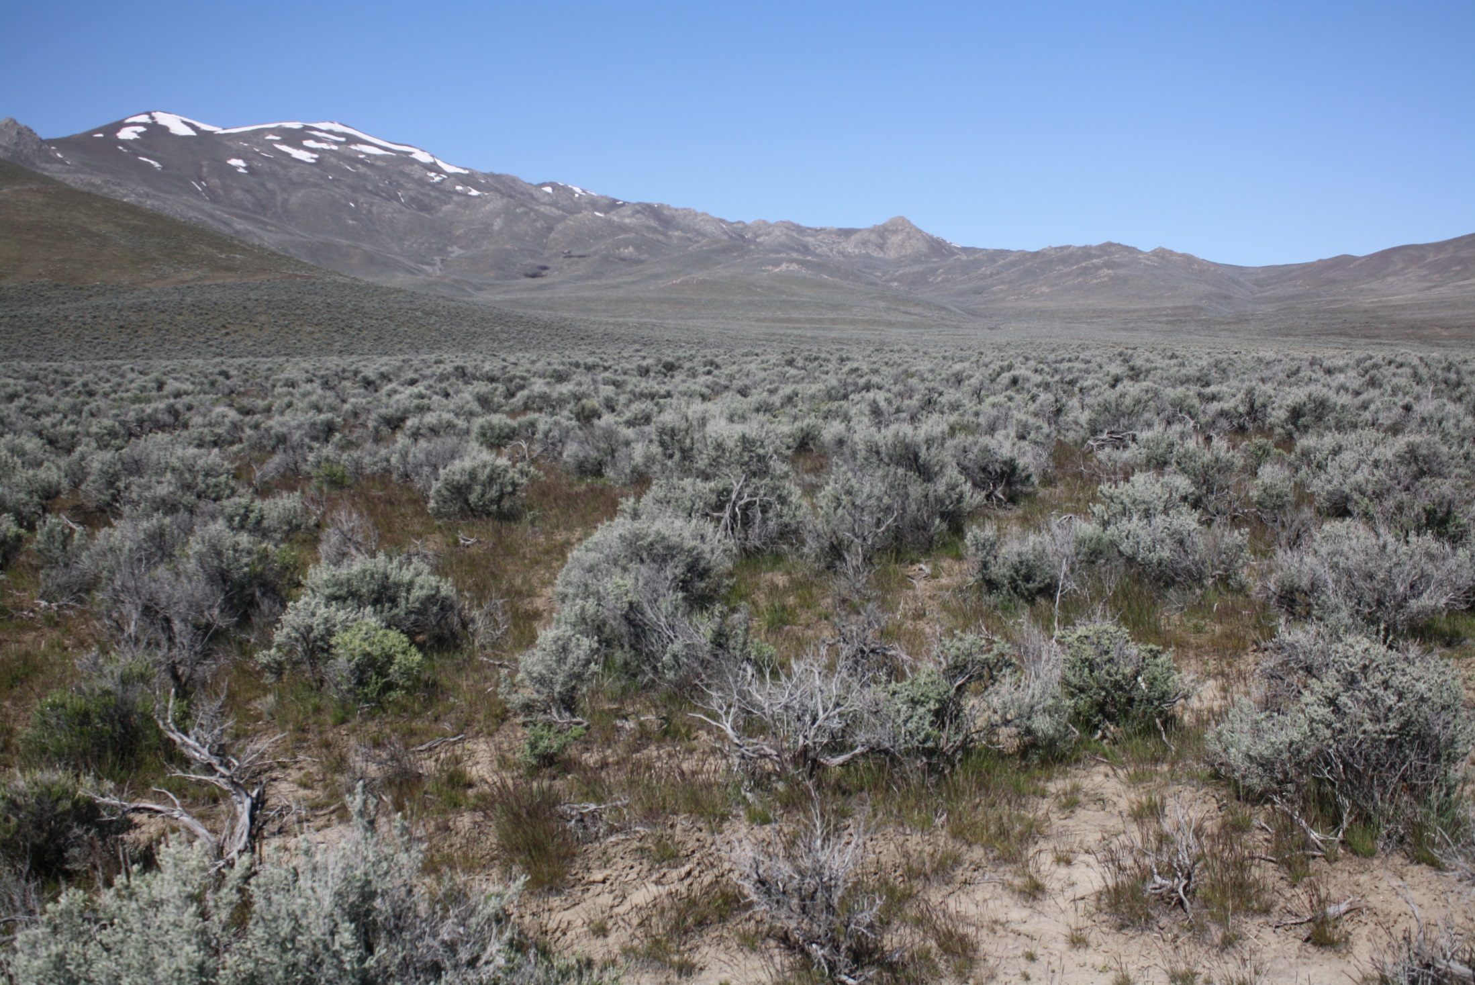
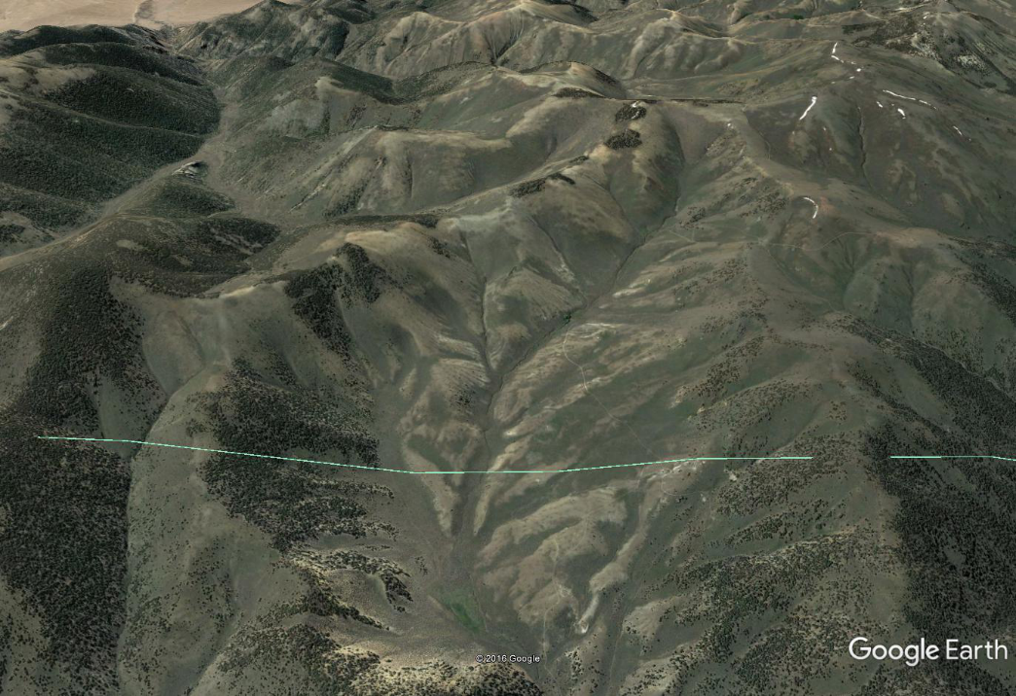
An Emphasis on “Quality Sagebrush Habitat” Can Miss the Bigger Picture
Santa Rosas
What does “Quality Sagebrush Habitat mean? A nebulous undefined term
Topographic and climatic influences at large spatial and temporal scales important
Critical elements within sagebrush landscapes
Spatial distribution of important habitat elements
Change focus to “quality SG landscapes” and the elements that create a quality landscape
Shoshone Range

Slide 3
Quality Sagebrush Habitat
Summary of Table 2-2
Upland Brood Rearing Habitat
10 to 25% Sagebrush Cover
> 15% PG and Forb Cover
≥ 5% PF cover in arid and >15% PF cover in mesic sagebrush
Riparian/Meadow Habitats
PFC
Preferred forbs are common, diverse and high species richness
Winter
≥ 10% sagebrush cover above snow depth
> 9.8 inches of sagebrush height above snow depth
General/Landscape Level
65% Landscape in sagebrush cover (nesting)
> 85% of land areas with sagebrush cover (winter)
Lek
Has adjacent sagebrush cover
Nesting
≥ 20% Sagebrush cover
≥ 30% Total shrub cover
≥ 10% Residual and live PG if shrub cover < 25%

Slide 4
What Table 2-2 Does Not Tell Us
Little about sage-grouse biology
  Always must be considered in the context of habitat availability and structure
Especially during the critical period from nest initiation through early and late brood rearing. Some important considerations:
Breeding typically occurs from mid to late March through early April
Nest sites typically selected 1-2 weeks before breeding
Laying/Incubation begins about 3 weeks after conception
Peak hatch is 6-7 weeks after conception (mid to early June, re-nests often later)
Forbs are a known dietary necessity for hens from pre-incubation (egg formation) through early brood rearing, and as chicks age (late brood rearing
Forbs likely increase insect abundance and diversity- critical to chicks the first 2-4 weeks of life

Slide 5
What Table 2-2 Does Not
Tell Us
Absolutely nothing about the relative abundance of the different habitat elements, the specific types of those elements, how they are arranged in space, and their availability at critical times of the year
How may these be important?

Slide 6
Are Desired Cover Values Realistic for Most Locations
101 WBSG Communities located away from water/livestock attractants and unburned > 50 years

Slide 7
Sagebrush Canopy Cover
Median = 11.9%
Similar to values reported in other studies in Eastern Oregon, Nevada and Utah
From: Davies et al. 2006

Slide 8
Tall Forb Cover
Perennial forb cover – median of 3.6%, with a maximum of 11.9%
TFC cover averaged 1.9%
From: Davies et al, 2006

Slide 9
Herbaceous Composition in Mountain and Wyoming BSB
SE Oregon
53 sites each of Mountain and Wyoming Big Sagebrush
MBSG mean cover of 23.0%: range of 9 to 42%
WBSB mean cover of 9.7 %, with range of 4 to 20%
Conclusion:
Many WBSB sites lack the intrinsic potential to meet the cover values in Table 2-2
Davies and Bates (2010)

Slide 10
Other Important Landscape Level Characteristics – Lek Locations
Community Type Percent
Big Sagebrush shrub-land 30
Big Sagebrush shrub-steppe 20
Low Sagebrush 20
Mountain Sagebrush 9**
All Sagebrush 79
Riparian 2
Topography and Climate
Slope 3.1 %ª
Terrain Ruggedness Index 1.0
Precipitation (mean) 13.1 inches
From: Knick et al. 2013
ª Baxter et al. (2017) found strong selection by broods for slope < 20%
Gibson et al. (2016) had about 90% or more of nests on slopes < 20%, and well over 50% on < 10% slope
Suggests architecture (structure) of the landscape has more overall importance than the specific “quality” of individual components. Individual components matter, but exceptional quality for one component can’t mitigate absence (or nearly so) of another.

Slide 11
How Does Topography Relate to Sage-Grouse Density
Topographic Population
PMU MLRA Classification Estimate Acres in PMU Acres/Bird
Lone Willow MHP 1 (n=5) 9,200 476,533 52
Islands OHP 1 3,127 270,163 86
Sheldon MHP 3 (n=2) 3,186 476,850 150
O’Neil Basin OHP 1 5,863 1,014,660 173
Gollaher OHP 1 4,852 912,217 184
Black Rock MHP 4 (n=9) 1,100 223,177 203
North Fork OHP 4 7,762 1,731,231 223
Santa Rosa OHP 4 4,196 938,793 224
Vya MHP 1 2,199 501,230 228
Snake OHP 4 2,336 538,120 230
Reese River CNBR 2 (n=32) 5,135 1,348,382 263
Massacre MHP 3 4,242 1,135,260 268
Diamond CNBR 2 3,125 841,396 269
South Fork OHP 2 3,277 1,369,936 418
Desotoya CNBR 2 858 512,000 597
Sonoma HUMBT 2 587 541,596 923

Slide 12
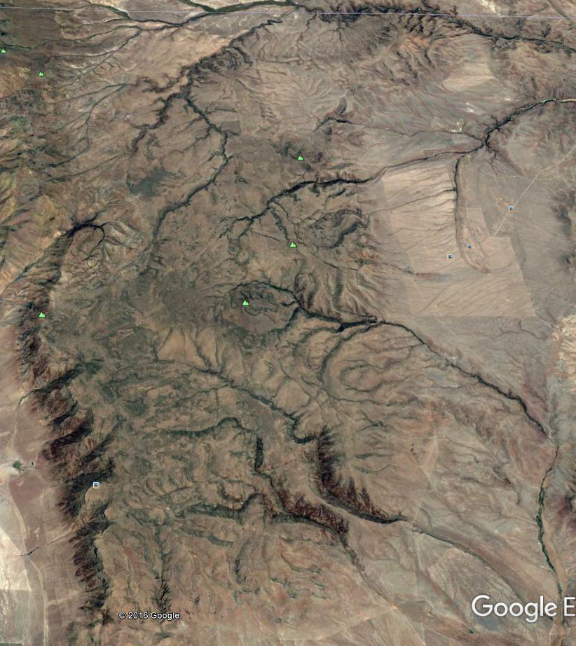
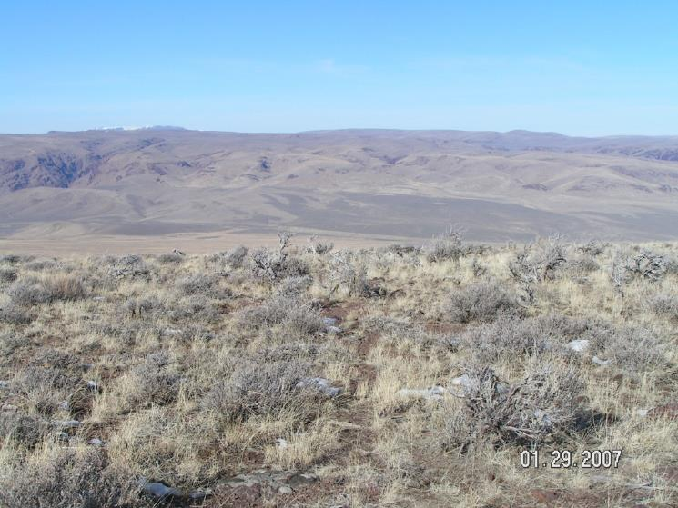
Montana Mountains
What Can We Learn by Comparison
Relatively long in the N-S
Broader than most in the E-W
Nearly flat top, but a gentle rolling micro-topography

Slide 13
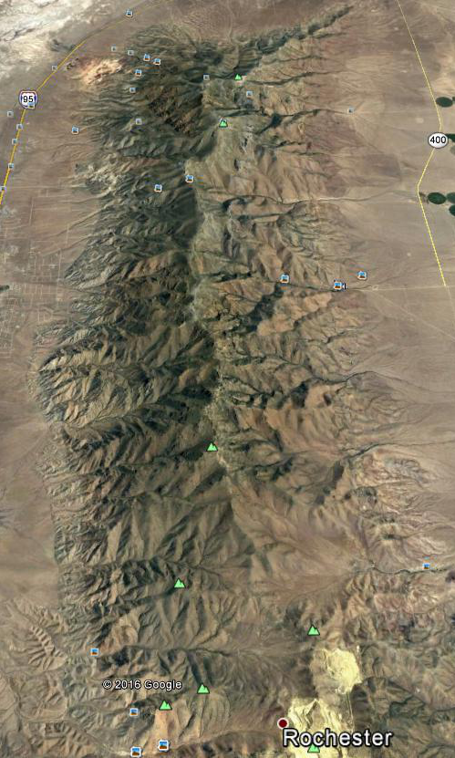
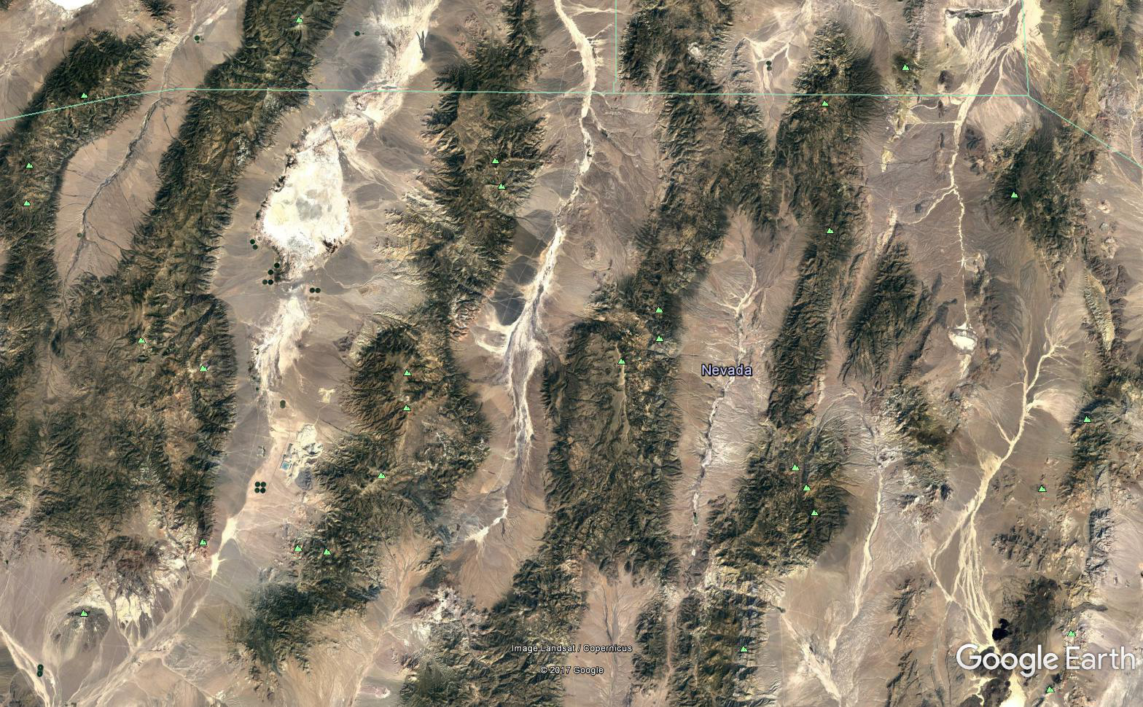
Classic Basin and Range – Tall (usually) Steep, and Deep canyons
Central Nevada Ranges
Humboldt

Slide 14
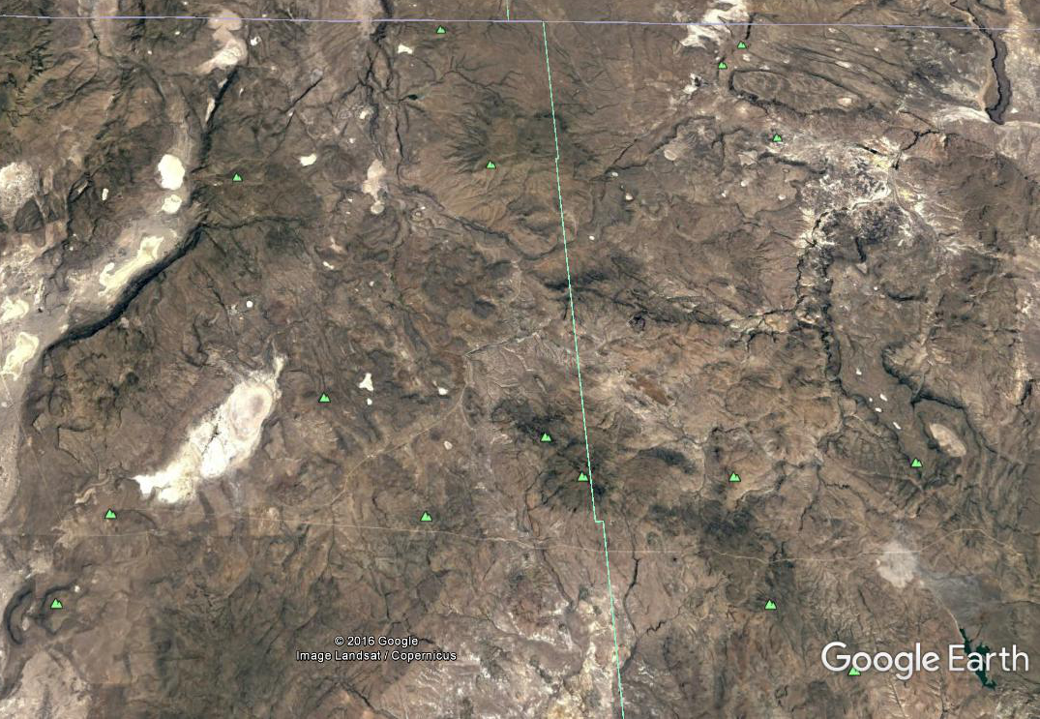
Sheldon– Largely Plateaus and Mesas – Shallow Dissection

Slide 15
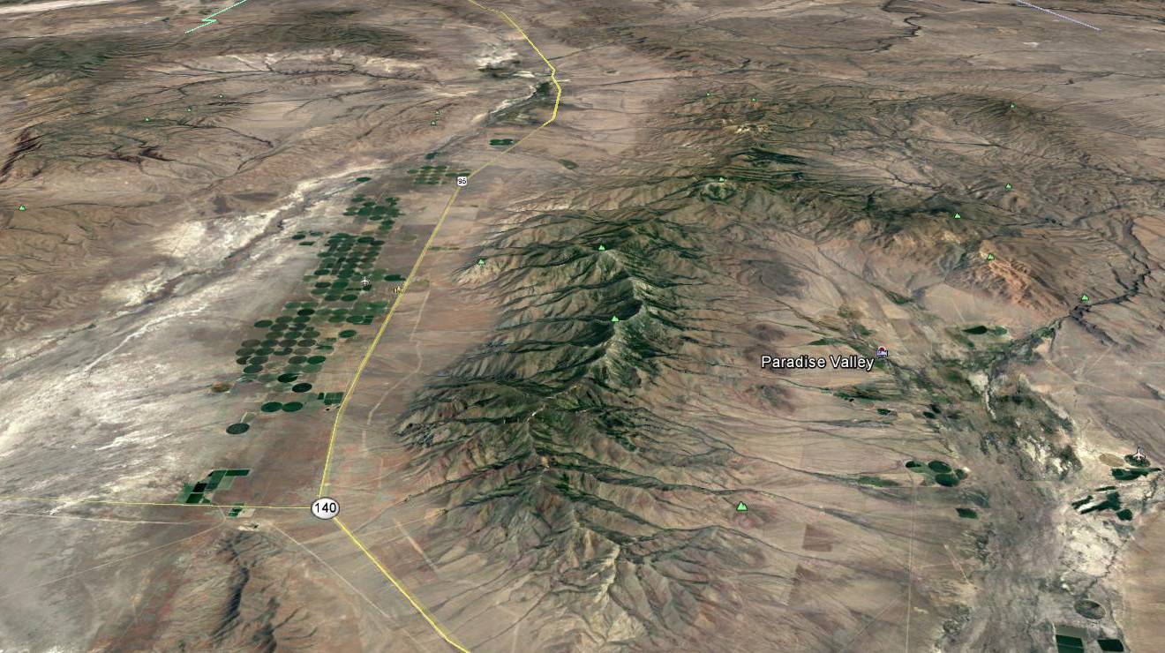
Santa Rosa PMU
A Combination of Landforms
Focus here

Slide 16
Snow Depth and Melt Out Influence Availability of Nesting Habitat
Fifty percent of the time, the Central Nevada Basin and Range (CNBR) MLRA generally has a shallow snow depth, or no snow at elevations below 7,400 to 7,600 ft, and deep snow depth above 7,800 ft.
Fifty percent of the time, the Malhuer High Plateau (MHP) generally has a shallow snow depth or no snow cover below 6,400 to 6,600 ft elevation.
Fifty percent of the time, the Owyhee High Plateau (OHP) has substantially shallower snow depth below about 6,500 ft., than above 6,500 ft.
South facing slopes at all elevations open up much earlier than north facing slopes

Slide 17
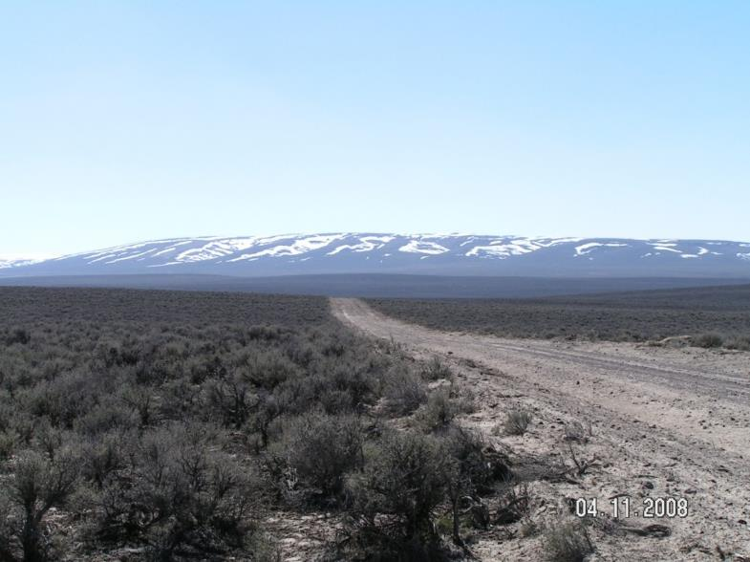
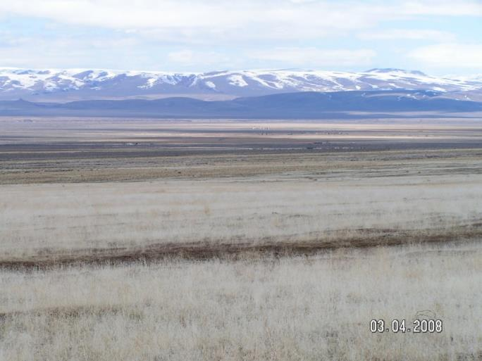
Montana Mountains Snow Accumulation and Melt Patterns
How much of the open area is generally < 20% slope?
Where will forbs be in April and early May, and late May and June?
What is the travel distance between the north and south slopes? Think predation risks.
What is common in the bottom of the gentle drainages? It’s about meadow type and density.

Slide 18
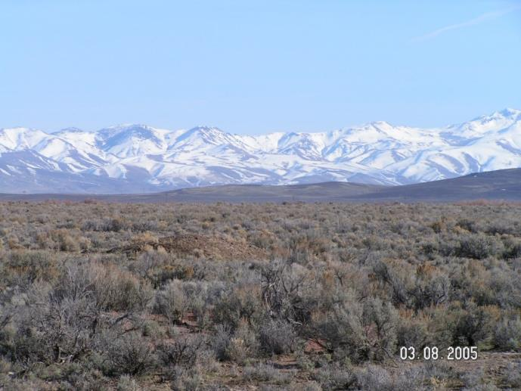
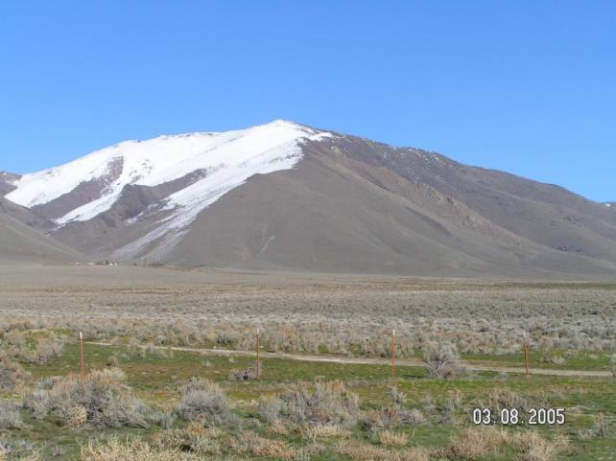
Classic Basin and Range Snow Accumulation and Melt
Where will forbs be in April and early May, and late May and June?
What types of riparian areas are common in the bottom of the deep drainages?
Without meadows on the arid fans how important is sagebrush habitat quality here?
From the Montana’s at
about 6,400 ft
What is the travel distance between the north and south slopes? Think predation risks.
How much of the open area is generally < 20% slope?

Slide 19
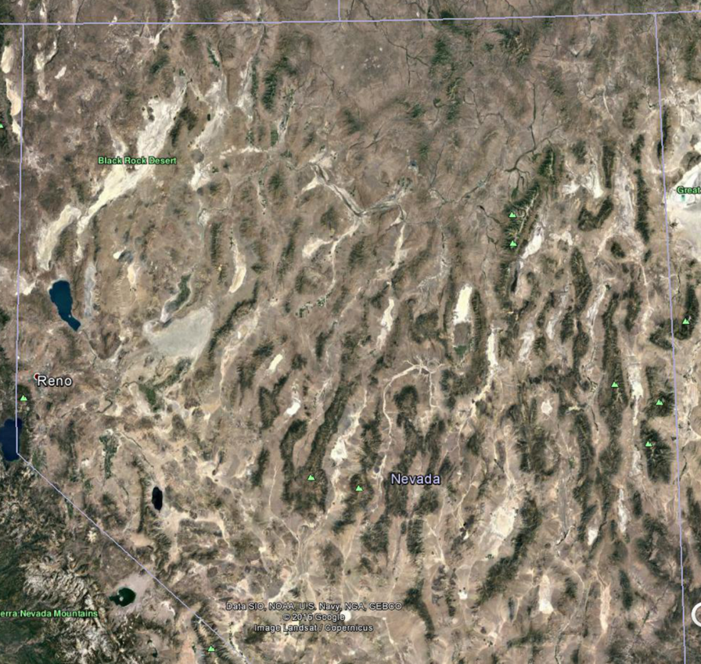
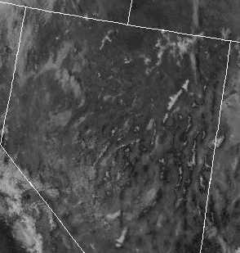
Where is Most of the Mid-Elevation, Gentle Sloped Topography
There are landscape level reasons the Malhuer High Plateau and Owyhee High Plateau have higher densities of sage-grouse

Slide 20
Landscape Level Factors that Influence Prioritization
Landscape scale factors affect the location, spatial structure, abundance and availability of areas inhabited by breeding SG
  Large acreage under snow during nest initiation where much of the landscape is above 7,000 feet – dramatically limits nesting potential
  Sites < 7,000 feet but > 20% slope also limited breeding habitat
  But strongly influenced by topography, ecological site (low sage melts before big sage) and total precipitation

Slide 21
Landscape Level Factors that Influence Prioritization
Optimal belt is roughly 6,000 to 7,000 feet
  Where greater portion of landscape is largely snow-free mid-March to early April, but
  Has Gentle rolling slopes
  Very heterogeneous mix of Low SB and Mountain SB ecological sites with potential for abundant forb production on most sites
  Abundant perennial grasses – insects and site resilience
  Many low gradient drainages with wet meadows nearby, preferably with large perimeter to area ratio

Slide 22
Landscape Level Factors that Influence Prioritization
Further from ‘optimum’ – less the landscape potential for SG, but most large landscapes will have small areas (1-3 mi²) that approach ‘optimum

Slide 23
Ecological Sites and their Potential are Important, But Highly Variable
Humboldt MLRA | Sites | Forb Prod | Elevation Range
Wy SB¹ | 11 | 30-90 | 5,000-7,000
Low SB | 2 | 50-80 | 5,500-9,500
Mtn SB | 4 | 100-340 | 6,500-9,500
Central NV BR MLRA | Sites | Forb Prod | Elevation Range
Wy SB | 13 | 30-80 | 5,000-7,500
Low SB | 6 | 50-60 | 6,300-9,500
Mtn SB | 10 | 50-120 | 6,400-9,500
Malhuer High Plateau MLRA | Sites | Forb Prod | Elevation Range
Wy SB¹ | 20 | 30-110 | 4,500-6,700
Low SB | 10 | 70-100 | 5,500-9,000+
Mtn SB | 17 | 100-340 | 5,500-8,500
Owyhee High Plateau MLRA | Sites | Forb Prod | Elevation Range
Wy SB | 9 | 30-80 | 5,200-6,500
Low SB | 6 | 40-105 | 5,500-8,000+
Mtn SB | 9 | 70-150 | 5,500-9,000+
1 Includes sites with mixes of Mountain SB

Slide 24
Once Sagebrush Is Present, Many Studies Have Clearly Identified the Importance of Forbs
Important for habitat selection, nest selection, nest survival, and chick survival
Factors that limit or promote forb distribution, availability and abundance at critical life stages of SG are important
Availability and abundance of forbs result from interactions among topography, geomorphology, snow accumulation and snowmelt patterns, and ecological sites/soils
Not everyplace has good potential for forbs from nest initiation to mid to late summer
Shorter distance SG must move to easily obtain forbs from nest initiation to late summer the better off for the population

Slide 25
Forbs
Maintaining/restoring PH meadows a priority
  Green high nutrient forage longer into summer
  Literally can’t have too many, but topographic location and relationship to perches for raptors can help prioritize
  Large perimeter to area is usually better – more likely for entire meadow to be near hiding cover
The locations on a landscape for where forbs are abundant often changes from nest initiation to late brood rearing
  The greater the distance the lower quality the habitat
Need to understand the intrinsic ability to produce forbs across the landscape
  When breeding SG require large amounts of them – below snowline
  Where breeding and broods are likely to be abundant (<20% slope),
  Areas with deep snow and steep slope should be lower priority

Slide 26
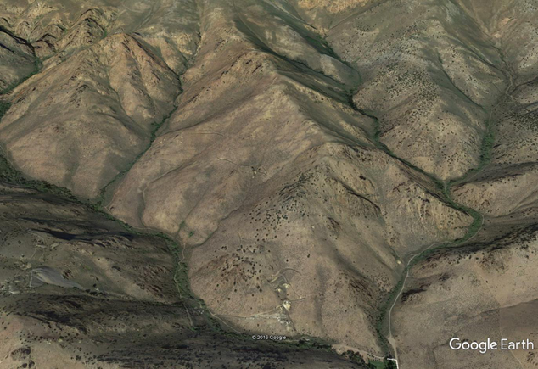
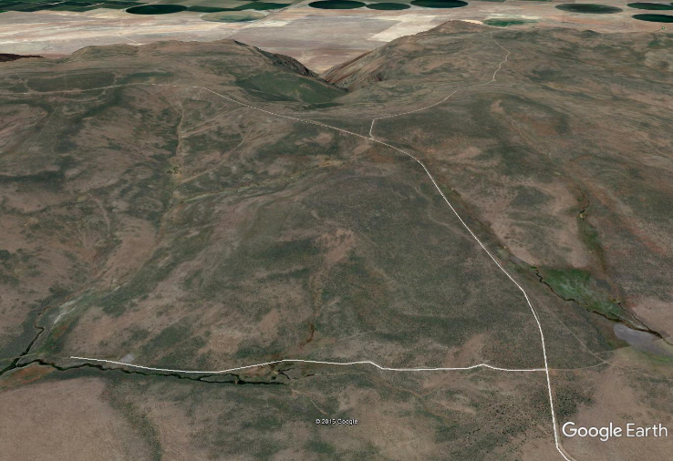
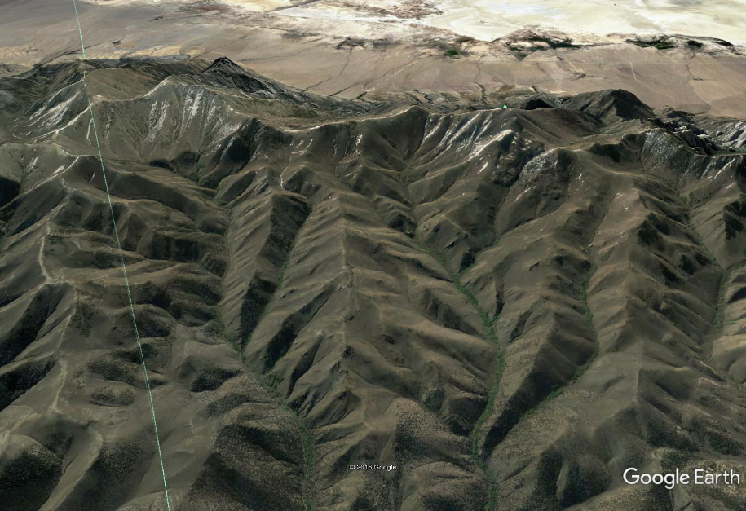
Ecological Sites; Their Type and Spatial Arrangement; and the Type and Distribution of Riparian Areas
Humboldt Range
Montana Mountains
Toiyabe Range

Slide 27
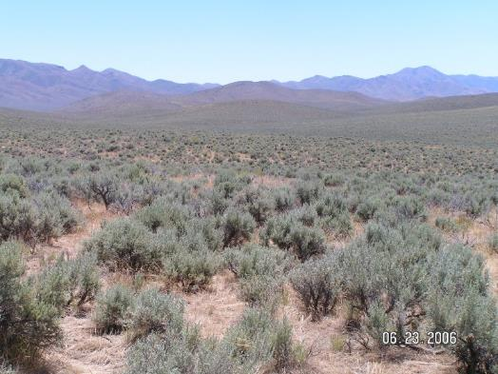
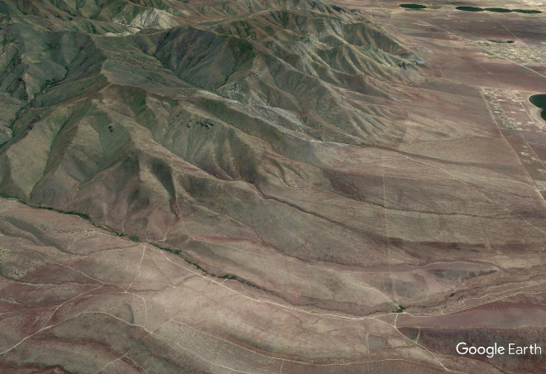
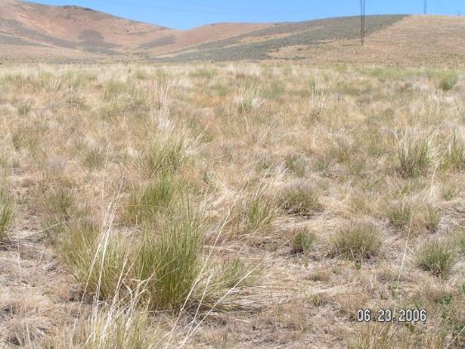
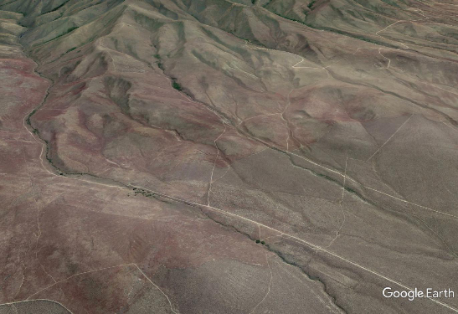
What Has Been Lost at Low Elevation?
Contiguous stands of sagebrush on alluvial fans does little for sage-grouse unless the meadows that were established during settlement also are re-established.

Slide 28
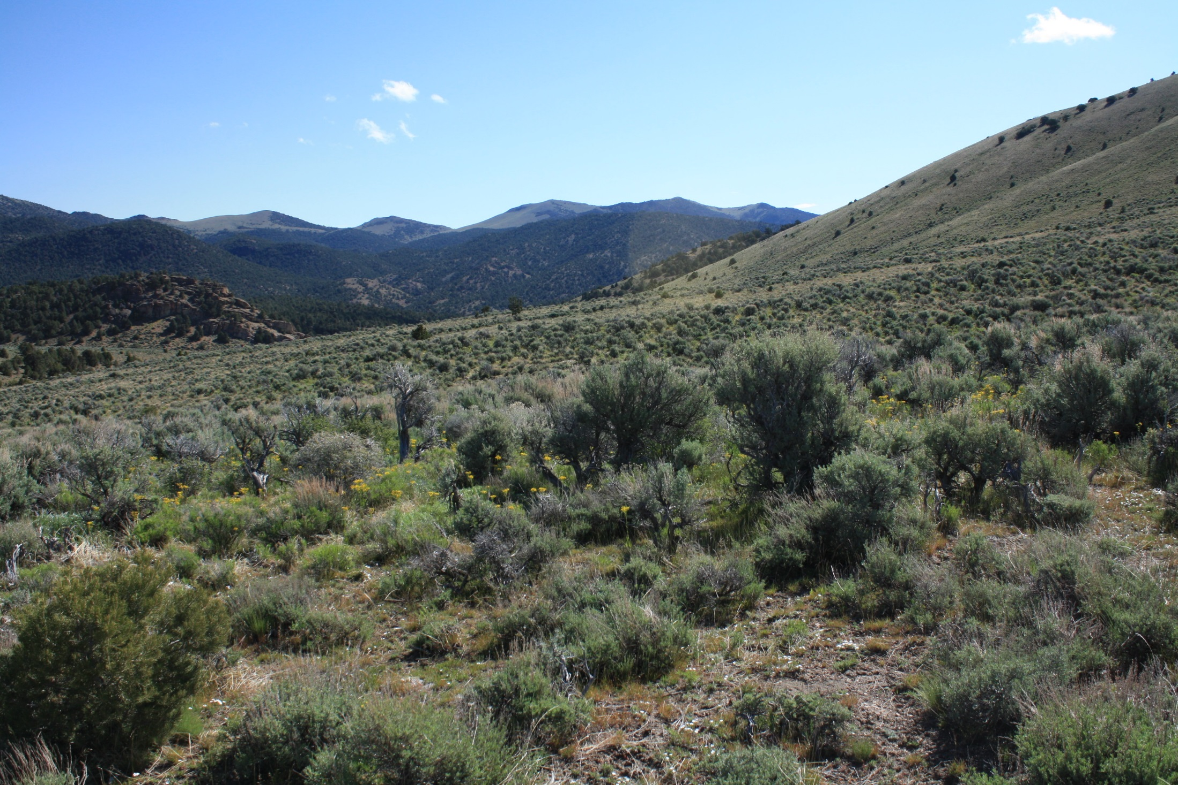
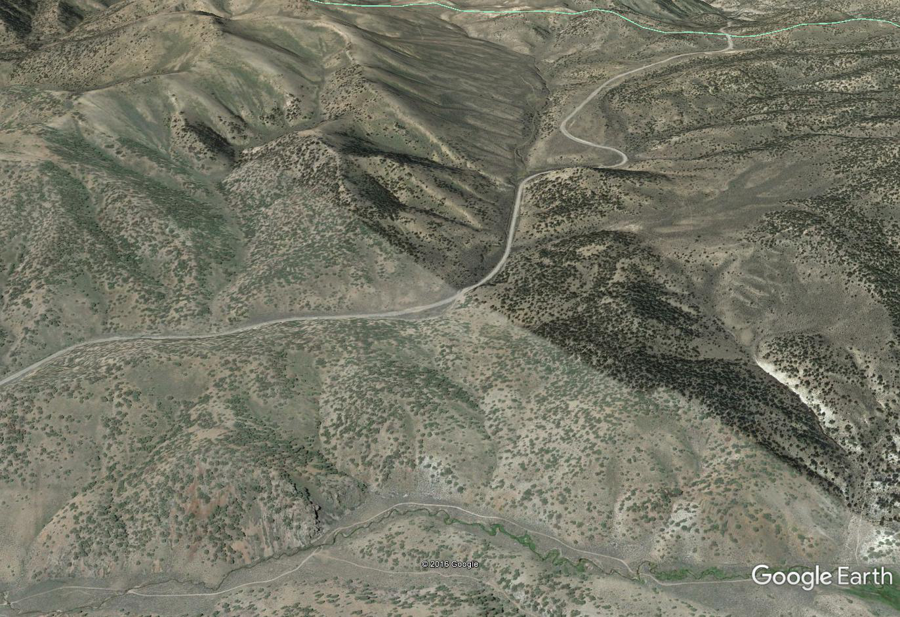
Prioritizing Riparian Areas
Perennial herbaceous riparian areas adjacent to level benches with good forb/bunchgrass understory offer great potential for meeting breeding and brood rearing
Perennial herbaceous riparian area boxed in by steep canyon walls is better than nothing, but not the best option
Notes:
Photos on right at 7,300 ft
Stringer meadow on bottom of photo on left abut 6800 ft, Excellent meadow potential but surrounded by steep rocky topography, compared to meadow in upper right of photo. Nesting potential around the meadow in upper right, very limited in bottom of photo.

Slide 29
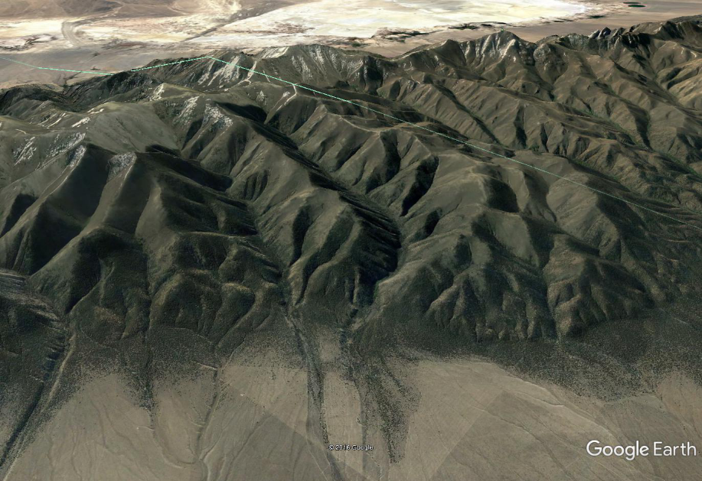
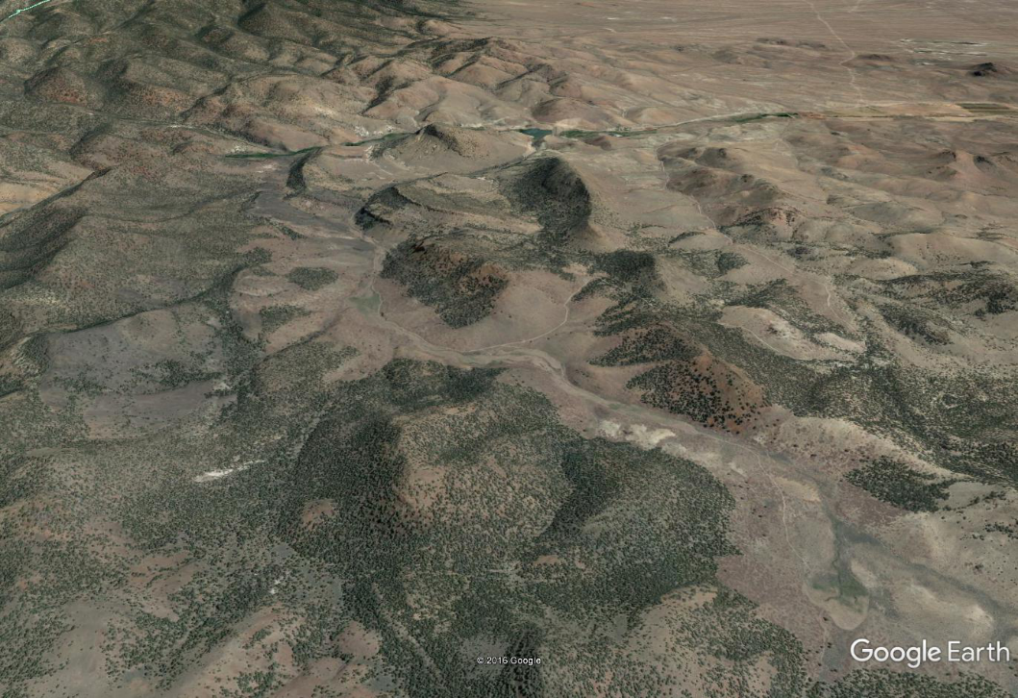
Prioritizing Areas in Basin and Range
Does the area occur where snow is largely absent at nest initiation?
Is the slope of most of the areas less than 20%
Are herbaceous meadows adequately embedded in the landscape matrix
Does the understory have sufficient resilience

Slide 30
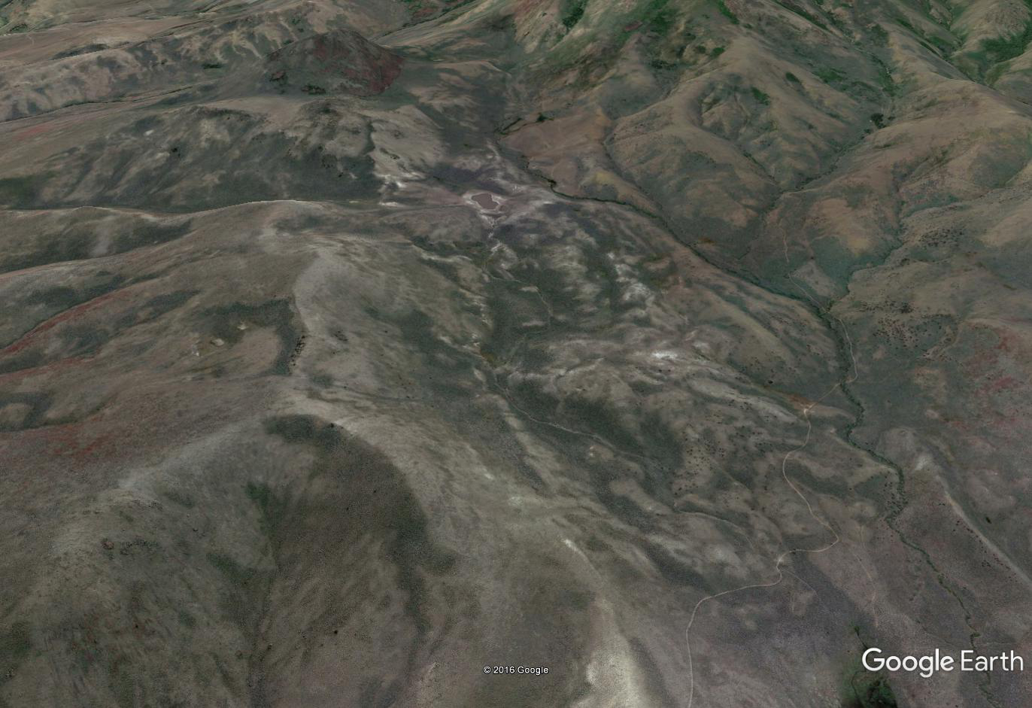
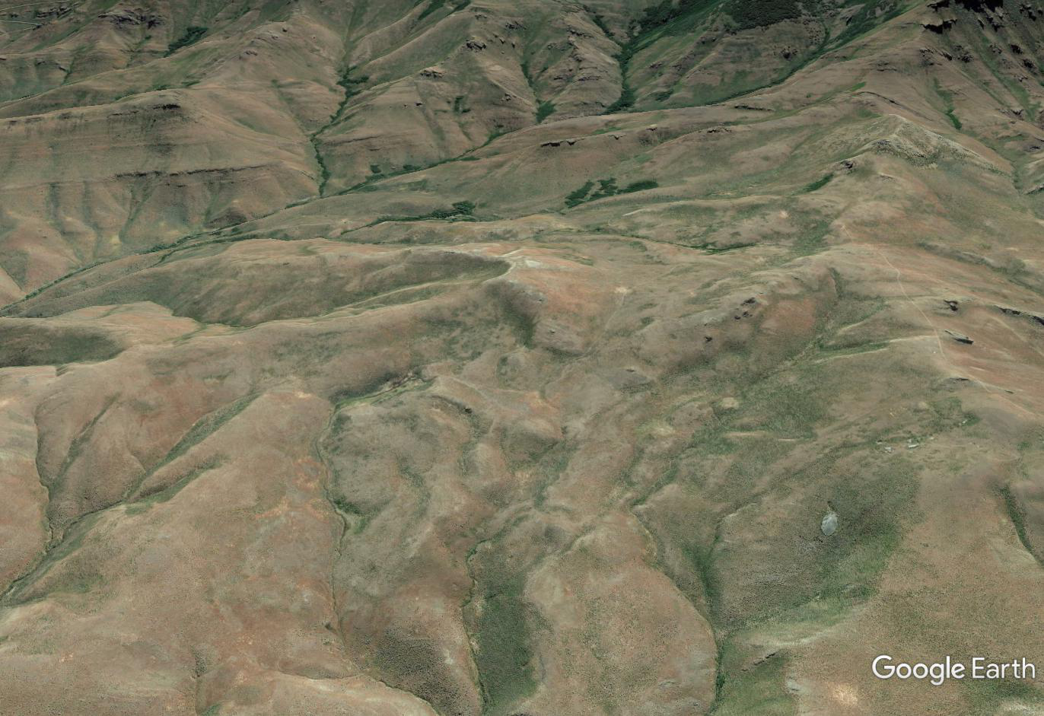
Prioritizing Better Areas Within Large Low Density Areas
Sonoma Range
Santa Rosa’s Westside

Slide 31
Targeted and Scaled SB Removal Can Change SG Use Patterns
Baxter et al. (in press)

Slide 32
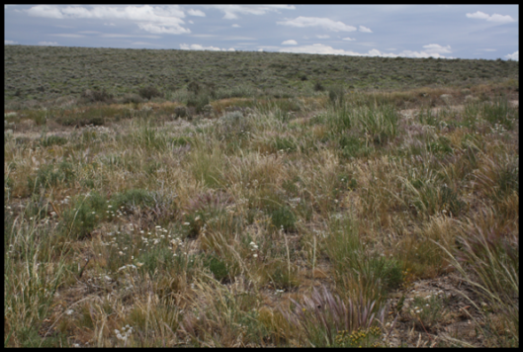
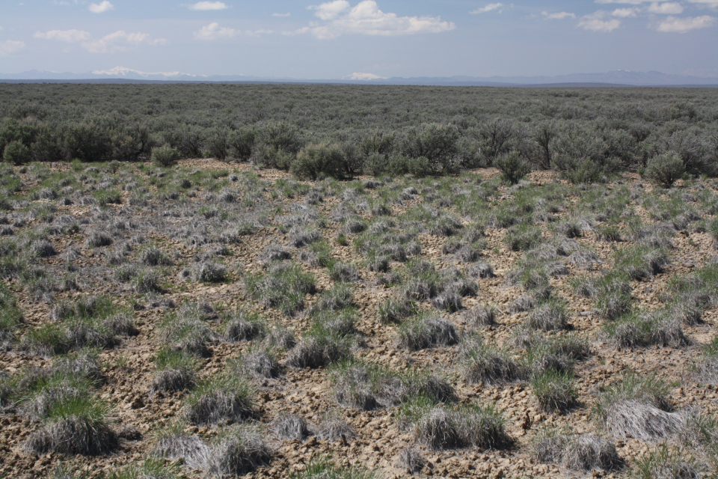
Its Hard to Eat What’s
Hard to Find (accessibility vs abundance), But Ecological Site is Important
Loamy 8-10 @ 5,400 ft
Loamy 14-16 @ 6,300 ft
Size, shape, density of treated areas, and relationship to other critical habitat elements are important

Slide 33
Too Little Fire/Too Much Sagebrush
WBSB canopy cover ≥ 16.5% typically sees a decline in the PH component threatening site resilience
Where understory is still resilient, keep canopy cover ≤ 18
Consider creating areas with little or no SB canopy cover where PH composition, especially forbs, is abundant
Density, size and shape of areas is important
Less than 25% of area of interest
<1 to < 10 acres
Center no more than 100 to 150 feet from an edge
Generally at least 100 to 200 yards from meadows
Low SB sites loose herbaceous component (lost resilience) at canopy cover > 20 to 22%
  Thinning a better potential option than removal – very slow increase

Slide 34
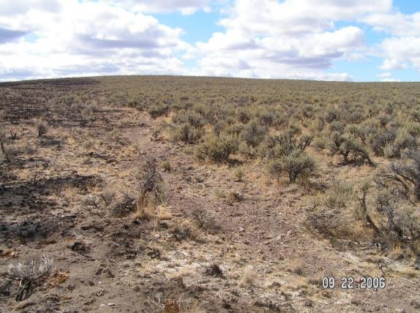
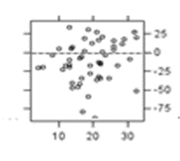
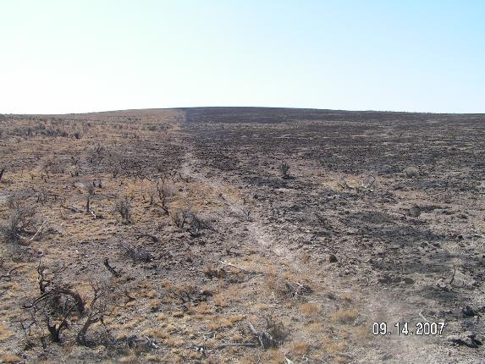
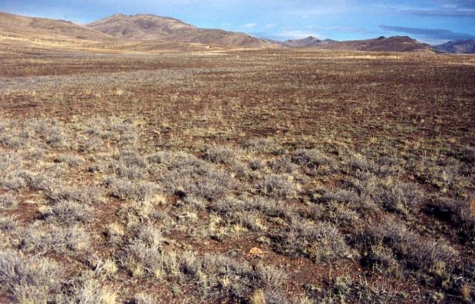
Sagebrush Foliar Cover,
Fire and Resilience
Sagebrush Foliar Cover (%)
From: Swanson et al. 2017.

Slide 35
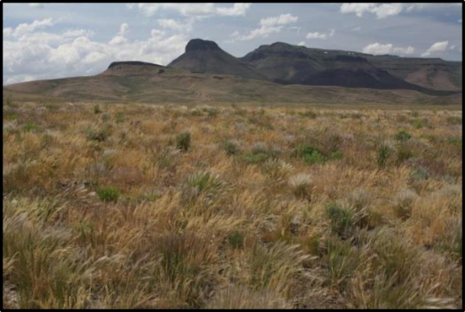
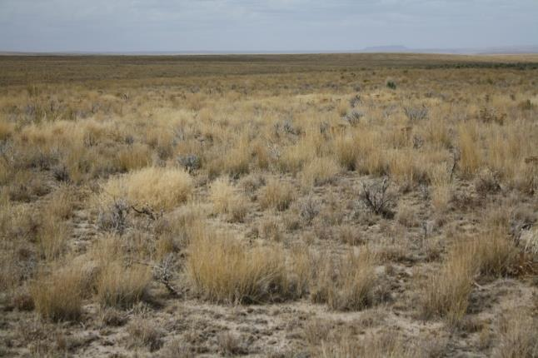
Resilience is the Most Important Attribute, Not Grass or Forb Height

Slide 36
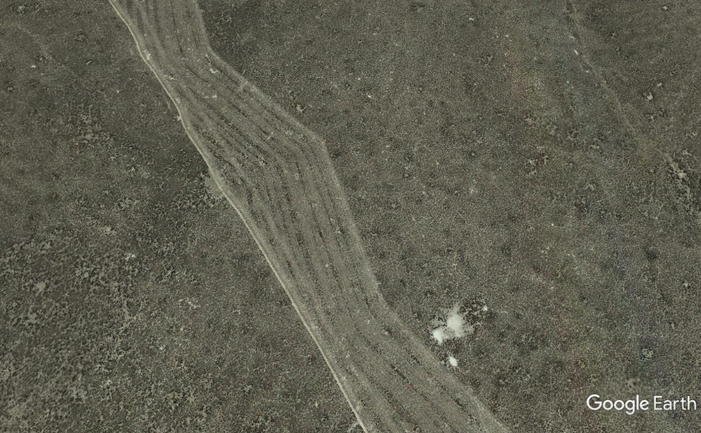
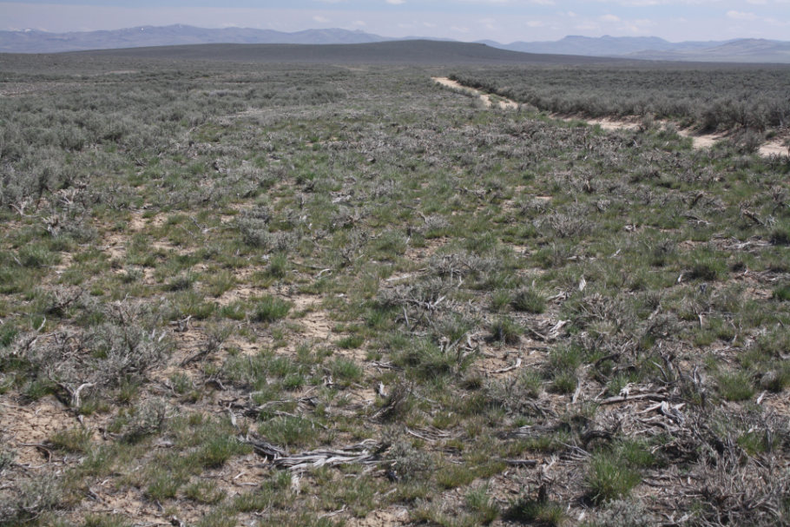
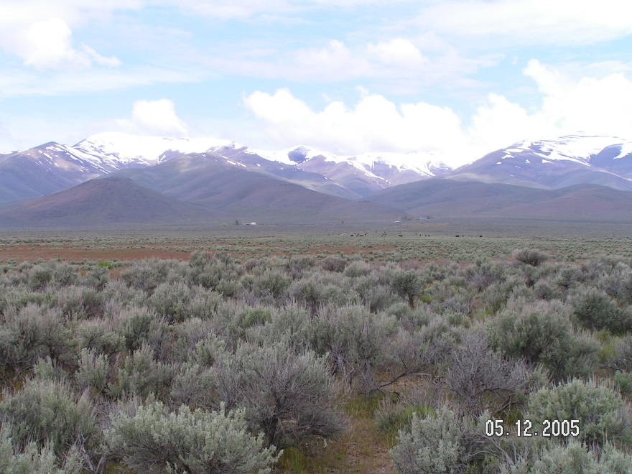
Fuel Reduction Zones Can Reduce Risk, But…

Slide 37
Fuel Break Priorities
Match fuel break density, width, structure, composition to the scale of the risk for area of concern
  What’s really needed to reduce large fires
  Do fuel breaks 20 miles apart reduce fire size or just become better access points for back fires
  Need to be constructed with fire management or control as the priority – do what it takes
  Connect with natural barriers
Where perennial herbaceous resilience is lacking annual/regular maintenance plan is essential
  Trading heavy fuel for flashy annual fuels is questionable
Periodic shrub control is essential
  Sprouting rabbitbrush
  Rapid regrowth of young sagebrush not killed by treatment

Slide 38
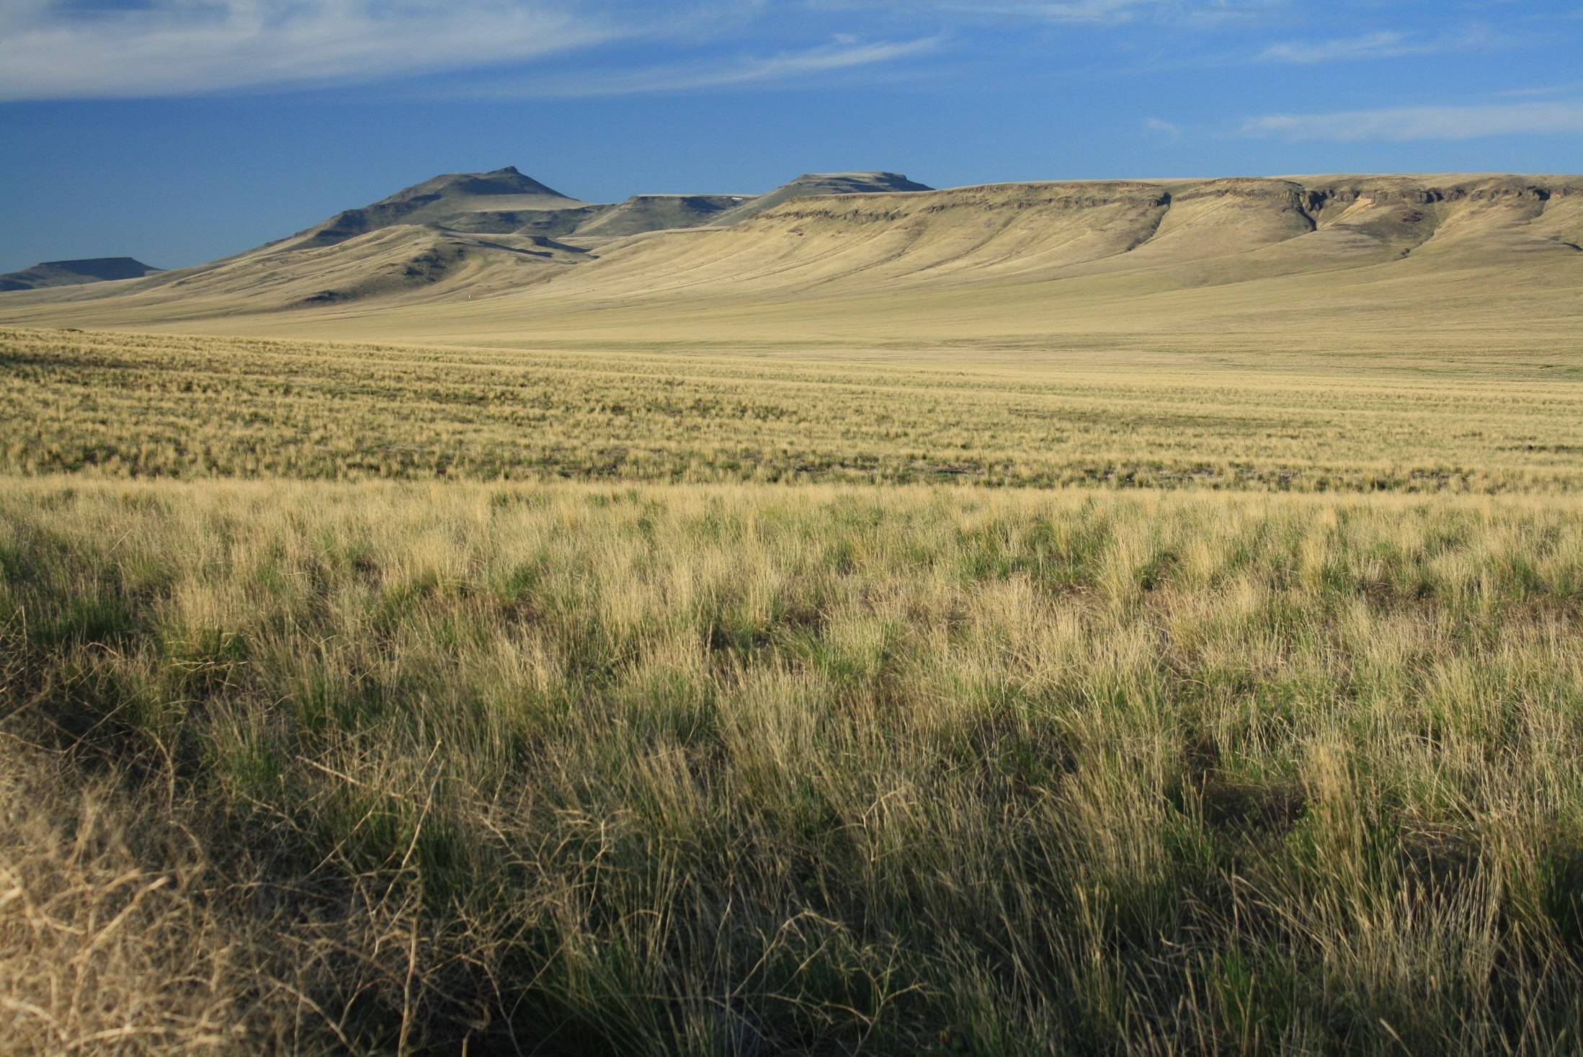
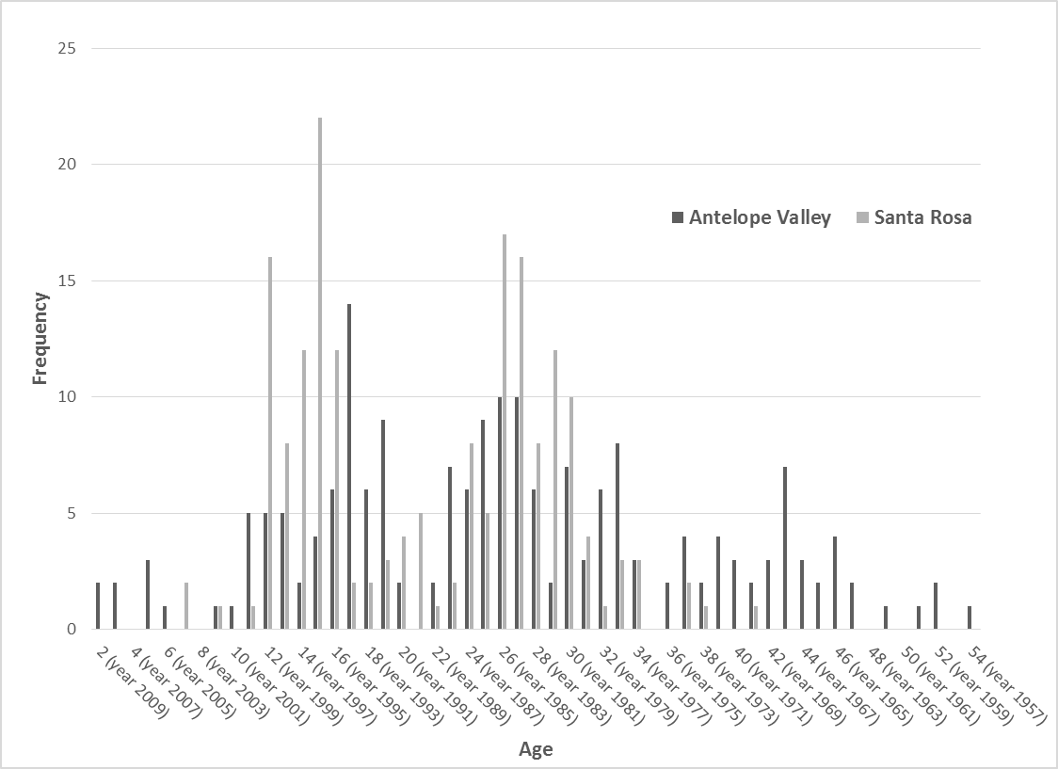
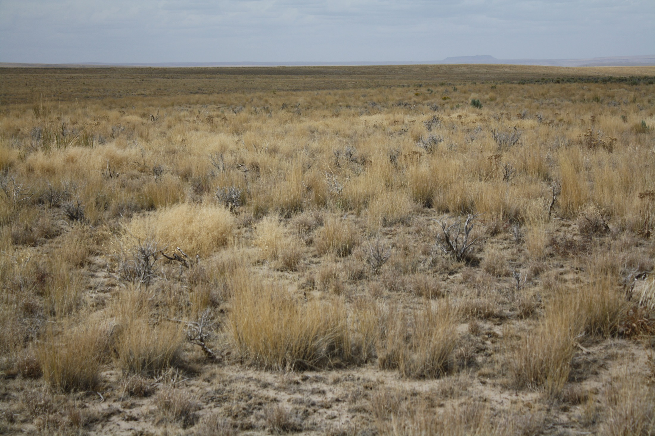
Restoring Sagebrush into Perennial Grasslands
Depends on Seasonal Needs
Wyoming SB
From: Hourihan et al. (in press)
Nesting/Brood rearing areas need forb producing sites close by
Winter habitat – meadows and forbs less important
Shrub establishment is episodic – it’s a pulse system

Slide 39
Some Conclusions
Are landscape scale bio-physical processes that constrain the location, spatial structure, and internal composition of plant communities inhabited by sage-grouse
Sagebrush presence (or potential for) is not necessarily SG breeding habitat - at least quality habitat - and often never will be
Assuming SB cover is adequate, forbs are the most integral attribute for robust SG populations
The locations for forb abundance on a landscape change from nest initiation to late brood rearing
One has to understand the intrinsic ability to produce forbs, but also the other critical habitat elements
  when SG require large amounts of them and
  where breeding SG are likely to be abundant - <20% slope
  to develop management actions/projects that are likely to be successful

Slide 40
More Conclusions
Lower elevation of sagebrush belt used for nesting constrained by abundance and availability of forbs in late May and early June – Desiccation
  < 5,000 to 5,500/6,000 ft, maybe higher in central to southeast NV
Upper end of nesting belt constrained by typical snow cover during nest initiation period
  > 6,500 to 7,000 ft, but strongly influenced by topography, ecological site (low sage melts before big sage) and total precipitation
Optimal belt is 6,000 to 7,000 ft
  Gentle slopes < 20% slope
  Very heterogeneous mix of LSB and BSB ecological sites
    Potential for abundant forb production on most sites
  Abundant perennial grasses – helps with insects – Site resilience
  Many moist/wet meadows nearby with large perimeter to area ratio
Further from optimum – less the landscape potential to SG

Slide 41
Still More Conclusions
Maintaining the ability of a site to become inhabited by large, deep-rooted perennial bunchgrasses (resilience) is essential to sustaining a sites indefinite potential for use by sage-grouse
If less SB is desired, make sure the perennial herbaceous component is likely to increase sufficiently post-treatment, to fully occupy the site increase
  Match fuel break size, structure, and density to the scale of the risk for the area of concern
If more sagebrush plants are desired, establishment is largely episodic, with longer periods between establishment years on the more arid sites. The PDO phase appears to play an important role

Slide 42
Important Side-Boards for Prioritization
Understand the intrinsic landscape potential of areas inhabited by, or potentially inhabited by sage-grouse, and recognize differences in potential in and among areas inhabited (PMU’s)
Understand the primary risks to sage-grouse in each PMU or landscape area of concern and manage accordingly
  Is your focus to protect something from an external risk or internal risk, improve the quality of an important landscape element, or both
Prioritize the landscapes and areas within those landscapes, where changes in management, specific management actions, or “specific projects” are more likely to improve landscape resistance and resilience to inevitable disturbances
Match the scale (size, space, and time) of projects/management actions to the specific risks that affect the target SG populations/habitat.
If you do not have resources for M&O, question if the action or project should occur

Slide 43
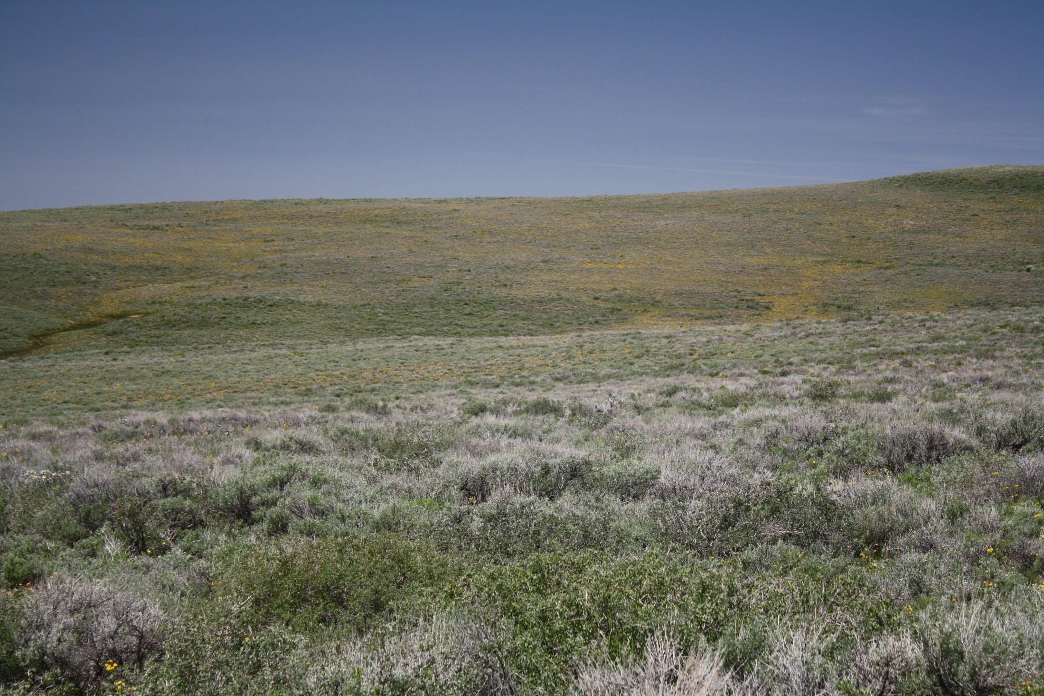
Questions
Montana Mountains

Slide 44
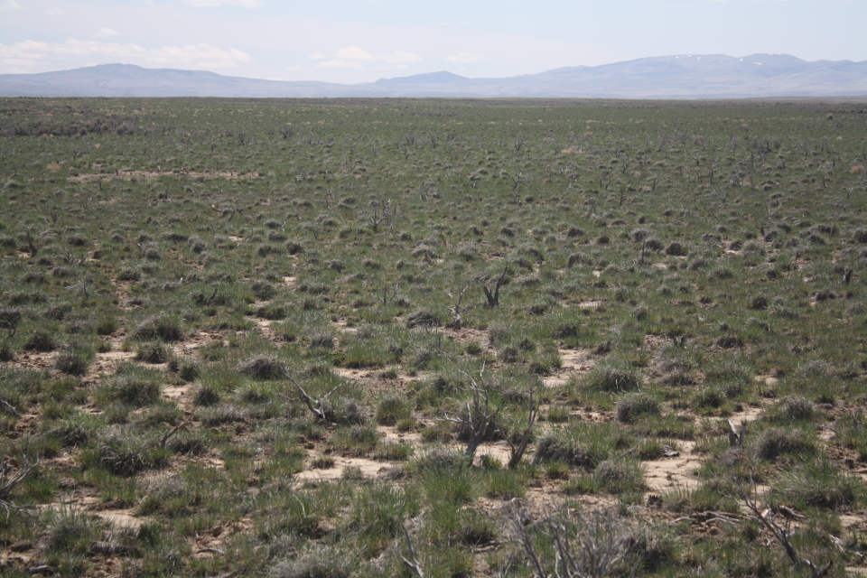
Notes:
Winters Fire not seeded. Midas would be on the other side of the mountains

Slide 45

Recognizing Sites for Effective Mitigation in Sage-Grouse Habitat
–
Its More than Quality Sagebrush Habitat
-
A Refocus to Quality SG Landscapes
Brad Schultz
Extension Educator
University of Nevada Cooperative Extension
Winnemucca, NV

Slide 46
Notes:
Same location as the previous slide but looking toward the burned/unbured boundary. Santa Rosas (granite peak and Buckskin in the background

Slide 47
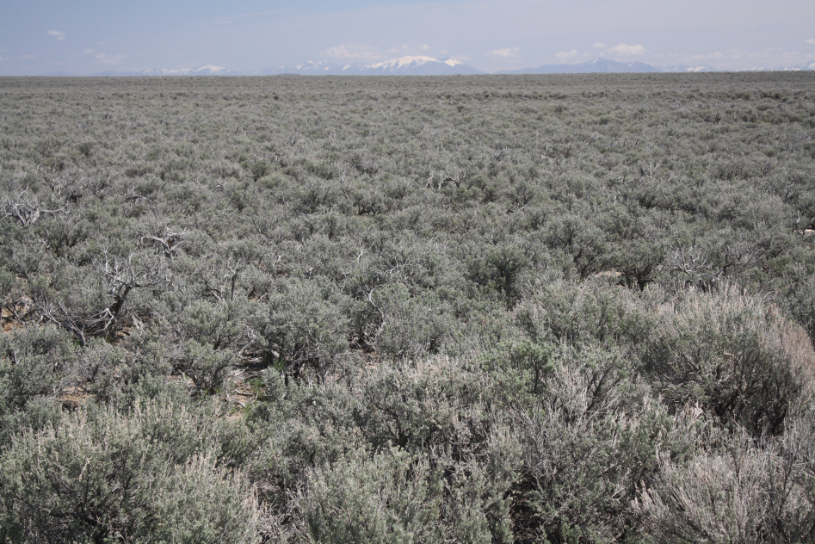
Notes:
Looking NE toward the Bull Runs from the edge of the Winters Fire. Probably what the burned area was like before the fire, Hard to see but a decent understory of BG

Slide 48
