Slide 1
Sagebrush Ecosystem Program:
Status and Directions

Slide 2
Debit Status:
Debit Project | Direct Impact Acres | Indirect Project Acres | Debits | County(s)
Gold Bar (McEwen Mining)* | 662 | 67,678 | 6,814 | Eureka
Gold Rock (GRP/Fiore Gold)* | 1,799 | 34,571 | 2,985 | White Pine
Bald Mountain Mine - Phase 2 (Kinross Gold) | 3,213 | 135,959 (Phases 1 & 2) | 2,737 | White Pine
Greater Phoenix Mine - Philadelphia Canyon (Newmont Mining) | 203 | 12,834 | 4 | Lander
Twin Creeks Mine - Sage Tailings (Newmont Mining) | 0 | 5,106 | 33 | Humboldt
Rossi Barite Expansion (Haliburton)* | 1,164 | 43,108 | 437 | Elko
Marigold Expansion (Marigold Mining) | 0 | 19,980 | 0 | Humboldt, Lander
Coeur Rochester Mine Expansion (Coeur Rochester, Inc.)* | 2,567 | 39,905 | 602 | Pershing
Long Canyon Mine - Phase 2 (Newmont Mining) | 1,570 | 82,568 | - | Elko
Lone Tree Mine – Buffalo Mountain (Newmont Mining) | 283 | 10,717 | - | Humboldt
Lithium Nevada Mine (Lithium Nevada) | - | - | - | Humboldt
Totals | 11.461 | 452,426 | 13,612

Slide 3
Debit Status:
Debit Project | Direct Impact Acres | Indirect Project Acres | Debits | County(s)
Gold Bar (McEwen Mining)* | 662 | 67,678 | 6,814 | Eureka
Gold Rock (GRP/Fiore Gold)* | 1,799 | 34,571 | 2,985 | White Pine
Bald Mountain Mine - Phase 2 (Kinross Gold) | 3,213 | 135,959 (Phases 1 & 2) | 2,737 | White Pine
Greater Phoenix Mine - Philadelphia Canyon (Newmont Mining) | 203 | 12,834 | 4 | Lander
Twin Creeks Mine - Sage Tailings (Newmont Mining) | 0 | 5,106 | 33 | Humboldt
Rossi Barite Expansion (Haliburton)* | 1,164 | 43,108 | 437 | Elko
Marigold Expansion (Marigold Mining) | 0 | 19,980 | 0 | Humboldt, Lander
Coeur Rochester Mine Expansion (Coeur Rochester, Inc.)* | 2,567 | 39,905 | 602 | Pershing
Long Canyon Mine - Phase 2 (Newmont Mining) | 1,570 | 82,568 | - | Elko
Lone Tree Mine – Buffalo Mountain (Newmont Mining) | 283 | 10,717 | - | Humboldt
Lithium Nevada Mine (Lithium Nevada) | - | - | - | Humboldt
Totals | 11.461 | 452,426 | 13,612

Slide 4
Credit Status:
Credit Project | Acres | Credits Available For Sale or Offset | County(s)
Cottonwood Ranch | 1,008 | 711 | Elko
Crawford Cattle - Snowstorms | 10,531 | 1,898 | Humboldt, Elko
Crawford Cattle - Sonoma | 1,498 | 467 | Humboldt
Johns Ranch | 1,073 | 164 | Elko
RDD | 1,094 | 740 | Humboldt
Totals | 15,204 | 3,980
Anticipated Credit Project | Acres | Anticipated Credits Available | County(s)
Coleman Valley Ranch | 1,137 | 394 | Washoe
Adobe Peak (Kinross Gold) | 10,901 | 3,555 | Elko
Eureka Livestock | 1,623 | 1,737 | Eureka
Estill Ranch | 1,671 | - | Washoe
Cave Valley Ranch | 1,769 | - | Lincoln
Heguy Ranch | 6,490 | - | Elko
Squaw Valley Ranch (Barrick Gold) | 198 | - | Elko
Totals | 23,789 | 5,686 Confirmed

Slide 5
Credit Status:
Credit Project | Acres | Credits Available For Sale or Offset | County(s)
Cottonwood Ranch | 1,008 | 711 | Elko
Crawford Cattle - Snowstorms | 10,531 | 1,898 | Humboldt, Elko
Crawford Cattle - Sonoma | 1,498 | 467 | Humboldt
Johns Ranch | 1,073 | 164 | Elko
RDD | 1,094 | 740 | Humboldt
Totals | 15,204 | 3,980
Anticipated Credit Project | Acres | Anticipated Credits Available | County(s)
Coleman Valley Ranch | 1,137 | 394 | Washoe
Adobe Peak (Kinross Gold) | 10,901 | 3,555 | Elko
Eureka Livestock | 1,623 | 1,737 | Eureka
Estill Ranch | 1,671 | - | Washoe
Cave Valley Ranch | 1,769 | - | Lincoln
Heguy Ranch | 6,490 | - | Elko
Squaw Valley Ranch (Barrick Gold) | 198 | - | Elko
Totals | 23,789 | 5,686 Confirmed

Slide 6
Status:
9,666 Confirmed and anticipated credits
13,612 Confirmed debits
No shortage of supply or demand, shortage of stability
State Agencies
MOA with Dept. of Interior
Executive order
SEC resolved to seek regulations

Slide 7
Status:

Slide 8
Status:
CCS

Slide 9
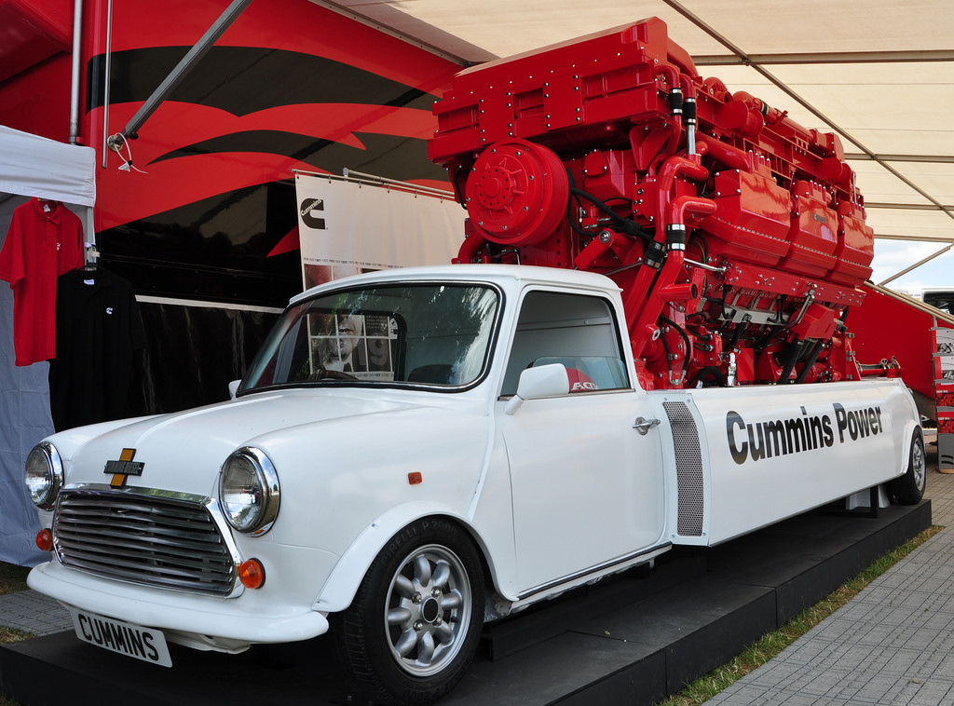
Status:
CCS

Slide 10
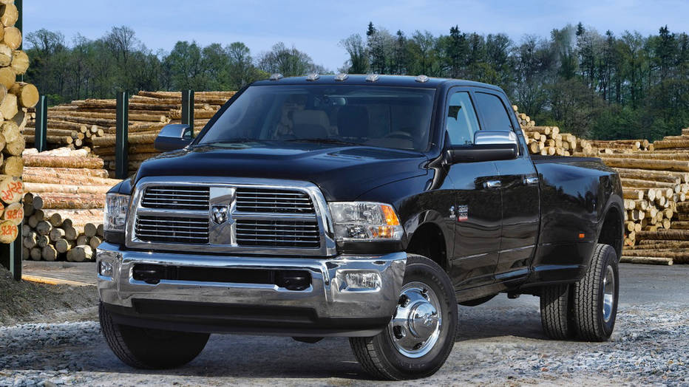
Status:
CCS

Slide 11
The Sagebrush Ecosystem Program
Sagebrush Ecosystem Threats ➔ Greatest Conservation Efforts To Date
ROGER
NCCN
LAWGs
Straight Restoration
Targeted Grazing – BLM
Outcome Based Grazing

Slide 12
The Sagebrush Ecosystem Program
Broader vision, issue specific, improving partnerships
SEC / SETT

Slide 13
SEP Purpose:
SEP
BLM
NDF
NGOs
Industry
CDs
NDOW
Producers
LAWGs
NRCS
Counties
USFWS

Slide 14
Invasive Weeds
Targeted Grazing
Fire Restoration
Wetland Enhancement
Wildlife Specific Projects
Fire

Slide 15
Partnerships:
CDs & NGOs
SEP
LAWGs
Restoration activities
Planning activities
Reporting & Messaging
Credit generation
(Potential for uplift outside CCS, stay tuned)

Slide 16
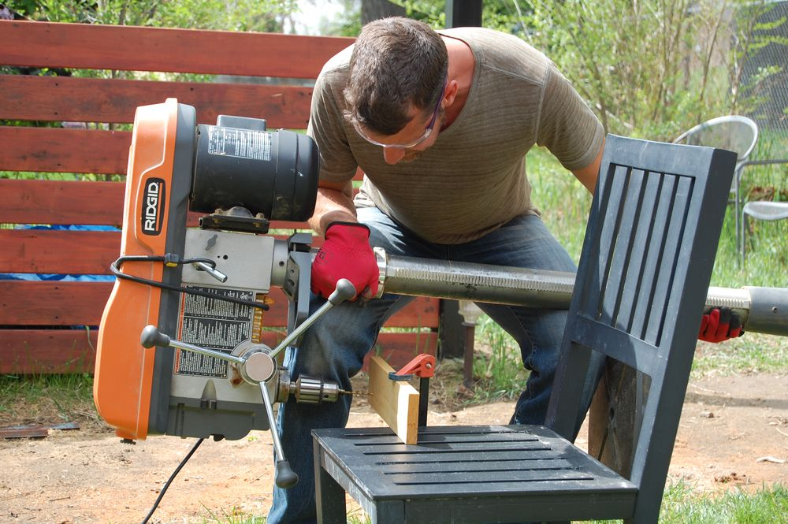
Partnerships:
Applicability
Availability

Slide 17
Nevada Heritage Preservation Time & Expertise Most Of All, Desire
Sagebrusheco.nv.gov

Slide 18
Nevada Heritage Preservation Time & Expertise Most Of All, Desire
?
Sagebrusheco.nv.gov

